Slide 1
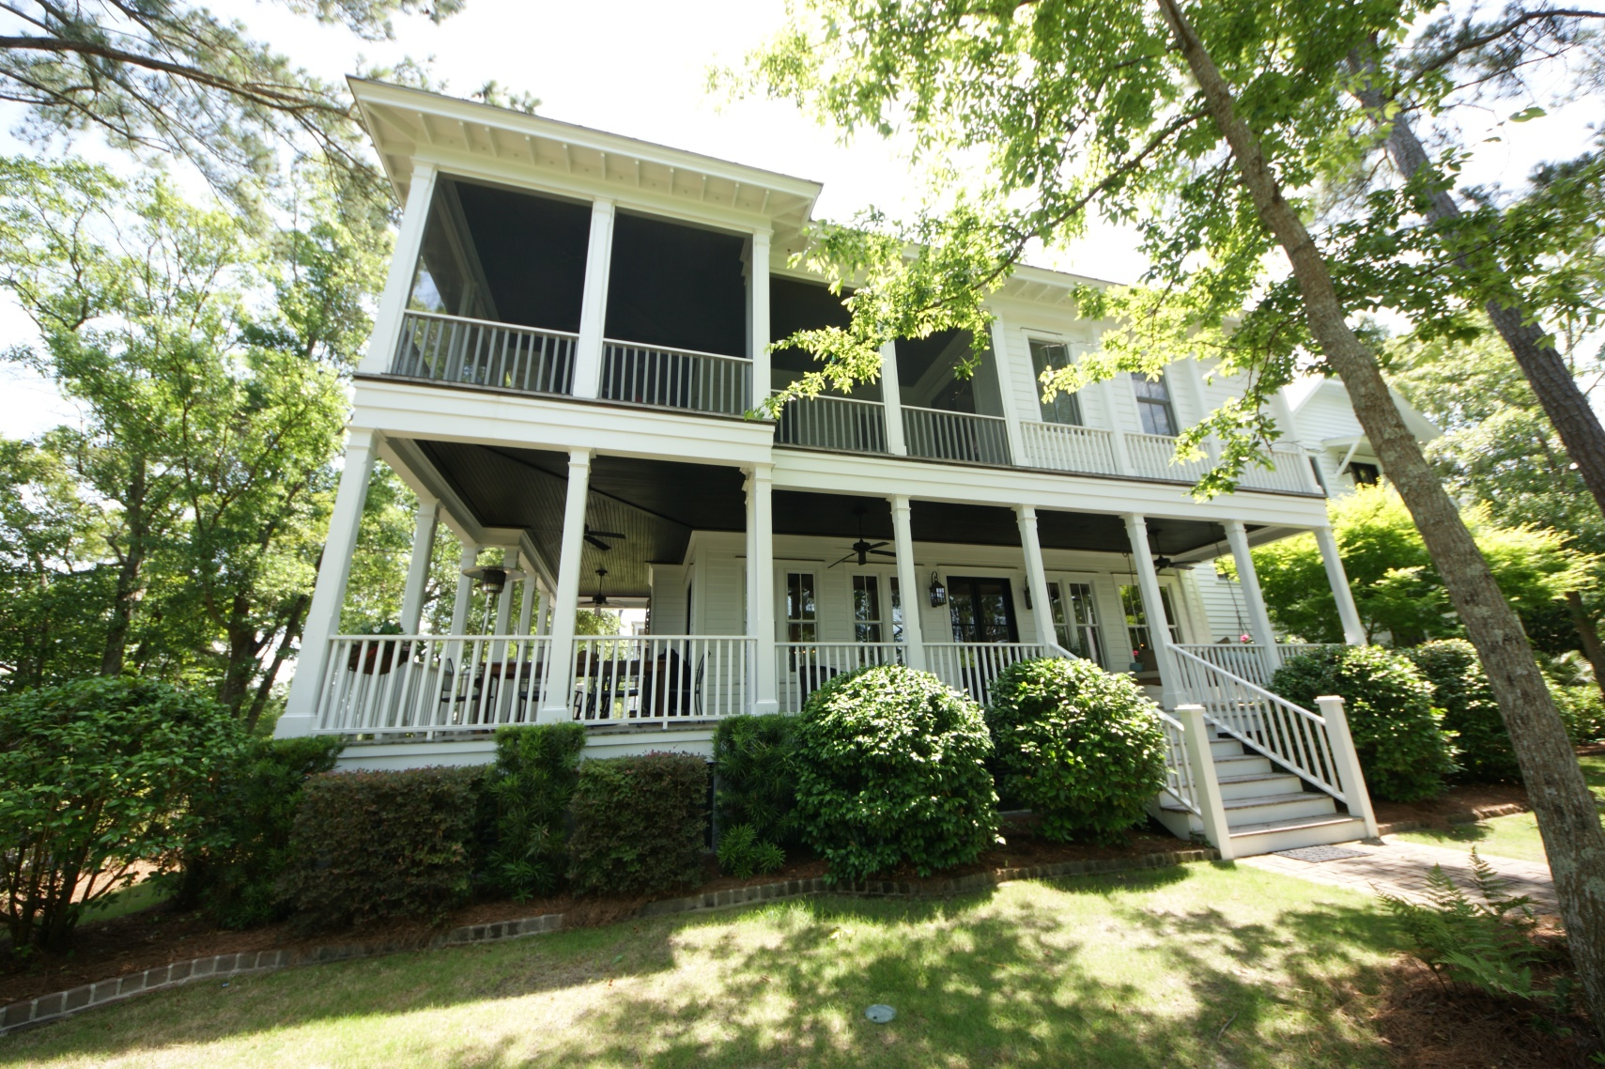
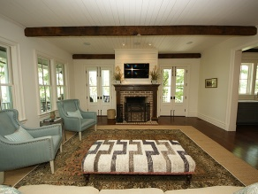
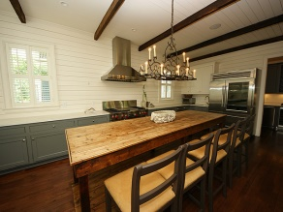
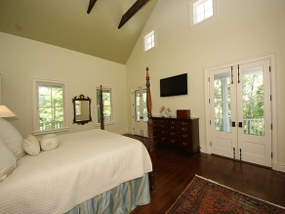
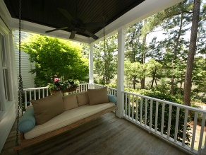
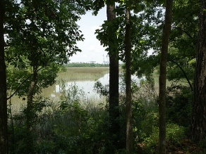


Beautiful I'on Home Bordered by Marsh/Creek on Two Sides
63 Robert Mills Cir
Mount Pleasant
MLS# 1415174
$1,849,000
Reduced!!
This beautiful home is situated on one of the most unique and private lots in Ion. It has water and fabulous marsh views from almost every room in the house. When you walk through the front door you are greeted with a Low country feel with wooden walls, beautiful hardwood floors, and an open floor plan. The great room and dining room are accented with antique wood beams. There are numerous doors that open up to the wrap around porch which makes it great for entertaining or just to enjoy the breeze. The kitchen is a chef's dream with marble countertops, a Wolf gas cooktop, griddle, electric double ovens, Boshe dishwasher, under-counter refrigerated drawers, and a large farm sink. There is a great butler's pantry featuring a wine cooler, ice maker, an additional dishwasher, sink, bar area and lots of extra storage. On the first floor there is also a spacious study, a full bedroom/bath, and a half bath for guests. Upstairs, you may start your day in the master suite by watching the wildlife in the marsh or admiring Hobcaw Creek from the spacious screened porch. It is the perfect place to drink your morning coffee or read a good book. The master bath also features amazing marsh and water views, a really cool copper bath tub, dual sinks with marble countertops, and a huge shower. The second floor also features two bedrooms, one bath, and a laundry room. The third floor of the home has lots of options. It is currently used as an office, exercise room, and storage area. It has a full bath and could be used as a playroom or an extra bedroom. The carriage house is of the same caliber as the main house boasting the same fabulous views, hardwood floors and wood beams. Approximately 525 sq. feet, it offers a bedroom, sitting area, full bath, washer/dryer combo, and walk-in closet.
Kea Whatley
Mobile 843-408-8704
keawhat@aol.com
AgentOwned Preferred Group | 824 Johnnie Dodds Blvd | Mt Pleasant, SC 29464

