Slide 1
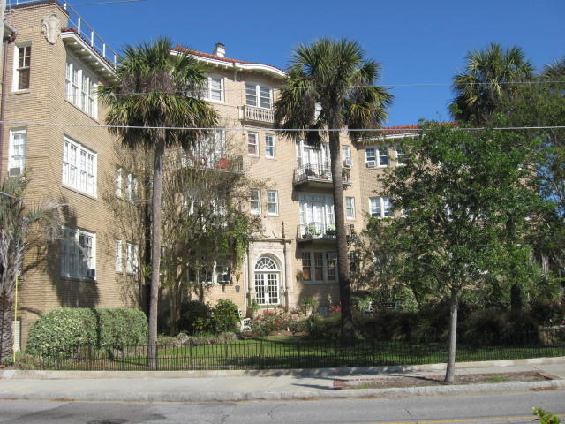
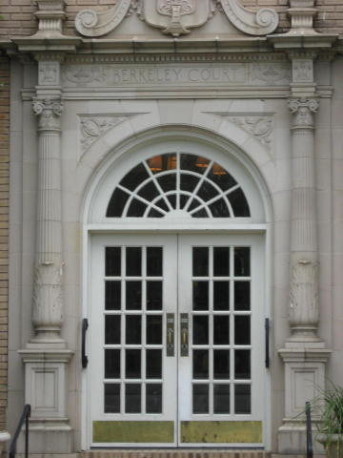
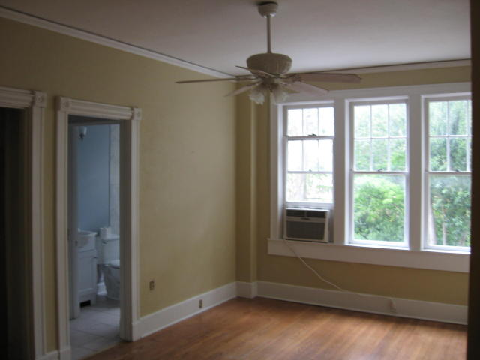
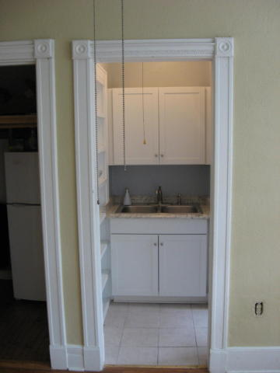
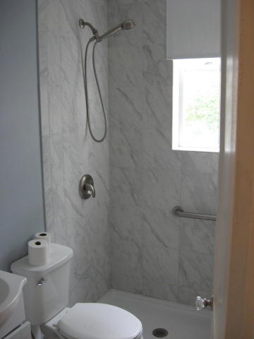
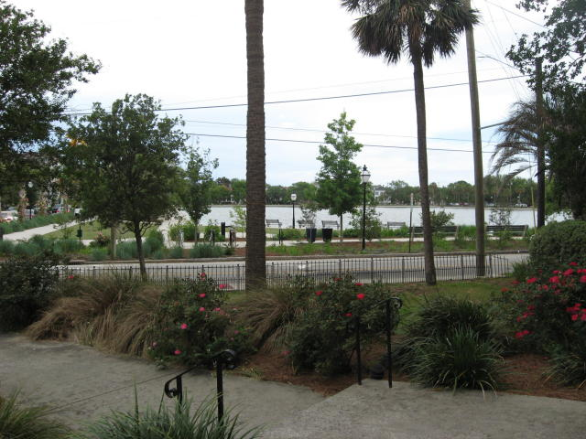
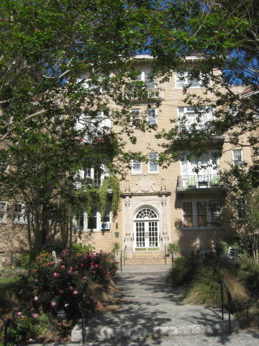
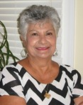

Just Listed Across From Colonial Lake
Buy.......Build.....Begin
63 Rutledge Avenue #24
Berkeley Court | Charleston, SC 29401
MLS# 18013912 | $207,000
Gorgeous location in the heart of Charleston/walk everywhere! Historic charm and lovely 1920's building has undergone many improvements in the past few years. Great location and close to shopping, restaurants, and across from Colonial Lake. Just a couple of blocks from the Battery! Berkeley Court's location and low regime fee make it attractive for full time residents, second home or rental income. This second floor studio apartment has hardwood floors and 9' ceilings. Pied a terre in a fantastic vintage building with deco details and high ceilings. Beautiful entrance and elevator. The building has a healthy HOA with good reserves.
Maria Latto
REALTOR, GRI
M (843) 327-1025 | O (843) 769-5100
maria@agentownedrealty.com | www.agentowned.com
The AgentOwned Realty Co. • 902 Savannah Hwy. • Charleston, SC 29407
Real Estate • Mortgage • Insurance

