Slide 1
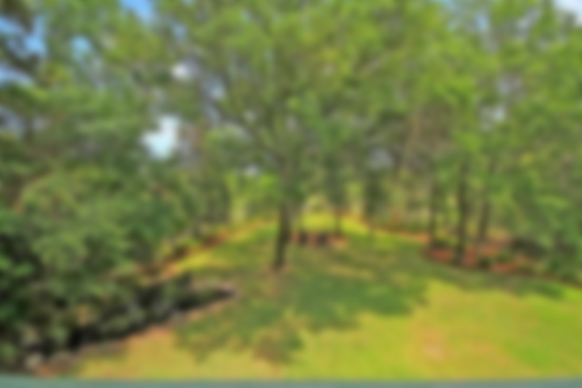
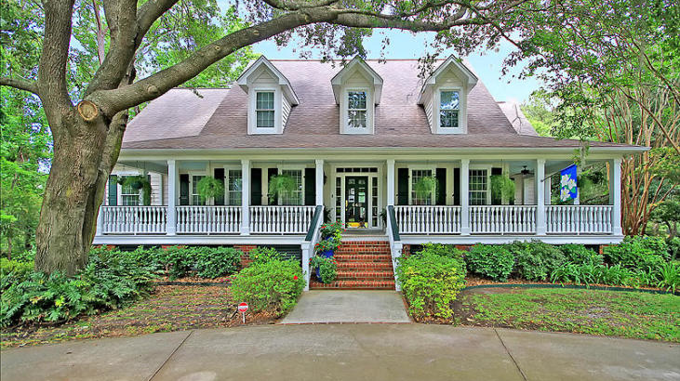
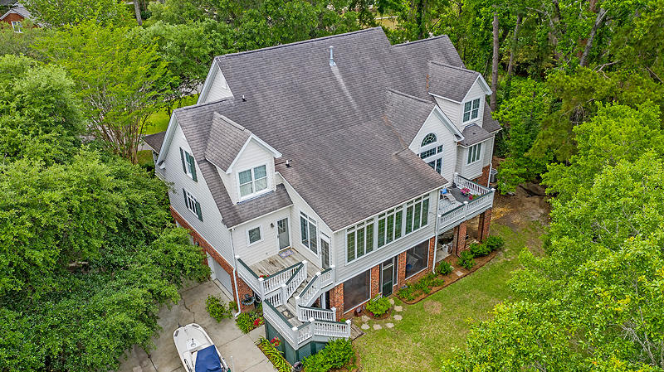
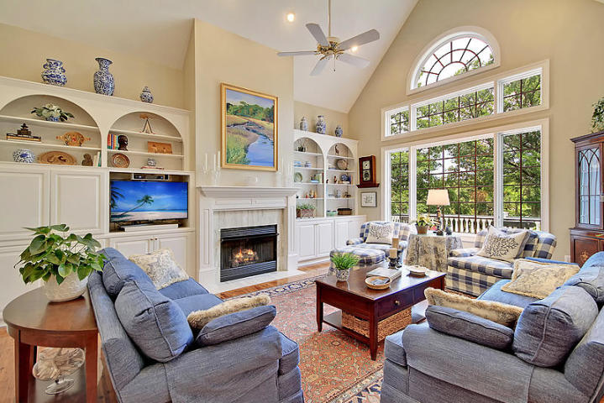
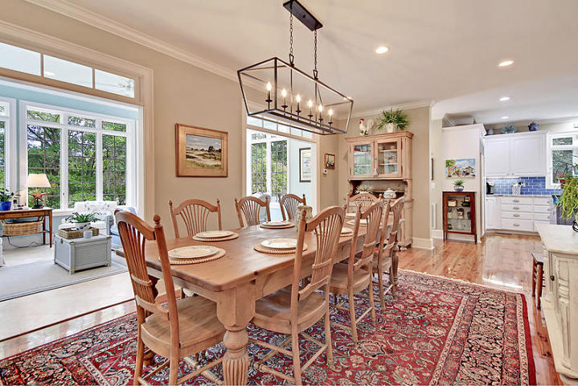
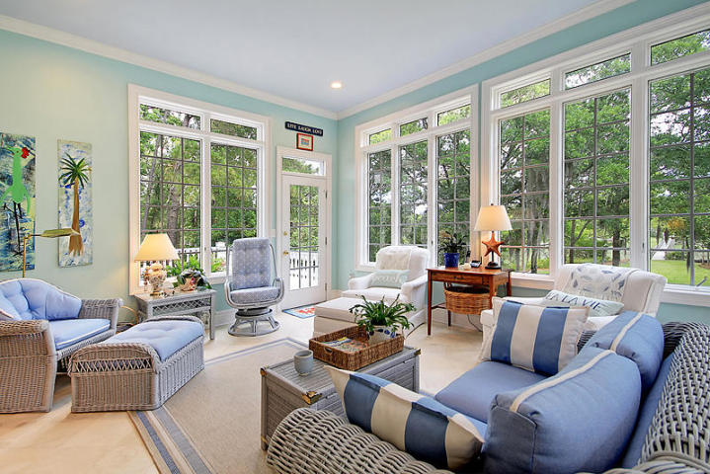
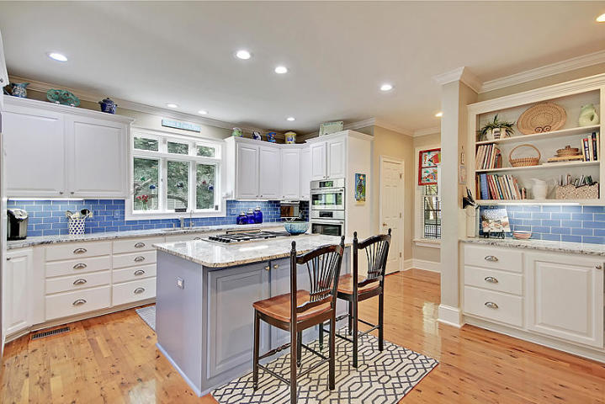
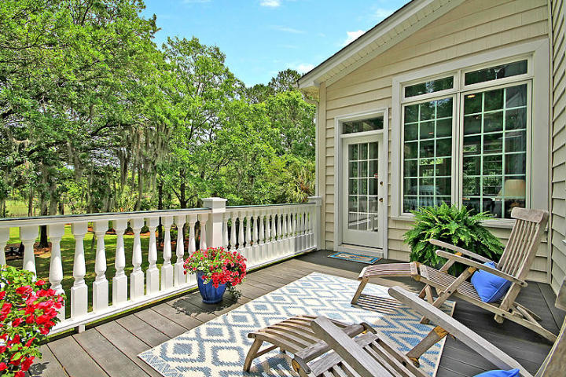
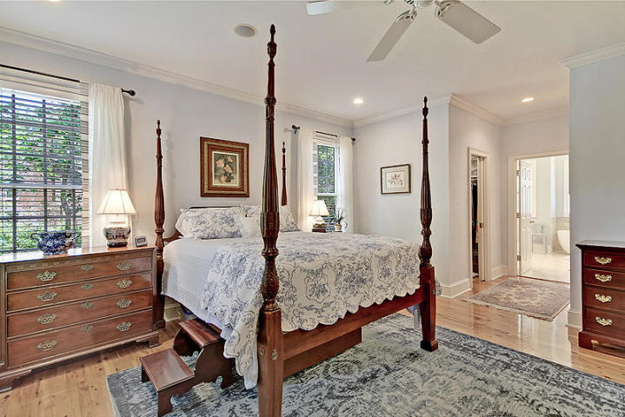
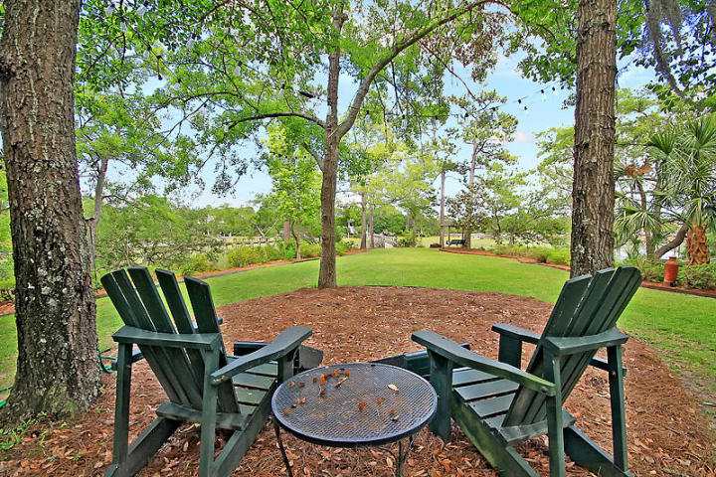
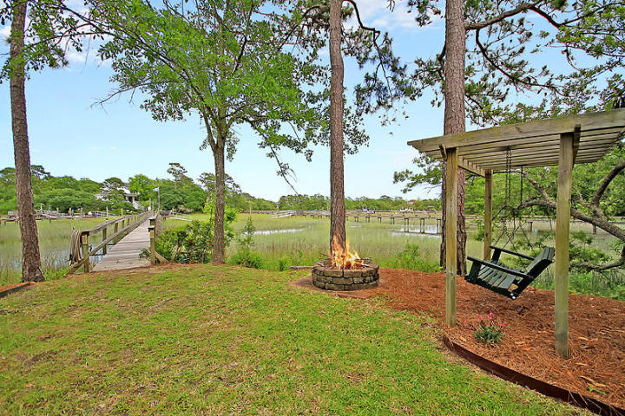
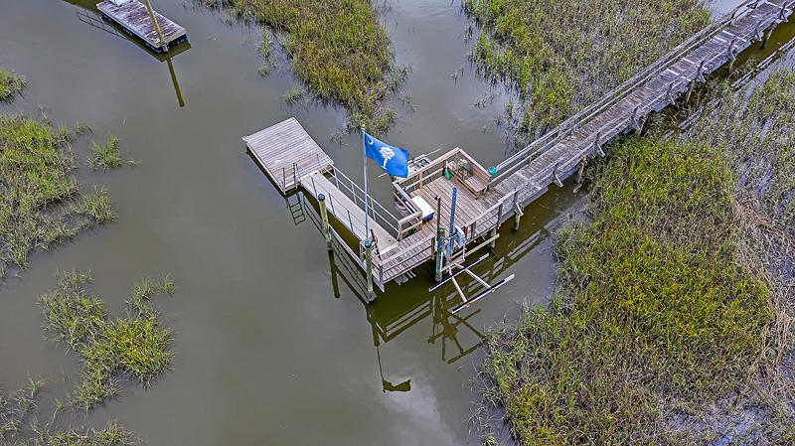
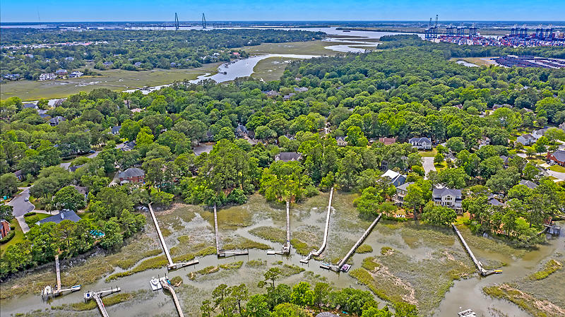
Southern Charm in Abundance
640 Fisherman's Bend
Hidden Cove | Mount Pleasant, SC 29464 | MLS# 20019283 | $1,300,000
This 4 bedroom, 4 1/2 bath, 4571 sq. ft. Traditional Lowcountry home invites you in with a spacious wrap around porch. As you enter the foyer, the wall of windows in the great room and sun room, across the back of the house, afford views of the natural beauty of the marsh and tidal creek. The open floor plan flows from the great room into the informal breakfast area, the sun room, and the kitchen to provide ample room for entertaining. The kitchen has granite counter tops and upgraded appliances, including a Dacor cook top with dual burners. The roomy walk-in pantry provides additional storage for more than just food. The first floor master suite has dual walk-in closets with a spacious master bathroom, tiled with travertine marble. The master bath includes a shower and a free standing tub. A formal dining room, an office/guest room, powder room, and laundry room are also on the first floor. All rooms on this level, with the exception of the office, have beautiful Australian Cypress flooring. There are 3 bedrooms and 2 full baths on the second floor. There is also a sewing/craft room and a large bonus room that could serve as a 5th bedroom or recreational space. A central vacuum system makes it easier to keep these spaces clean. Since the basement/garage is the size of the footprint of the house, it includes 2 parking spaces, a 4th bathroom, and a huge storage space for bikes, riding lawnmower, golf cart, workshop, and so much more. The spacious and well landscaped backyard leads you to a dock on the creek with a lift that can accommodate a small boat. A screened porch provides insect free relaxation. Other perks include an irrigation system with a well, and a koi pond with a waterfall. Hidden Cove is a small and friendly neighborhood with a small town feel. The community dock on Hobcaw Creek is its most desirable amenity as well as a gathering place to meet and socialize with neighbors. Other amenities include tennis courts, pool, and club house. there is DEEP WATER at the dock at 2 hours on incoming tide * Over the years, there has been some slight water intrusion in the garage area at the expansion joints.
Fudgy Brabham
(843) 568-1241
fudgy@hbrtwn.com
www.hbrtwn.com
Harbourtowne Real Estate
672 Marina Drive, Ste 110
Daniel Island, SC 29492
Harbourtowne Real Estate | 672 Marina Drive, Ste 110 | Daniel Island, SC 29492

