Slide 1
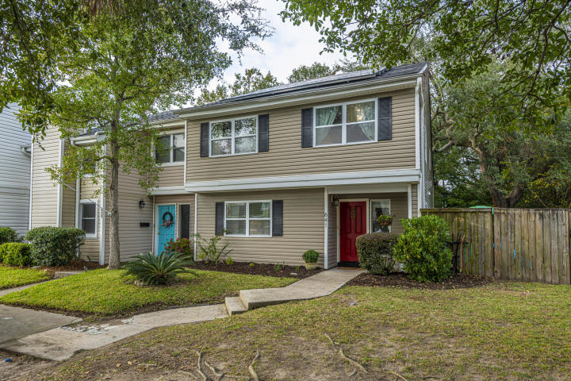
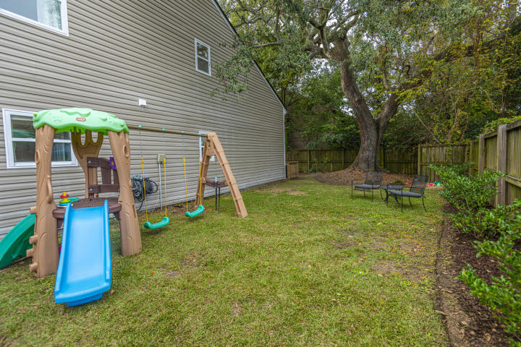
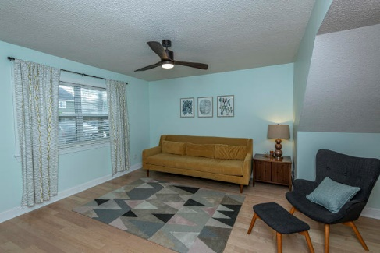
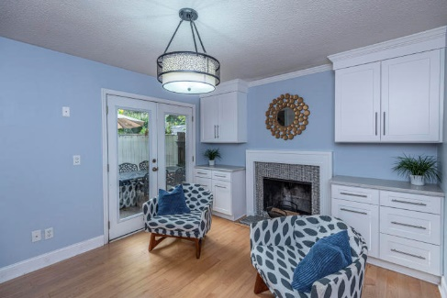
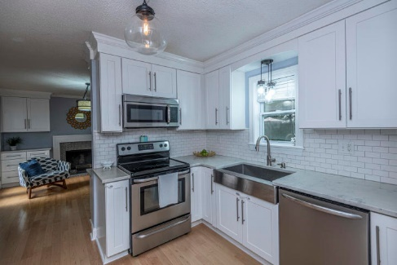
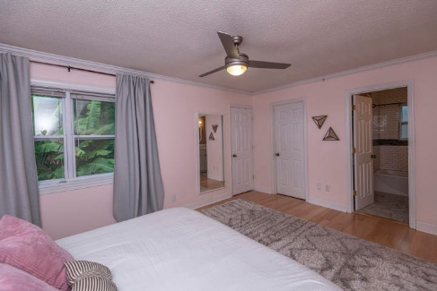
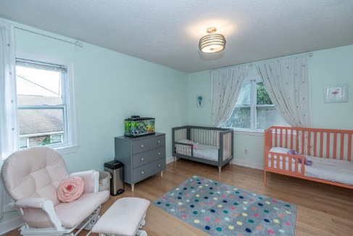
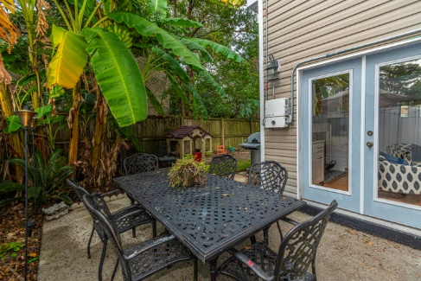



Why wait for new construction? This Park Circle area home is LESS THAN 2 YEARS!
Mt Pleasant Townhouse Near Downtown
641 Baytree Court Bay Tree ~ Mount Pleasant, SC 29464 ~ MLS# 19030868 ~ $300,000
Welcome to 641 Baytree Court in the highly sought after Bay Tree subdivision!
This is the bigger floorplan and an END UNIT with a big sideyard. This 3 bedroom, 2.5 bath townhouse boasts hardwood floors and an updated kitchen with quartz countertops, subway tile backsplash and stainless steel appliances. The family room can be used as an office. No HOA!
This location is amazing with easy access to downtown Charleston for work or school. Trader Joe's, Whole Foods and Aldi's are also close by.
Del Shaffer
843.408.6821
dshaffer@carolinaoneplus.com
2713 Highway 17 North
Mt. Pleasant, SC 29466

