Slide 1
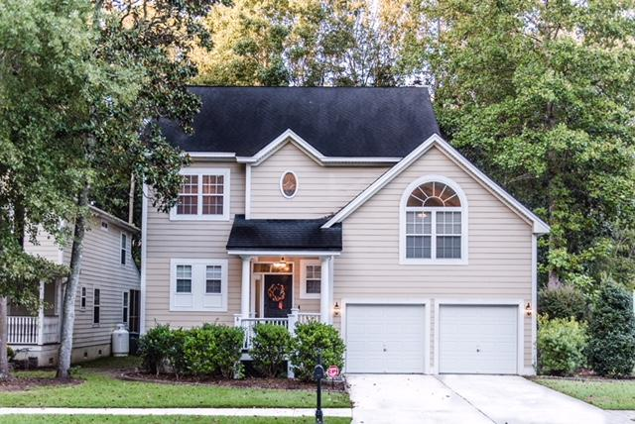
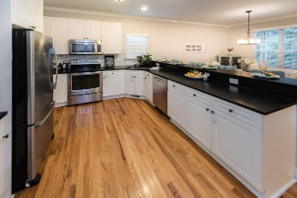
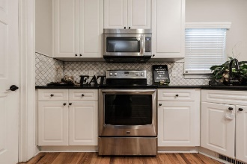
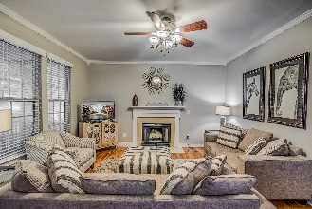
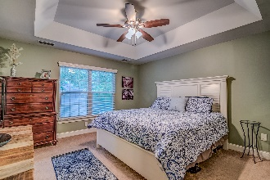
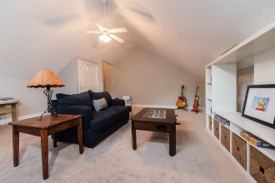
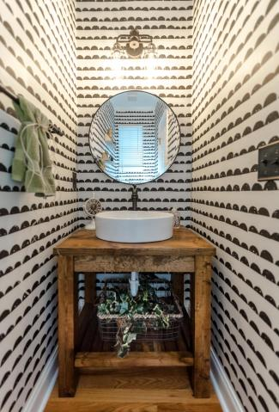
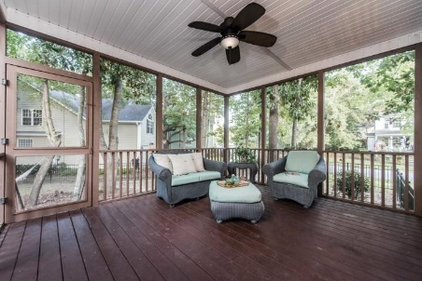


642 Fair Spring Drive Schieveling Plantation Charleston, SC 29414 MLS# 18027146 $334,900 2,069 Sq Ft - 4 Bedroom – 2½ Bath
$5,000 Agent Bonus!
West Ashley's Best Kept Secret, Schieveling Plantation. You'll fall in love with this neighborhood from the second you turn down Rhett Butler and drive under the Live-Oaks, with a view of the stately neighborhood clubhouse. Feel right at home as you enter in to 642 Fair Spring, which sits on a corner lot, with fully fenced back yard, one of the larger yards in the neighborhood. Another great thing about this home, it does NOT back to Hwy 61! First thing you'll notice when you step inside are all of the updates, current owners have put lots of love in to this home. You'll appreciate the honey-oak hardwoods throughout the first floor and trendy, gray paint color. Just to the left of the foyer is a recently remodeled powder room with funky wallpaper and locally made vanity with vessel sink.
As you enter in to the main living area you will be pleasantly surprised by the very open floorplan. Kitchen boasts leathered, black granite countertops, marble tile backsplash, stainless steel appliances and white cabinets. Off of kitchen is the laundry room/pantry. As you head upstairs you'll notice the custom stair runner with fun, Arabesque design. Upstairs you'll find 3 bedrooms and two full baths, with a huge FROG that could be 4th bedroom. Ensuite master bath features double vanity with granite countertop, tile floor, garden tub and separate shower. Guest bath has same granite countertop and tile flooring with a round window for extra charm. Relax on the large screened-in porch or take a nap in the hammock in the shade of the yard. Large two car garage rounds out this fantastic home. Two new HVAC units installed 2017.
BONUS PAID WITH ACCEPTABLE OFFER, RATIFIED BY 12/31/18
Victoria Cherry
(843) 860-4151
vickycherryrealtor@gmail.com
Weichert Palmetto Coast | 1035 Johnnie Dodds, Ste B2 | Mt. Pleasant, SC 29464

