Slide 1
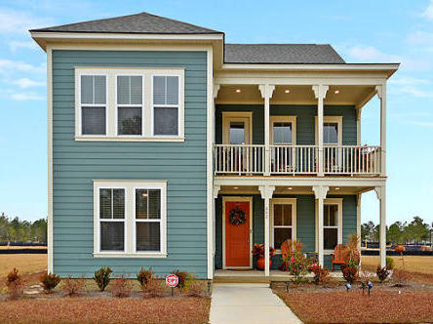
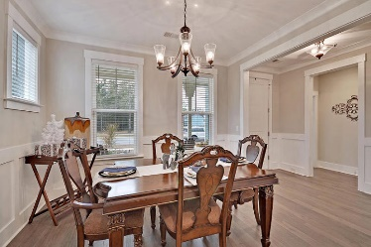
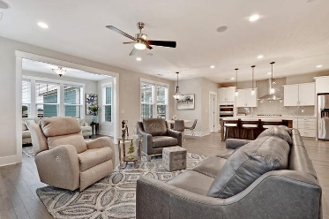
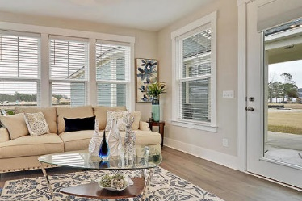
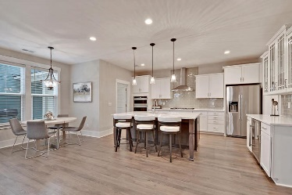
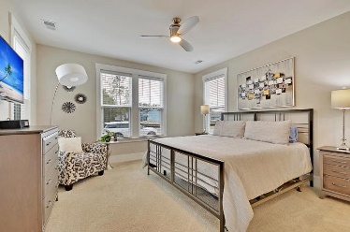
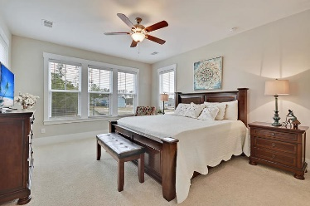
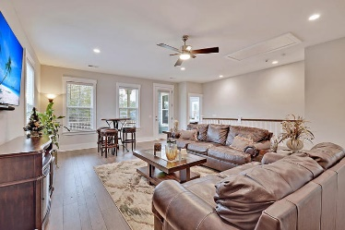
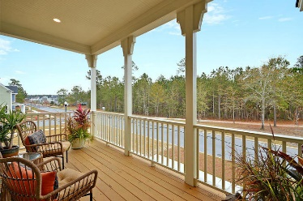

642 Van Buren Drive Carnes Crossroads · Summerville, SC 29486 MLS# 19033976 · $426,500
1 Year New Home in Carnes Crossroads
New Price
Gorgeous Listing
SPECTACULAR 4 bed, 3.5 bath, 7 month old home that shows exquisitely, better than a model! This home has wonderful curb appeal with double stacked front porches that are perfect for relaxing with a morning cup of coffee. Upon entering the home you are greeted with beautiful floors, heavy trim molding, and an abundance of natural light. To the right is a stately dining room that connects to the kitchen via a hidden hallway. Continuing in is an open concept floor-plan with family room, gleaming sunroom, and a chef-inspired gourmet kitchen! The kitchen boast a HUGE island, Calacatta Gold quartz countertops, single-bowl farmhouse sink , glass subway tile backsplash, stainless steel appliances, 42'' white cabinets, custom light fixtures, gas cooktop, pantry and built-in wall oven and microwave. This kitchen is absolutely beautiful, a must see to appreciate and is perfect for entertaining family and friends! The grand master bedroom suite is on the first floor and has a luxurious spa-like master bath with dual vanities, stunning frameless glass tiled shower, tiled floors, and large walk-in closet. There is a powder room, and laundry/mud room on the first floor. Upstairs there is an oversized loft that is a great second living area or media room and leads to a covered second floor porch. There is also a second master bedroom suite with private full bath and walk-in closet. Two additional large bedrooms, a shared full bath, and an office finishes off this floor. This home has a patio grilling area and a wonderful covered breezeway leading to the 2 car detached garage. Additional features: smart home that can be connected to appliances, garage and security system, and family room has built in speakers for entertainment systems. Carnes Crossroads in Summerville is a wonderfully landscaped community with a play park, community pool, exercise area, and walking and jogging trails. The neighborhood is close to local shopping and grocery stores and is a short drive to downtown Charleston with 5-star restaurants, world class shopping and iconic history as well as a short drive to the beaches, the airport, Boeing, Volvo, and Daniel Island. Come take a look because you will not find another home that offers as much as this one: a chef's delight and entertainer's dream! Call today to see!
Stan Huff
843-670-2835 stan.huff@agentowned.com
Jill Marcacci
843-297-5590 jill@agentowned.com
www.agentownedrealty.com
AgentOwned Realty Co. Preferred Group, Inc. | 824 Johnnie Dodds Blvd | Mt Pleasant, SC 29464

