Slide 1
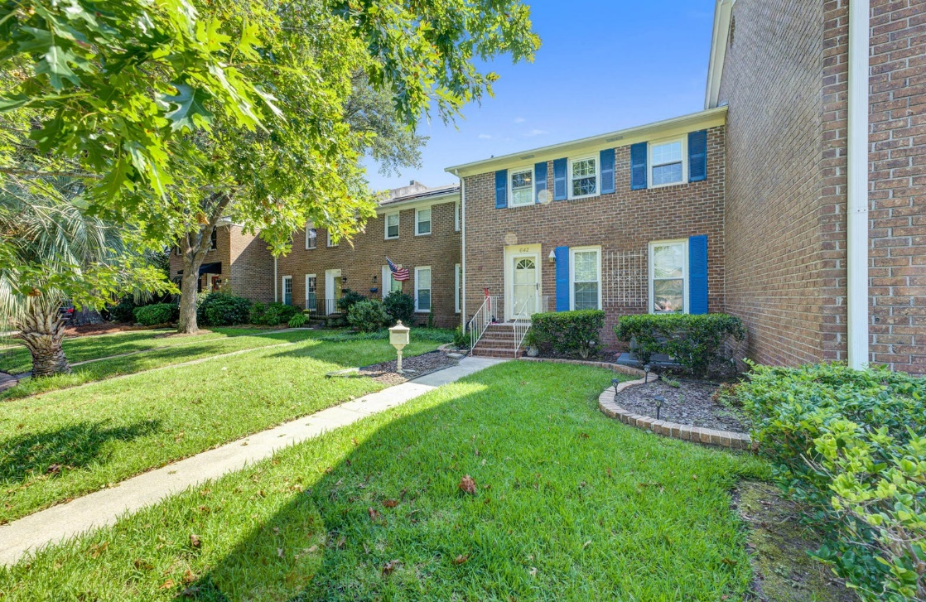
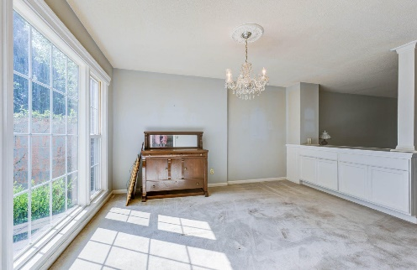
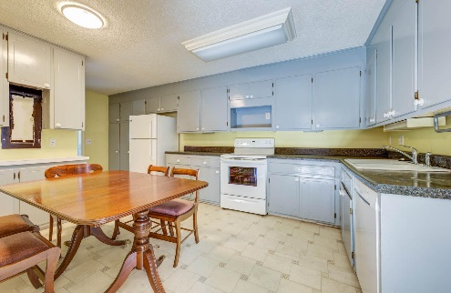
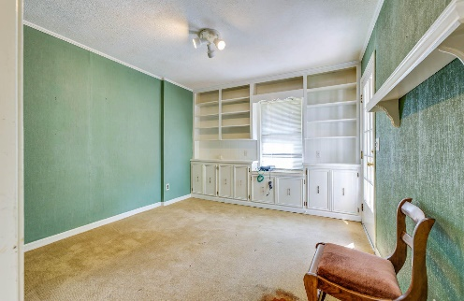
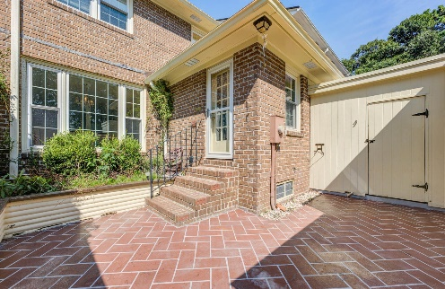


Fabulous Location!!
JUST
LISTED
642 Bonneau Lane
Cooper Estates · Mount Pleasant, SC 29464
MLS# 23018899 · $550,000
Michael Dew
O 843-769-5100
M 843-870-7000
michaeledew@gmail.com
www.michaeldewrealestate.com
Spacious 3 bedroom. 2.5 bathroom townhome in Cooper Estates!
Large family room and dining room with lots of light. Eat in kitchen. Additional office or flex space. Private, fenced-in courtyard leads to additional parking behind.
Cooper Estates has a private community dock and boat landing! Super convenient location to the beaches, Historic Downtown Charleston & Shem Creek! Needs TLC.
AgentOwned Charleston Group
902 Savannah Hwy
Charleston, SC 29407
Real Estate ● Mortgage Insurance ● Business Brokerage

