Slide 1
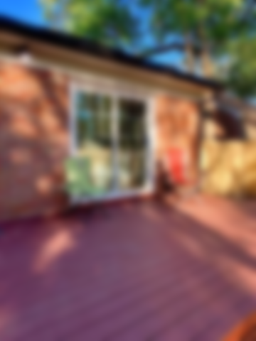
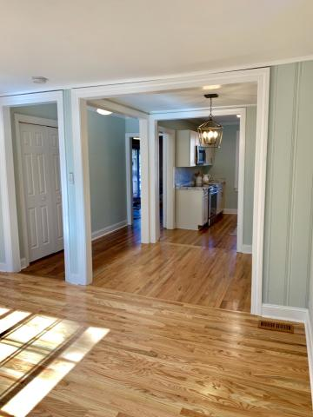
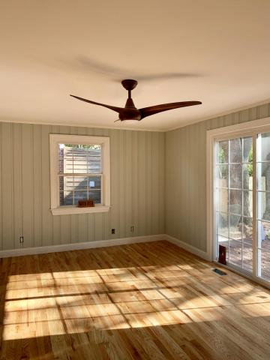
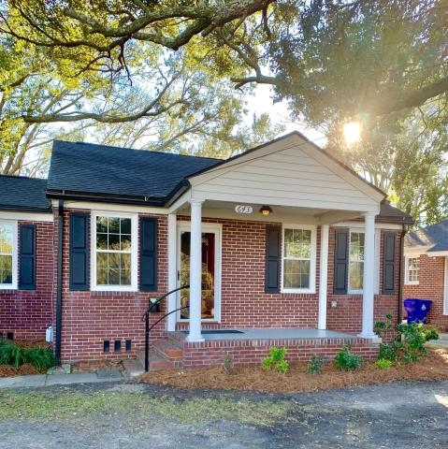
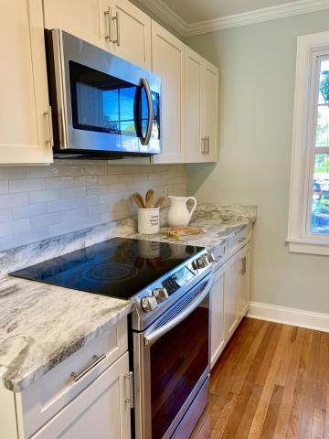
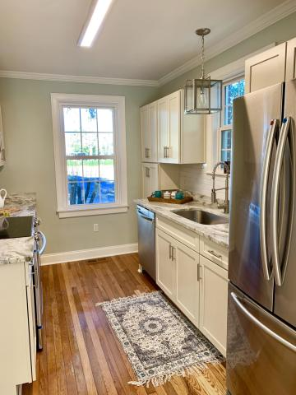
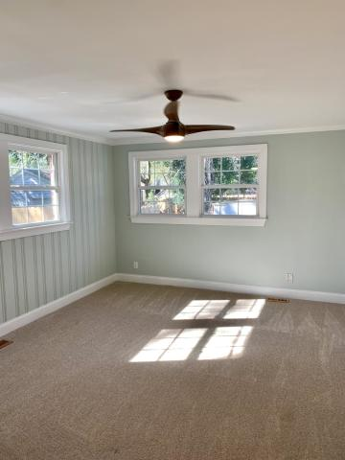
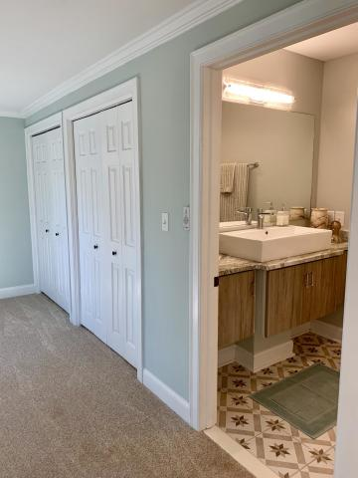
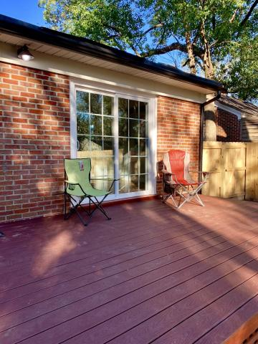
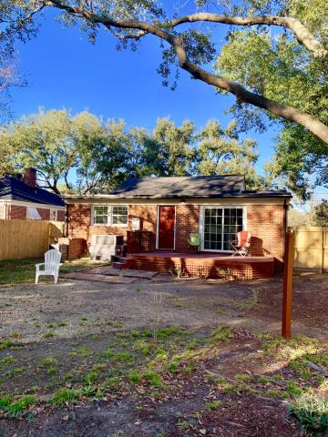


Move-in Ready! Go & Show!
643 Savannah Highway
Byrnes Downs · Charleston, SC 29407 · MLS# 20004405 · $364,000
This home features Living rm. Dining rm. AND a LARGE FAMILY ROOM, with a big deck for entertaining. 3 bed. and 2 full baths. Has a HUGE master en-suite, plenty of closet space in master. This solid brick home, has just been renovated from top to bottom, capturing the warm cottage feel of Olde Charleston. Includes, new soft close cabinets, w/lots of space. Beautiful Granite counter tops, tile backsplash, all new stainless steel appliances, and beautiful hardwood floors, laundry w/cabinets for laundry supplies, and a large bright family room! New lighting fixtures, that were carefully selected throughout. What makes this home stand out is the size for the area, and the flowing floor plan, plus huge fenced in back yard. Minutes to downtown Charleston
Becky Bouchard
(978) 257-0353
nearbyagent@gmail.com
AgentOwned Charleston Group
902 Savannah Hwy
Charleston, SC 29407
Real Estate ● Mortgage
Insurance ● Business Brokerage

