Slide 1
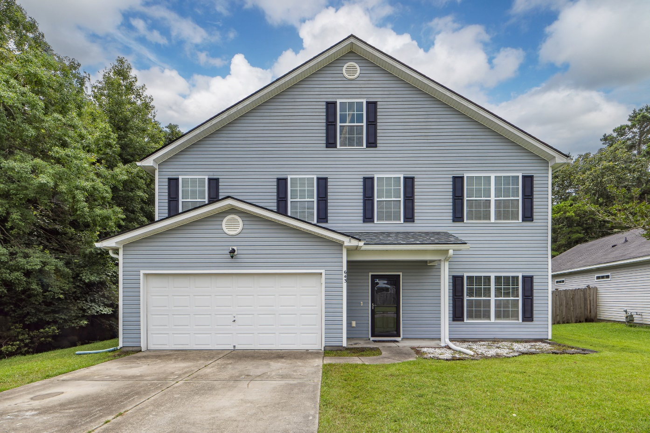
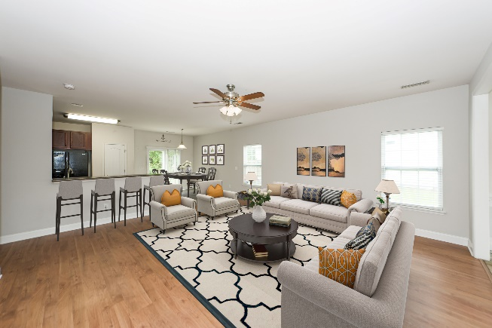
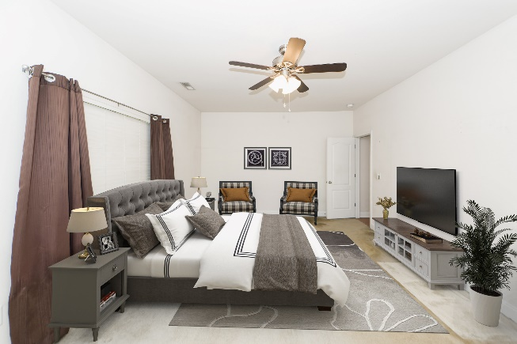


643 Savannah River Drive Lakes of Summerville | Summerville, SC 29485 MLS# 23015193 | $450,000
Open House
Wednesday, 7/20
3-5PM
Spacious Home on Over Half Acre in Summerville
Welcome to this spacious home! This property offers over 3500 square feet of living space, nestled on over half an acre. With 5 bedrooms and 3.5 bathrooms, there is ample room for the whole family to thrive. The heart of the home boasts of an open layout with a flowing dining room, living room, and eat in kitchen. The main level also features the master bedroom ensuite. The master bathroom is true oasis, with a walk-in closet and spaciousness that dreams are made of. Upstairs you will find a generous loft area, offering endless possibilities for a home office, playroom, or relaxation retreat. Each of the 5 bedrooms is liberally sized and offers a tranquil haven to unwind after a long day.
Outside, the expansive backyard bordered by woods on two sides beckons you to bask in the beauty of nature. With over half an acre of land, there's plenty of space for outdoor activities, gardening, or simply enjoying the fresh air. The community itself boasts of amenities, including a sparkling pool, perfect for cooling off on hot summer days or enjoying a weekend with friends and family.
Conveniently located, this home offers the best of both worlds: a peaceful retreat away from the hustle and bustle, yet just a short drive from shopping, dining, and entertainment options.
A $2,000 Lender Credit is available and will be applied towards the buyer's closing costs and pre-paids if the buyer chooses to use the seller's preferred lender. This credit is in addition to any negotiated seller concessions.
Take a virtual tour!
Christie Rainwater
843-478-8600
christie.rainwater@carolinaone.com
www.christierainwater.com
Carolina One Real Estate
900 N Main St
Summerville, SC 29483

