Slide 1
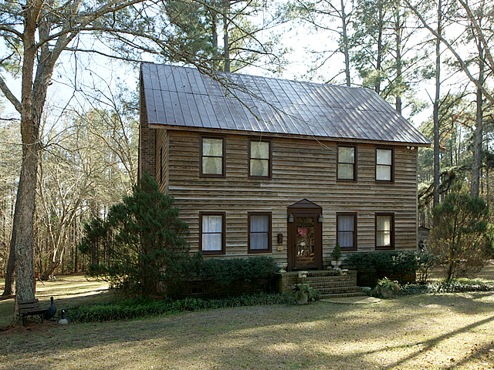
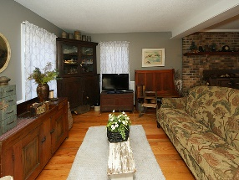
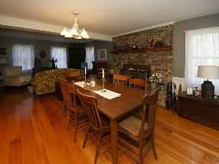
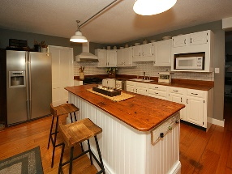
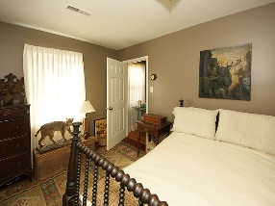
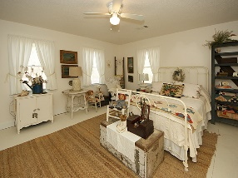
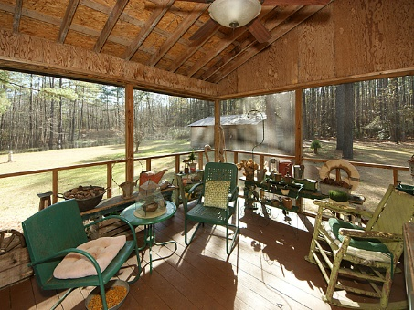
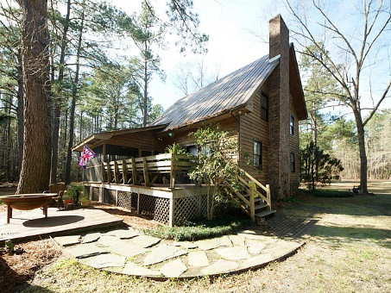
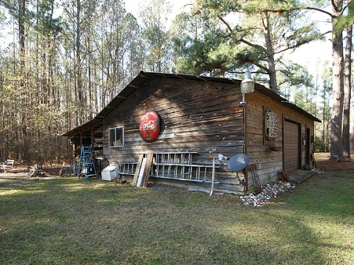

645 Benton Farm Rd
Walterboro, SC 29488
MLS# 17001606 | $289,900
2,036 Sq Ft - 3 Bedroom – 2 Bath
15 ACRES IN WALTERBORO
If you are looking for peace and tranquility this is the house for you. Enjoy 15 acres of your own private oasis including ponds and plenty of room to enjoy nature. Just minutes away from downtown Walterboro and easy access to I95. For the cook in the house you will love the rustic gourmet kitchen equipped with stainless steel appliances and plenty of cabinet space and a spacious island with wood counter tops. Open floor plan downstairs with brick fireplace makes it easy for relaxing. Get ready to unwind in your claw foot tub while enjoying your peaceful surroundings. Upstairs you will find 3 bedrooms including the master with an adjoining bathroom with double sinks. You will enjoy entertaining on your back porch and deck or by the fire pit while viewing the pond in the spacious backyard.
Barbara Limehouse
843-870-8291
bllimehouse@gmail.com
Weichert Palmetto Coast
1035 Johnnie Dodds, Ste B2
Mt. Pleasant, SC 29464

