Slide 1
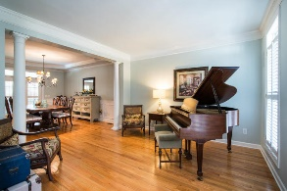
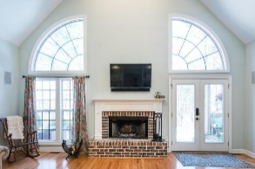
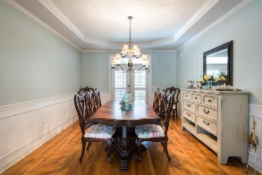
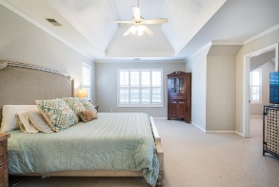
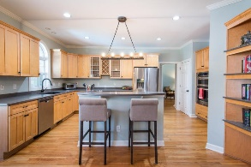
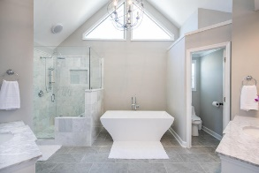
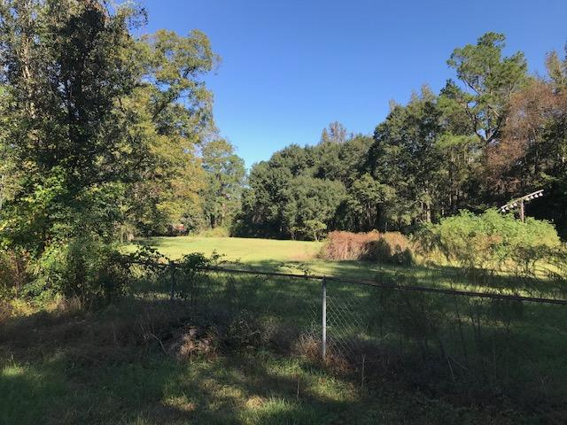
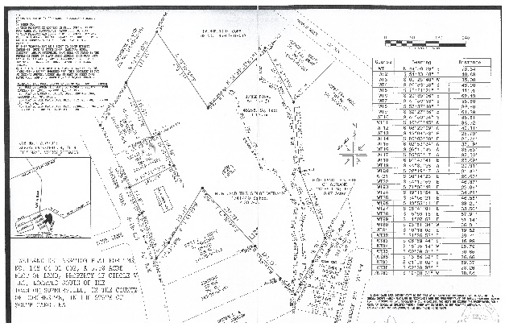
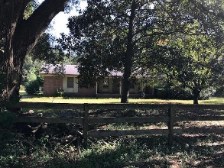
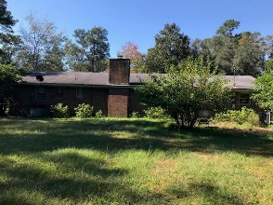
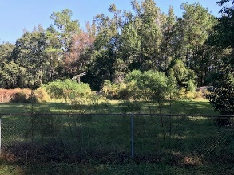
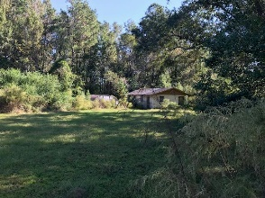
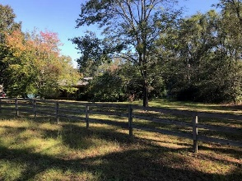
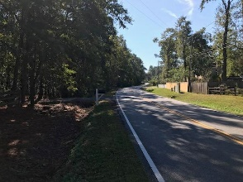

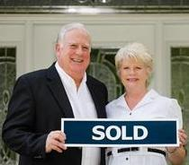
645 Gahagan Road
Summerville, SC 29483
MLS# 19030140
$565,000
Investment and Development Opportunity
$550,000
Wonderful investment and development opportunity with endless possibilities!! Wetlands Delineation shows 4.00 acre of High Ground which makes several good possibilities for MULTI FAMILY and or large SINGLE FAMILY lot development or whatever meets your needs. Existing 1700 square foot 3br2ba Brick Ranch structure on property conveys in "as is" condition. Old Tree survey from 2007. Easy to view. Just call listing agent for information and appointment.
Tommy Lovett
Tommy - (843) 442-1276
tlovett@carolinaone.com
www.tommylovettrealestate.com
Carolina One Real Estate
628 Long Point Rd.
Mt Pleasant, SC 29464-3032

