Slide 1
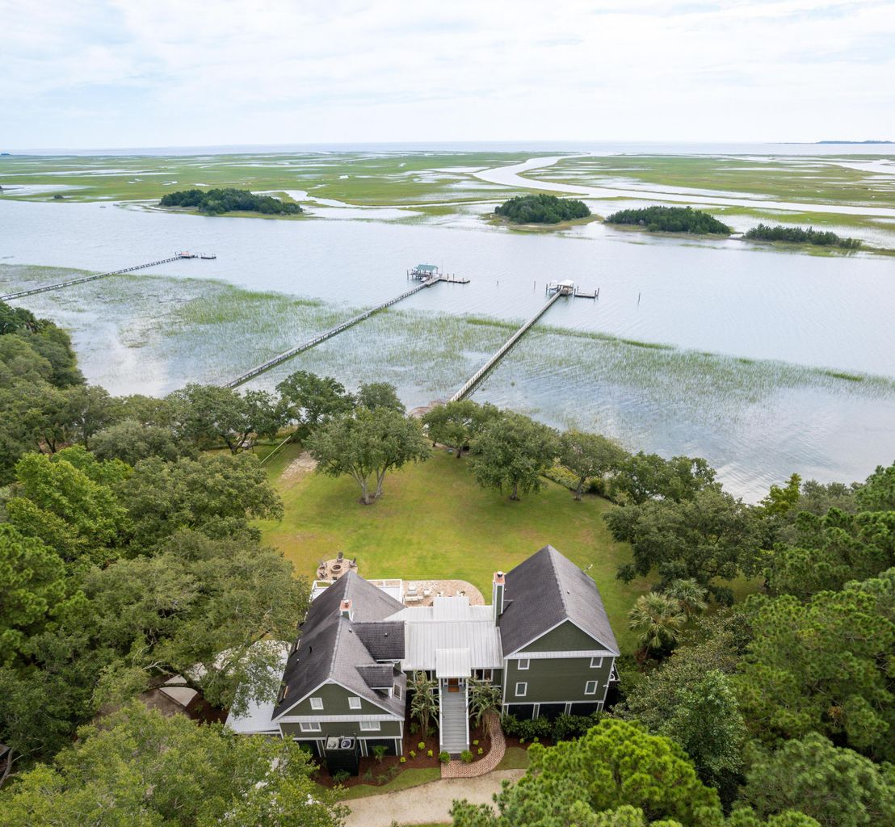
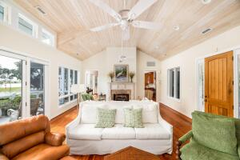
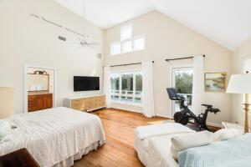
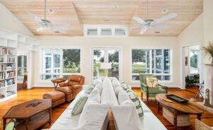
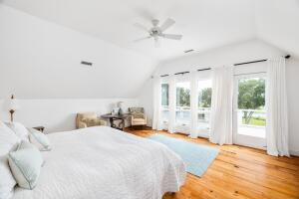
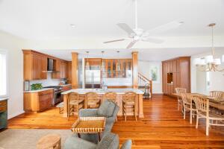
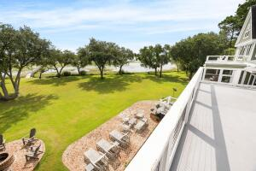
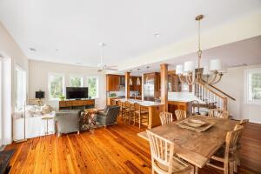
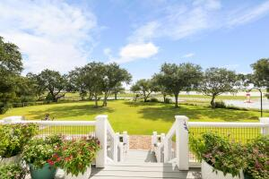
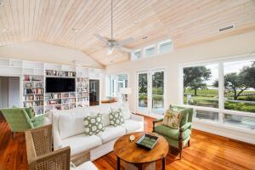
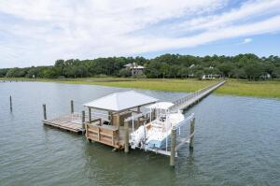



Why wait for new construction? This Park Circle area home is LESS THAN 2 YEARS!
DEEPWATER ON ICW
6461 Come About Way
Romain Retreat | Awendaw, SC 29429 | MLS# 21025302 | $2,685,000
Welcome to 6461 Come About Way. Situated on 2 acres, this Deepwater home provides Lowcountry waterfront living at its finest. The home takes advantage of the spectacular views of the Intercoastal Waterway and a wide expanse of Bulls Bay. With over 300 feet of water frontage and a private dock, you can take full advantage of the best fishing and boating that Charleston has to offer. The main house is approximately 4,400 square feet with a guest apartment over the detached two car garage. As you enter the front door, you immediately are struck by the spectacular views from almost every room. The main living room is bright and open with vaulted shiplap ceilings. Walk past the double sided fireplace into the open kitchen, dining, and sitting room.
The current owners have updated the kitchen with all new Wolf appliances, a Subzero refrigerator, new granite countertops, and backsplash. Additionally, an elevator from the ground level to the first floor was installed along with a carport. The expansive master bedroom, situated on the second floor has a large waterfront porch. The secondary bedrooms are in a separate wing opposite the living room that provides privacy and proximity to the rest of the home.
Each section of the home has an attached screened in porch or large deck space, to take in the expansive view. The current owners have recently added brick walkways, a brick patio, and a firepit. The existing dock was completely updated. The owners added a covered dock house with water and electricity, and a 10,000 pound boat lift.
Showings by appointment only. Don't miss this beautiful Deepwater property!
Tommy Manous
843-813-1678
tmanous@carolinaone.com
191 Rutledge Ave
Charleston, SC 29403

