Slide 1
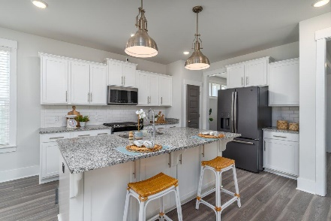
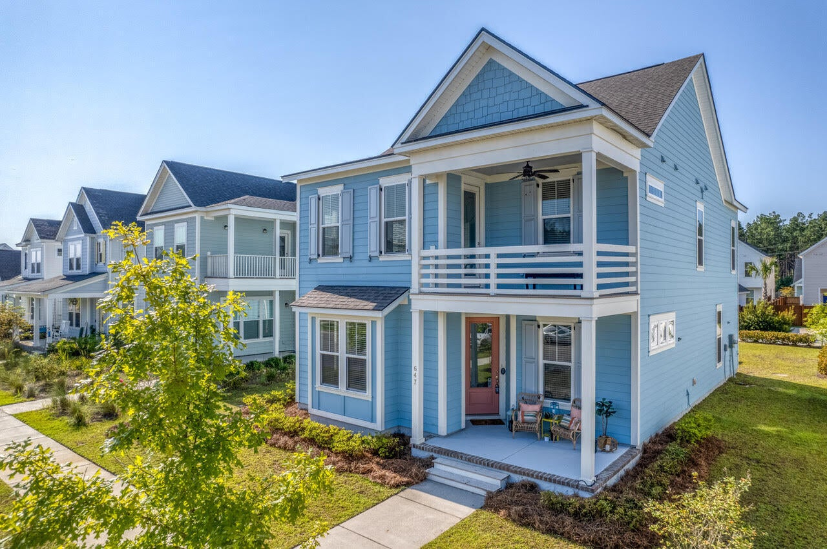
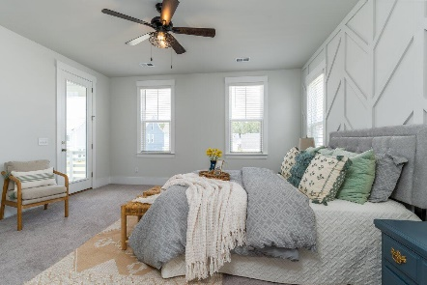
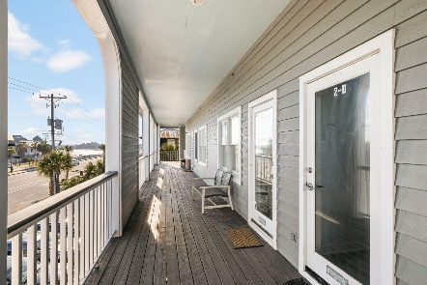
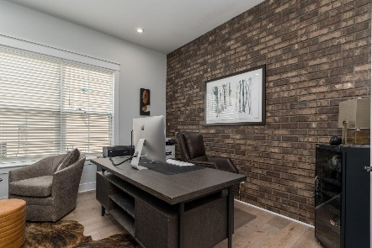
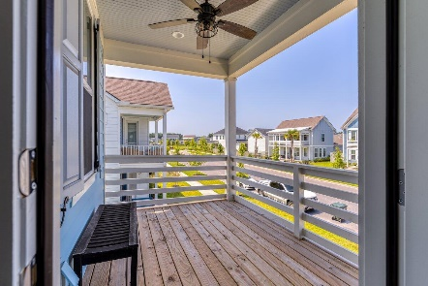
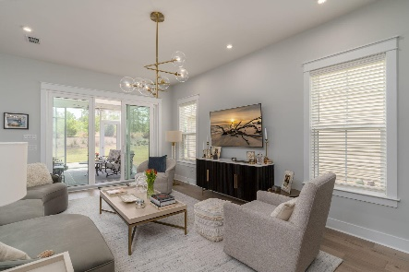
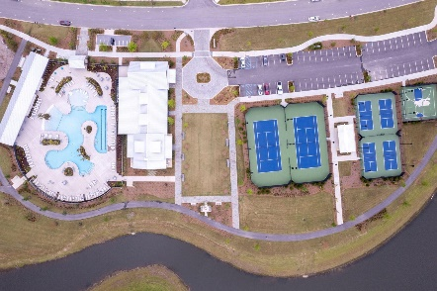

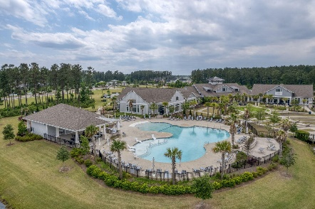
647 Blueway Avenue Midtown @ Nexton Summerville, SC 29486 MLS# 23019625 | $495,000
Darrell Creek Elevated Home With Elevator & Salt Pool
$1,500 Agent Bonus &
$10,000 in Closing Costs
with acceptable offer by 9/30!!!
Recently Reduced
in Nexton!
Co-sponsored by
$10,000 IN CLOSING COSTS OR RATE BUYDOWN WITH ACCEPTABLE OFFER!!!
Welcome Home to 647 Blueway Ave, in Nexton's Midtown Neighborhood, where the doors are colorful and front porch sitting is a way of life! As you enter the popular Marigold Model, you are greeted by a bright, airy, and open floorplan. One of the first things you notice is all the attention to detail, including wainscoting, wide trim baseboards & window casings, and engineered hardwood throughout the main level. Off the Foyer, there is a beautiful Formal Dining Room. There is also a Den/Office, or even a 4th Bedroom, complete with a closet and Murphy Bed! Also, off the Foyer is a convenient Drop Zone and Half Bath. The Home flows into a Large Gourmet Kitchen and Dining Area with gas stove, level-up granite, and Freshly Painted level-up cabinets with pull-out drawers.
Notice the magnificent Family Room with intricate wainscoting and custom ceiling fan.
Travel upstairs to the Breathtaking Master Suite with balcony to relax and sip your morning coffee. Retreat to the Spa-Like Master Bath and pamper yourself in the upgraded HUGE tiled shower with dual showerheads. Make sure to check out the master closet with all its upgraded shelving. Right off of the Master, is a well-appointed Laundry Room. Down the hall is a separate "Guest Wing", including 2 generously sized Guest Bedrooms with custom ceiling fans and a Full Bath.
Relax in the evening or entertain a crowd on your extended Covered Patio. This home truly has it all and is only 2 years old!
The other wonderful aspect about this home is the proximity to the Midtown Club in Nexton. The Midtown Club is home to Summerville's best-known Resort-Style Pool...you'll instantly feel like you're on vacation! In addition, the Club boasts a state-of-the-art gym and yoga studio, media room, and the largest and most beautiful work-from-home space, the Living Room. In addition, Midtown offers Pickleball, Tennis, and Basketball Courts, as well as miles of walking/jogging trails. Midtown Residents also can use Brighton Park's Pool, Pavilion, and Dog Parks at no extra charge! And if that isn't enough, hop on your golf cart or bike to Nexton Square. Get your shopping on and then unwind at Taco Boy or Halls Chophouse or any of the many Nexton Square Restaurants! This beautiful home will truly not last, book your showing today! $2500 LENDER CREDIT AVAILBE WITH USE OF PREFERRED LENDER!
House Tour | Amenity Tour
Elissa Campbell
843-853-1433 | elissa.campbell@agentownedrealty.com
AgentOwned Realty Preferred Group | 824 Johnnie Dodds Blvd | Mt Pleasant, SC 29464

