Slide 1
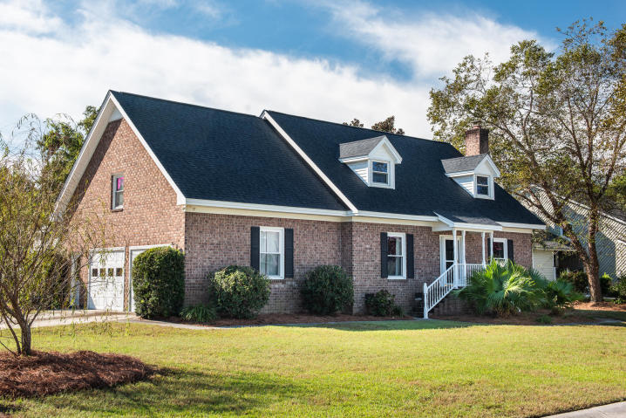
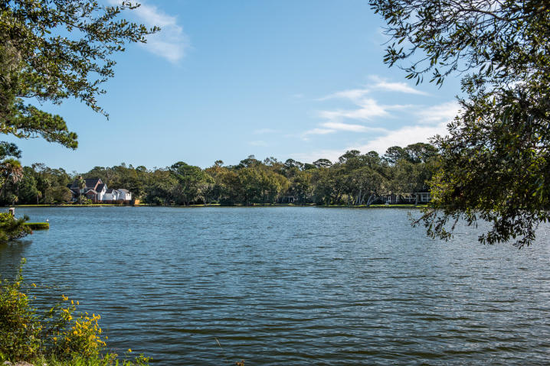
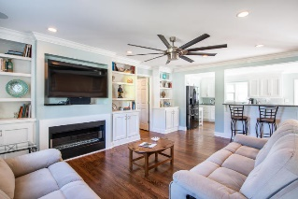
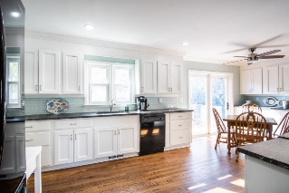
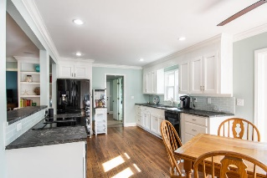
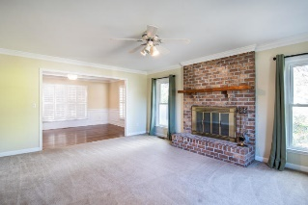
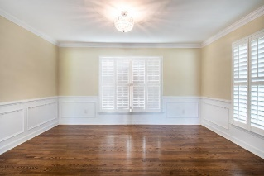
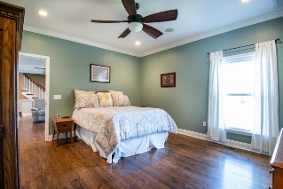
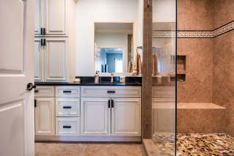
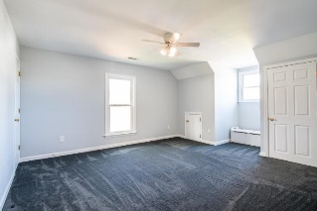
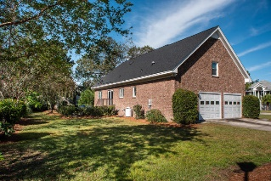
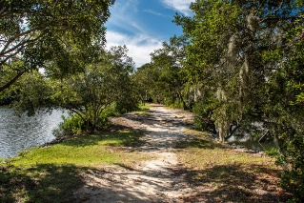


648 Oak Marsh Drive
Wakendaw Lakes | Mount Pleasant, SC 29464 | MLS# 19029477 | $500,000
Welcome Home to Wakendaw Lakes
Price Improved ~ Don’t Let This One Get Away!
Enjoy Neighborhood Lakes
Location, location, location! Highly sought after neighborhood, located just minutes from downtown, Isle of Palms, Hwy 526, Mt Pleasant Towne Center and East Cooper Hospital. Additionally, neighborhood is zoned for the new Lucy Beckham High School , slated to open in 2020. This home is on a corner lot just across the street from Hobcaw Creek and enjoys views of the creek. This well maintained home was renovated in 2014 and added a master suite, family room with modern wall gas fireplace and open concept kitchen. A formal living room with a second wood burning fireplace and formal dining room, a mudroom, half bath and laundry room are also on the first floor. All kitchen appliances do convey. The upstairs has two large bedrooms, a full bathroom and landing area. The sellers just replaced the roof October 2019 and completed the nice sized yard with fresh landscaping.
Wakendaw Lakes is home to great wildlife with beautiful lakes throughout the neighborhood. The neighborhood is governed by Wakendaw Lakes Civic Association by the neighborhood volunteers. There are social activities for neighbors to enjoy throughout the year.
Charla McDonald
Cell - (843) 343-1456
cmcdonald@carolinaone.com
charlamcdonaldproperties.com
Jeanie Acsell
Cell - (843) 224-9589
jean.acsell@carolinaone.com
Carolina One Real Estate
628 Long Point Rd.
Mt Pleasant, SC 29464-3032

