Slide 1
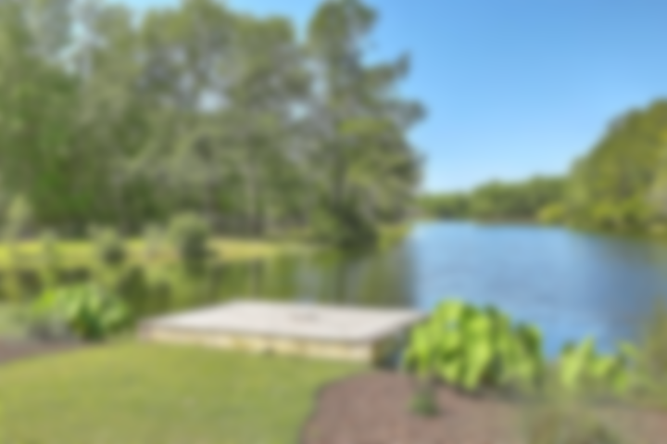
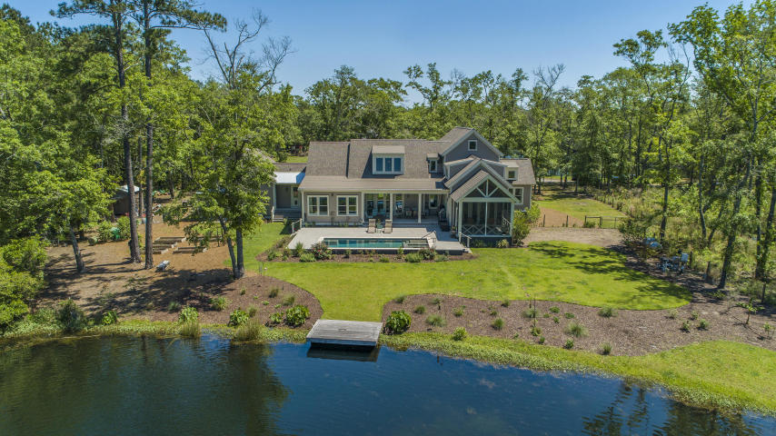
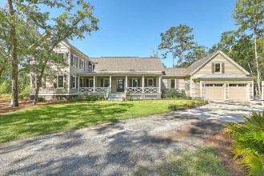
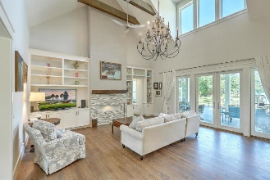
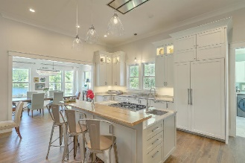
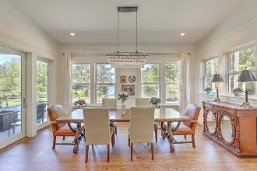
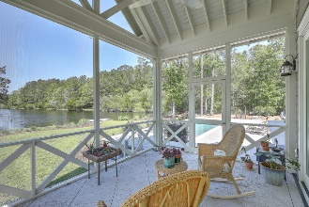
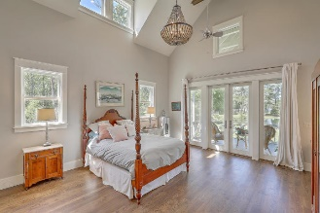
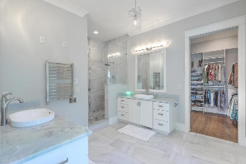
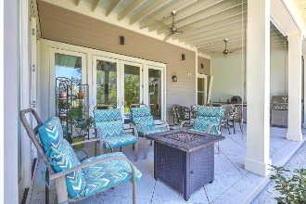
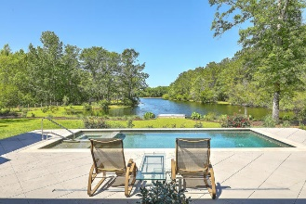
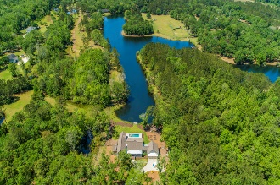


JUST LISTED!
Do Not Miss This Truly One-of-a-kind Haven!
6498 Scarletts Retreat
Rhetts Crossing | Ravenel, SC 29470 | MLS# 20011027 | $1,100,000
Escape the hustle and bustle with this privately situated lakefront retreat & enjoy the privacy of your own sanctuary only minutes from the culture and lifestyle people love about Downtown Charleston. This stunning, custom built home spared no expense with its design. As you pull into the gated driveway and walk onto the massive southern-style front porch, you will be instantly greeted as you walk through the entryway, with beautiful lake views off the back of your home. Soaring high ceilings give the Great Room, which opens to the impressive chef's kitchen, a light and airy feel. Featuring professional grade s/s Thermador appliances, meal prep is simplified with the 6-burner gas range/oven, electric wall oven with built-in microwave and warming drawer, prep sink and plenty of counter and cabinet space. Family or guests can enjoy meals at the island or in the lovely separate dining room. The refrigerator is paneled to match the exquisite custom cabinets. Windows over the sink provide additional natural light and an adjacent walk-in pantry provides ample storage and even has another prep sink and ice machine, perfect for those impromptu cocktail parties. If you love to entertain, you will love the flow of the rooms, which open onto an oversized covered patio, complete with its own outdoor kitchen, and wonderful inground saltwater pool, overlooking the bass-stocked lake. The Master ensuite is a dream oasis with enormous dressing room with built-in shelving, beautifully tiled bathroom with his and her custom vanities, bidet, large soaking tub and oversized tiled shower. Enjoy your morning coffee or glass of wine as the sun sets over the water in your large screened porch which also opens to the pool. A second nicely sized en suite bedroom across the hall from the Master has a lovely custom tiled bathroom with antique dual sink vanity and artists will love the office off the bedroom which has vaulted ceilings and wall of windows overlooking the water. Upstairs, you will find 2 additional large bedrooms, both with vaulted ceilings and jack-n-jill bathroom, also with antique vanity with dual sinks. Dog lovers will love the huge laundry room, off of the kitchen, complete with its own dog bathing area, laundry sink and 2nd dishwasher! Over the garage, enjoy the huge Bonus Room, not included in the square footage but has a separate heat source, perfect for home office, work shop, exercise room, media room - the opportunities are endless! Love to garden? Multiple raised beds, gardening shed and irrigation are already in place!
Desiree Maurer
Office - (843) 416-2000
Mobile - (843) 327-9010
desiree.maurer1@gmail.com
www.yourcharlestonhousesearch.com
Keller Williams Realty
496 Bramson Ct Ste 200
Mt. Pleasant, SC 29464

