Slide 1
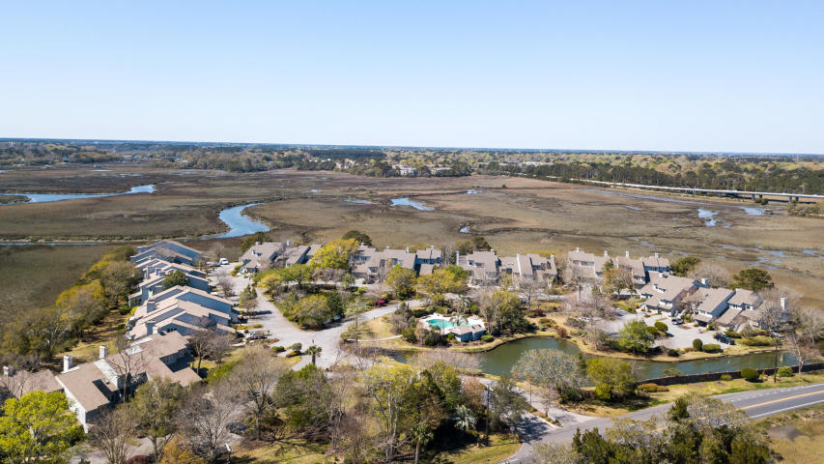
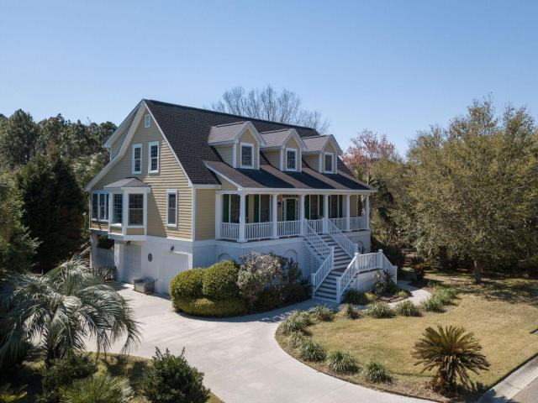
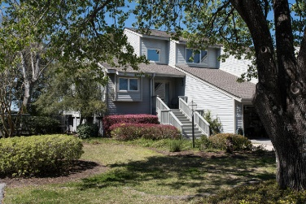
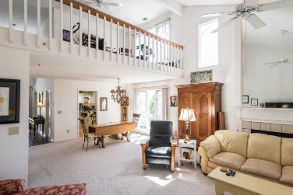
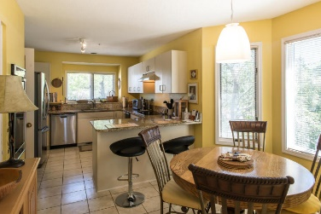
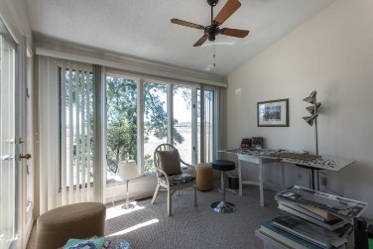
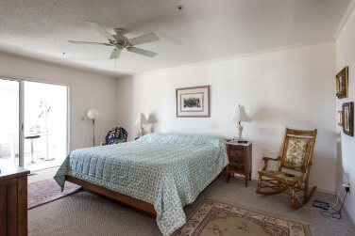
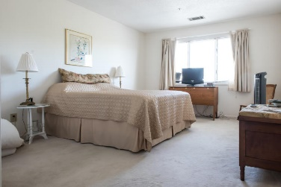
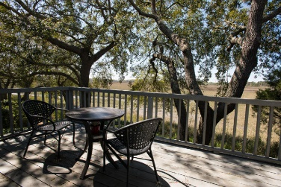
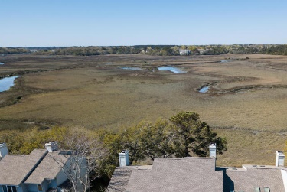


Stunning Views, Location, and Floor Plan
650 Harbor Creek Place #25
Harbor Creek · Charleston, SC 29412 · MLS# 18007206 · $439,000
Absolutely stunning END UNIT in HIGHLY sought after Harbor Creek. Beautiful marsh views with fantastic sun-room and open deck for those spectacular sunsets year round. Master bedroom on the main level. Beautiful kitchen with great flow of space into dining area and main living room with fireplace. The sun-room allows for great sunsets year round and the light in this wonderful end unit is spectacular. The pool is an oasis in and of it self and the location to downtown and the beaches is unparalleled. Sprinkler system in the home. Most likely the best view of all the units in Harbor Creek. Just minutes from downtown, MUSC, Boeing and the historic district.
Bryan Thompson
Office - (843) 769-5100
Mobile - (843) 452-1686
bryan.thompson@agentownedrealty.com
www.bryanthompsonrealestate.com
AgentOwned Charleston Group | 902 Savannah Hwy | Charleston, SC 29407-7802

