Slide 1
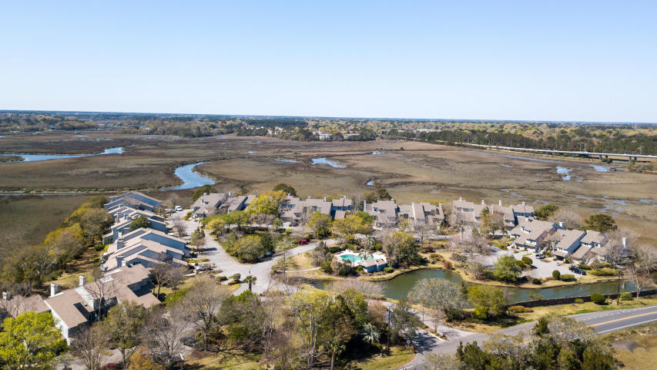
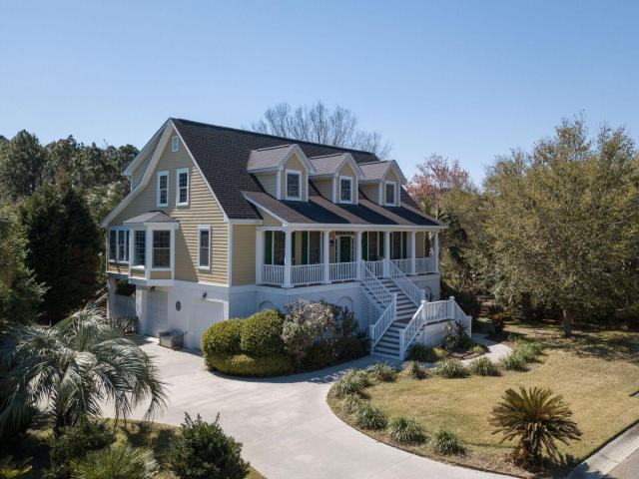
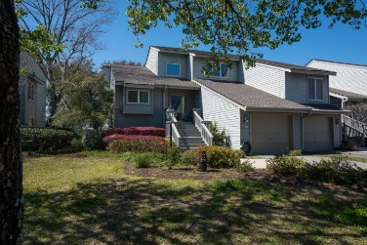
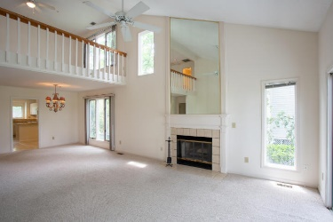
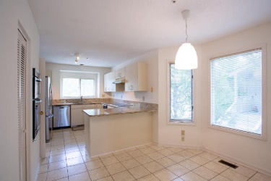
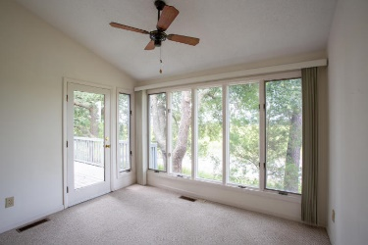

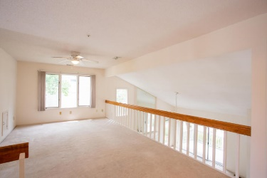
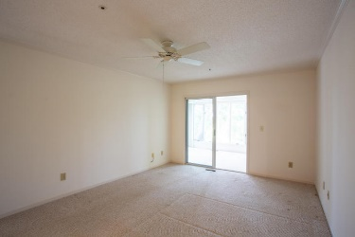
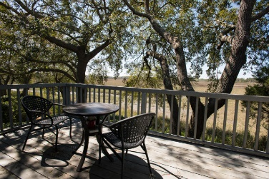
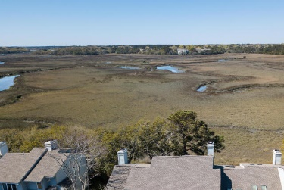

Must See! Stunning Views, Location, and Floor Plan
650 Harbor Creek Place #25
Harbor Creek · Charleston, SC 29412 · MLS# 18021042 · $424,900
Absolutely stunning END UNIT in HIGHLY sought after Harbor Creek. Beautiful sweeping marsh views with fantastic sun-room and open deck for those spectacular sunsets year round. Master bedroom is on the main level and the additional two bedrooms are upstairs. Beautiful kitchen with great flow of space into dining area and main living room with fireplace. The pool is an oasis in and of itself and the location to downtown and the beaches is unparalleled. Most likely the best view of all the units in Harbor Creek. Just minutes from downtown, MUSC, Boeing and the historic district. Very close to shopping and all fine dining in the area. Perfect lock & leave with very low maintenance. This is a must see!
Gregory Gelber
(843) 494-2354
greg.gelber@agentownedrealty.com
www.agentowned.com
Bryan Thompson
Mobile - (843) 452-1686
bryan.thompson@agentownedrealty.com
www.bryanthompsonrealestate.com
AgentOwned Charleston Group | 902 Savannah Hwy | Charleston, SC 29407-7802

