Slide 1
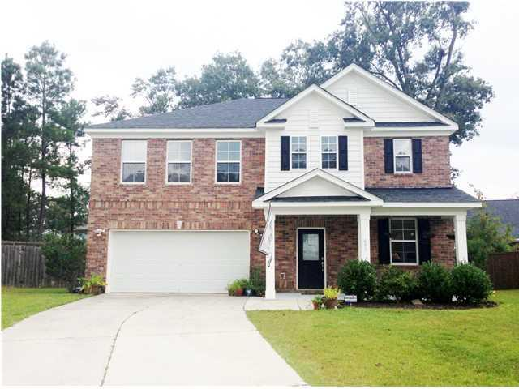
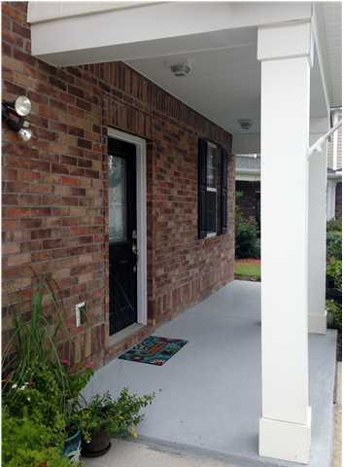
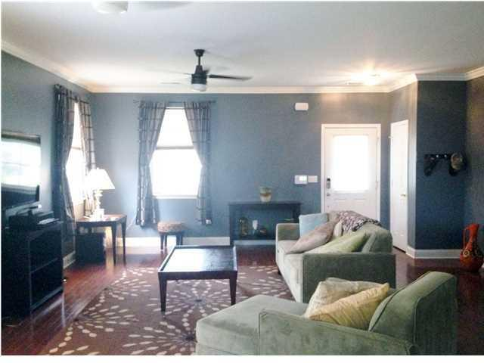
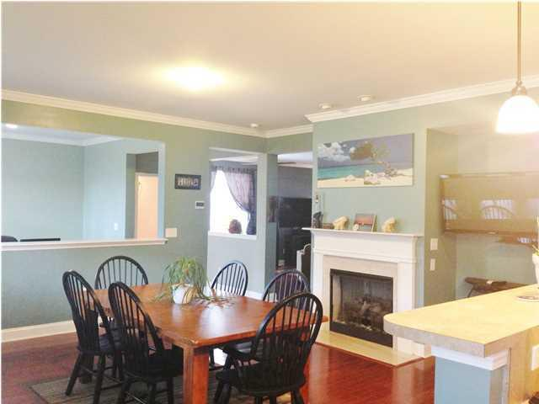
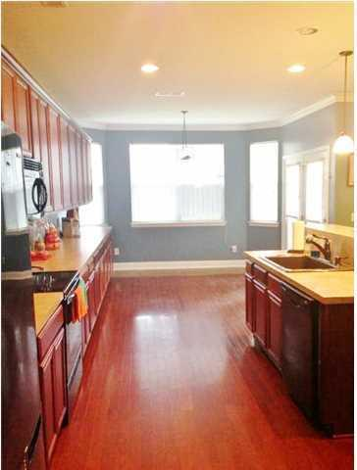
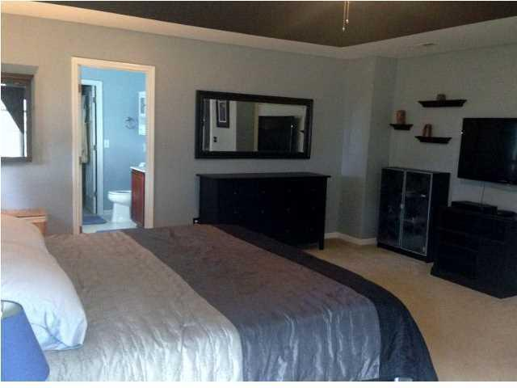
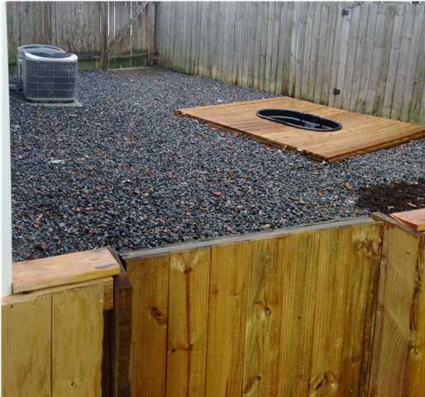
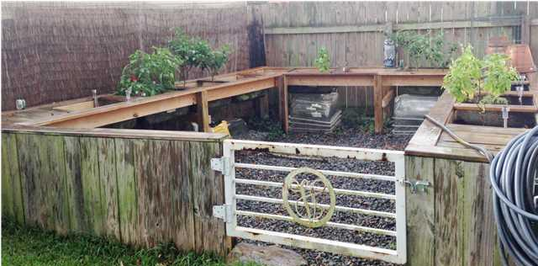
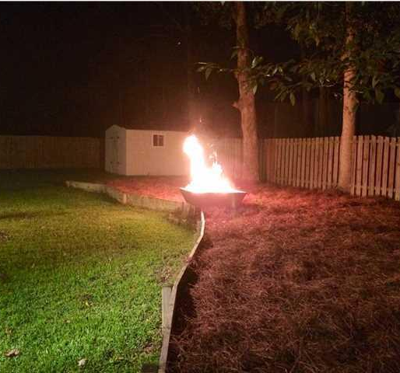

Wonderful Family Home in Blackberry Creek
651 Grassy Hill Road Summerville, SC | MLS# 1425420 | $264,900 5 Bedrooms | 2½ Baths | 3,114 Sq Ft
Wonderful family home in Blackberry Creek located on a cul-de-sac at the end of Grassy Hill Rd. Beautiful Hardwood flooring throughout the downstairs with open concept living. Large kitchen with separate dining room and eat in kitchen. All bedrooms are upstairs and spacious! Back yard is expansive with a large center area for entertaining and a designated dog area and garden area installed by the owners.
Jennifer Robinson
(843) 442-1145
jrobinson@carolinaone.com
Carolina One Real Estate
195 W Coleman Blvd
Mt Pleasant, SC 29464

