Slide 1
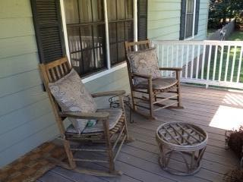
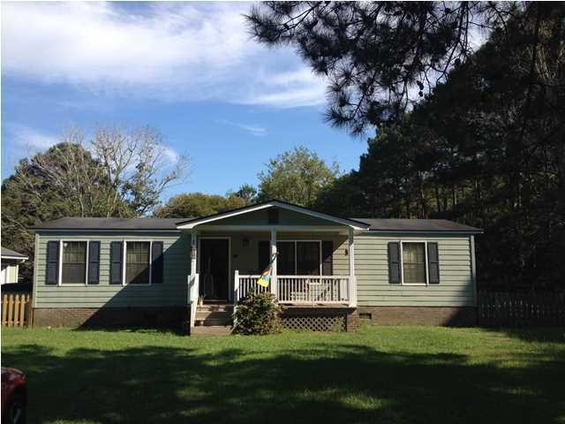
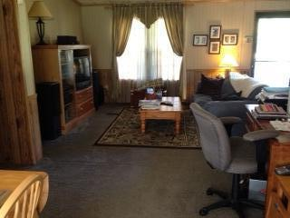
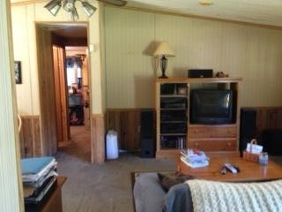
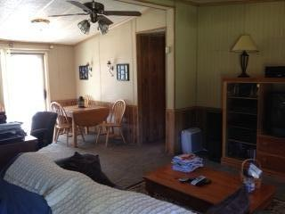
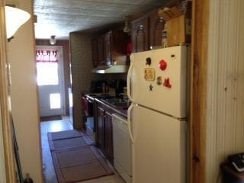
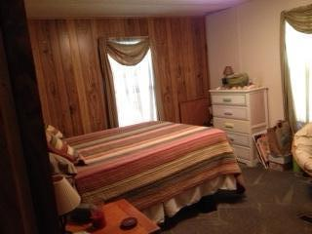
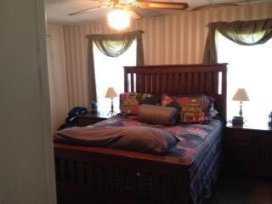
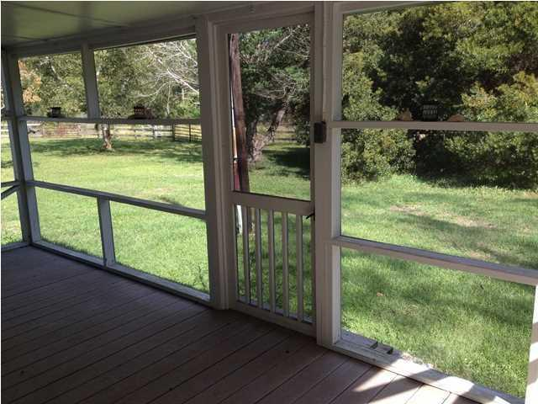
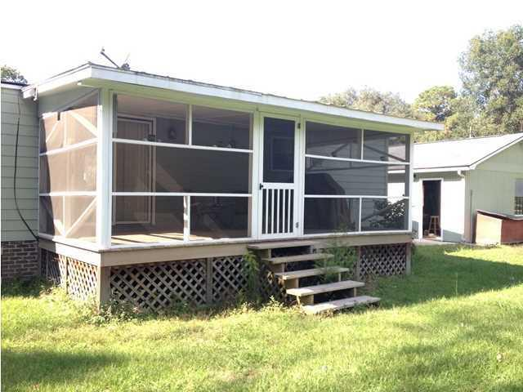
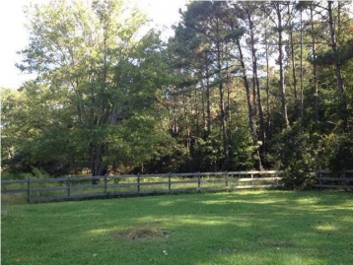
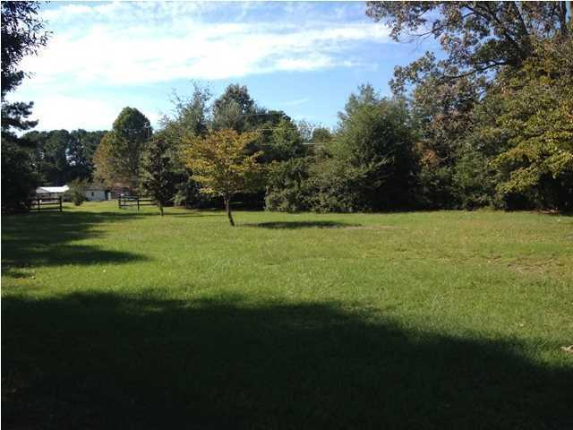
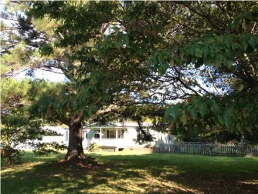


3.70 Acres On Wadmalaw Island
Price Reduced!
6521 Foxfire Rd
Wadmalaw Island
Foxfire Farms
MLS# 1426881 – $177,400
Enjoy Peaceful Country Living with acres for your horses, dogs, and outdoor space for all to enjoy.
Manufactured Home on permanent foundation.
Fenced-in areas.
Spacious Front Porch and Screened Back Porch.
Large TWO Car Garage.
Robyn Lane, Realtor
843-222-5599
robynlane01@icloud.com
ERA Wilder Realty, 125-F Wappoo Creek Dr, Charleston, SC 29412

