Slide 1
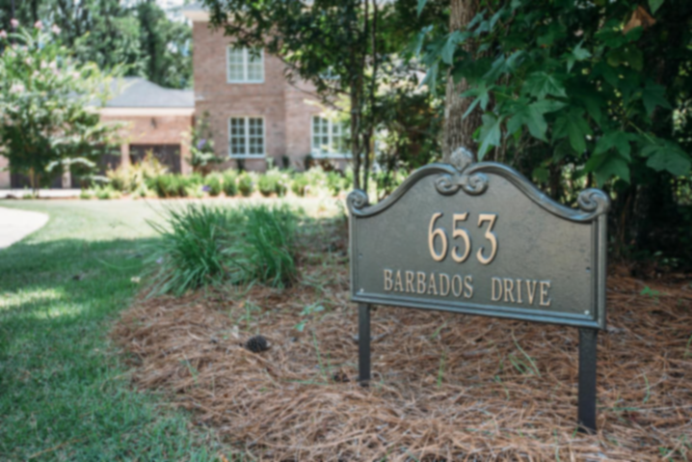
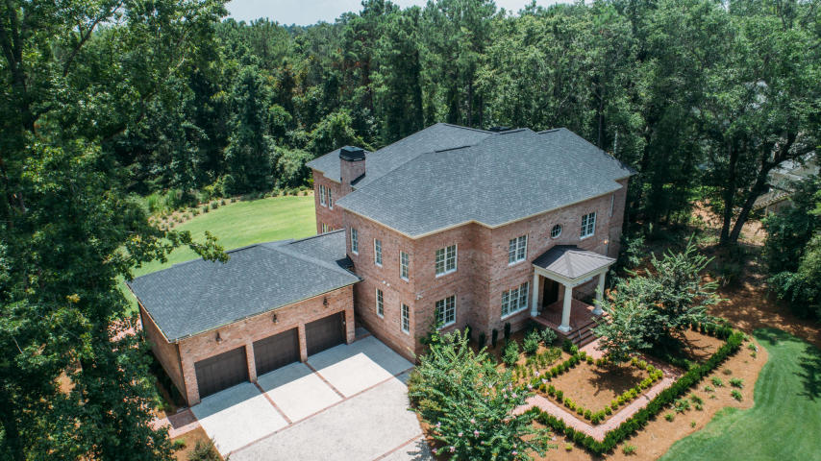
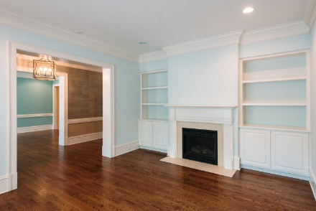
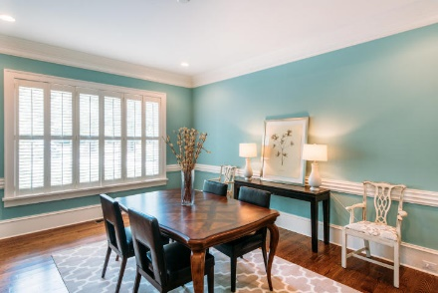
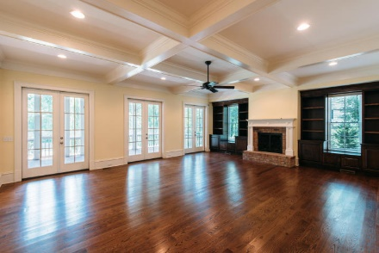
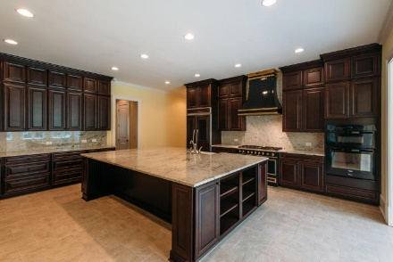
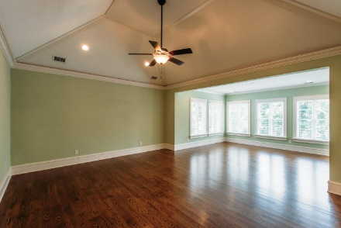
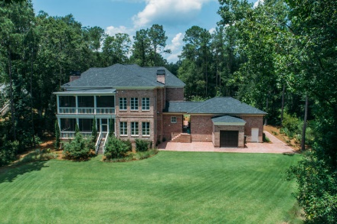
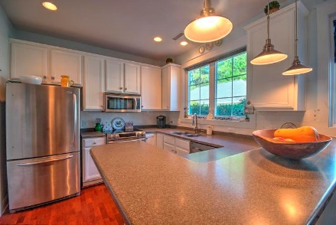
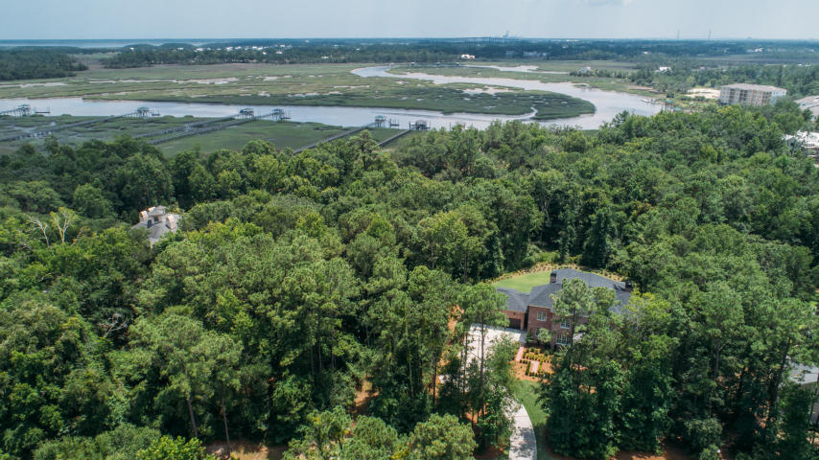
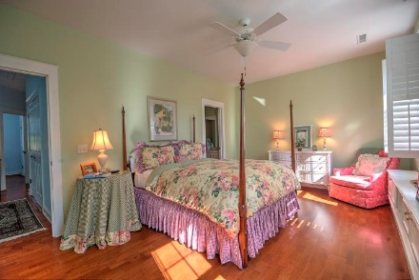


Commission increased to 3.5% for contract ratified by 3/31 Paid only at closing.
Open House Sunday 12pm to 3pm
Starbucks card to first 10 agents
Beautiful, immaculate townhome convenient to everything! Walk up the front stairs to a gracious front porch. Enter the large great room with high ceilings and a gas fireplace. Open floor plan allows entertaining with a big dining room and eat-in kitchen that leads to a screened back porch. From the back porch you can walk down to an enclosed backyard with a patio. That's where you will find the two car garage with its alley entryway. Upstairs you will find a big, bright master bedroom that is separated from the two secondary bedrooms by a hallway. Of course, it has its own bath with a walk-in shower. The two back bedrooms open to one another with double doors. It's gorgeous! We can't wait for you to see it!
Beresford Hall
Charleston
MLS# 17019455
Now $1,199,500
Jennifer LePage (843) 478-2600 | LePageJ@bellsouth.net
www.jjlrealestate.com
AgentOwned Charleston Group | 902 Savannah Hwy | Charleston, SC 29407

