Slide 1
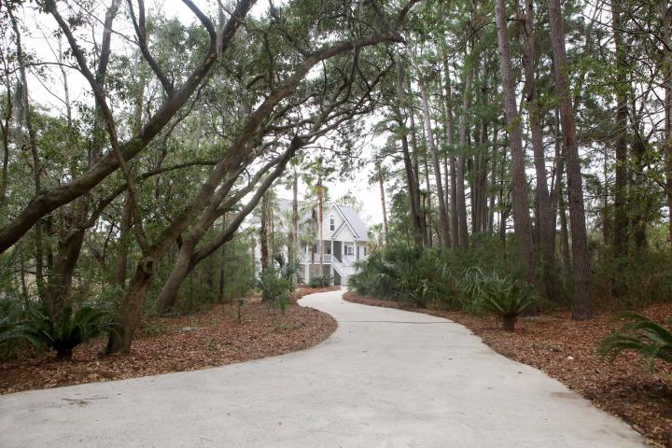
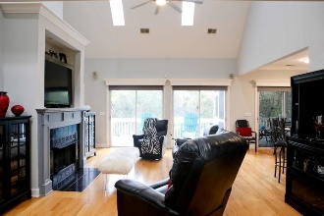
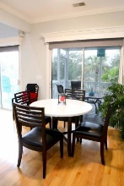
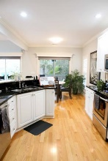
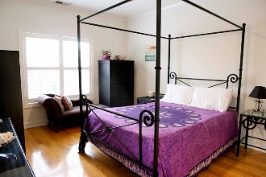
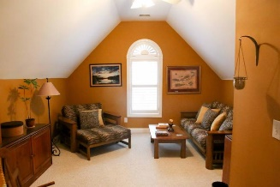
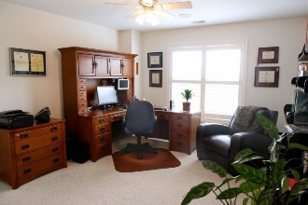
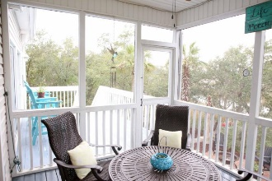
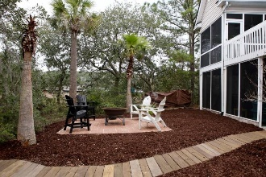
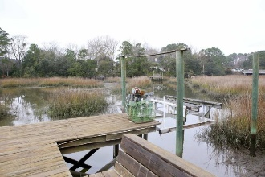


Under $650k on Hobcaw Creek
653 Oak Marsh Drive
Wakendaw On The Creek | Mount Pleasant
MLS# 19004258 | $649,700
Stunning views and unforgettable sunsets are yours from almost every room in this contemporary home located in the established neighborhood of Wakendaw Lakes on Hobcaw Creek! From the moment you arrive, this expertly designed and well-appointed property is perfectly sited to take advantage of this spectacular Lowcountry setting. Talk about privacy...The house sits on well over ½ acre & the long driveway is adorned with beautiful palm trees and mature landscaping with custom lighting designed by Outdoor Lighting Perspectives. Upon entering this home, you will be greeted by gleaming hardwoods & an open floor plan that flows nicely for entertaining throughout. The immaculate kitchen is a dream, thoughtfully designed so the chef can enjoy guests as well as views of the creek while cooking!
Anchored by newer appliances, granite, beautiful cabinetry, breakfast bar, and custom painted tiled backsplash, it doesn't get more inviting than this! Retreat to the spacious master suite conveniently on the main floor that boasts amazing views! Attention to detail wasn't spared here...granite countertops, his and her sinks, water closet, new custom closet, separate shower and garden tub makes it the perfect place to unwind. Rounding out the main floor is the large family room with fireplace, dining room, laundry room, powder room (with custom mural by Jim Brown) and spacious screen porch off the breakfast area. Three additional oversized bedrooms and bathroom are also found on the second floor still allowing you to enjoy the views and wildlife of Hobcaw Creek. Want to take advantage of Charleston's outdoor year round living? How does 2 screen porches, a high end 41" deep Dimension One hot tub, large front porch, paved patio/fire pit and your own PRIVATE dock with marine grade lighting sound? To some maybe saving the best for last is the 2 car garage with race-deck flooring, custom cabinetry, mini split unit, huge custom bar with kitchenette and with all that, this man cave still has ample storage and space for work and tools. This is the best priced Tidal Creek/Marshfront home in South Mt. Pleasant! Your private oasis is awaiting!
Robert Jacoby 843-455-7075
Billy D'Elia (843) 478-3869
billy@charlestonpropertyexperts.com
www.charlestonpropertyexperts.com
Charleston Property Experts
812 A Johnnie Dodds Blvd | Mt Pleasant, SC 29464

