Slide 1
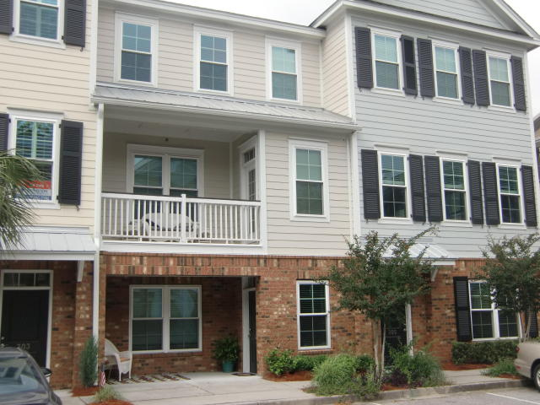
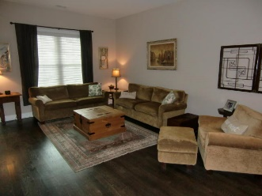
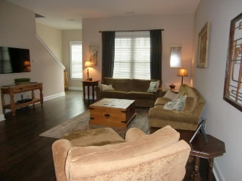
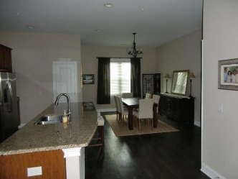
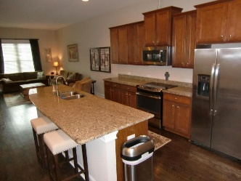
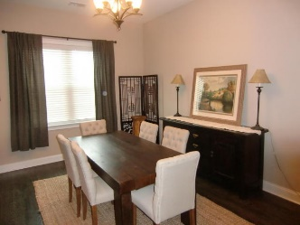
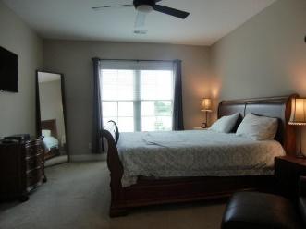
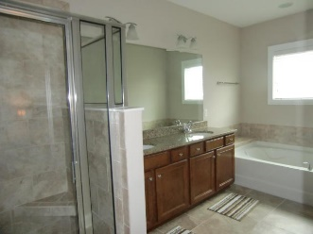
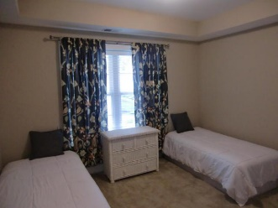
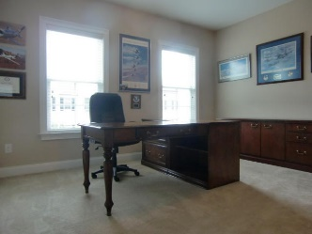
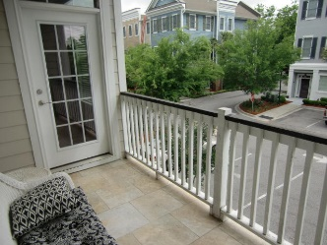

656 Coleman Boulevard 304
Six Fifty Six Coleman
Mount Pleasant, SC 29464
MLS# 17011591
$515,000
3 Bedrooms | 3½ Baths | 2,151 sf
Guess Who's Coming to Town? No, Not Santa… It's Volvo!
Location, Location, Location!
Luxury townhome in the heart of Mount Pleasant within walking distance to Shem Creek, restaurants, retail shops, area entertainment and the Mount Pleasant Farmer's Market. Just a 5 minute drive to downtown Charleston or a short bike ride to Sullivan's Island.
This 3 story townhome features stainless steel appliances, granite countertops in the kitchen, extra large kitchen island, 42'' cabinets, ceramic tile floors in the baths and entryway, hardwood floors in the main living area, large 2 car garage, covered porch and patio. There is an elevator shaft in place that currently serves as extra closet space.
This is a must see! Schedule an appointment today!
Michelle Wood
(843) 410-3691
michelle.wood@agentownedrealty.com
AgentOwned Realty Co. Premier Group, Inc. | 824 Johnnie Dodds Blvd | Mt Pleasant, SC 29464

