Slide 1
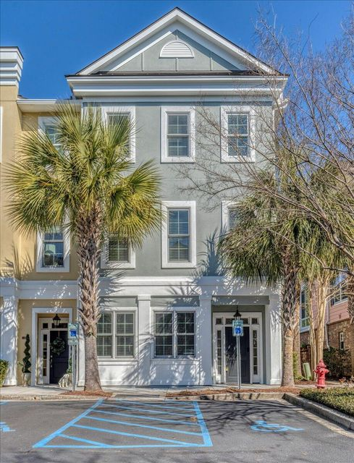
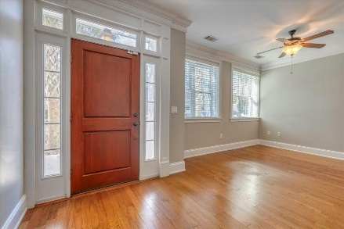
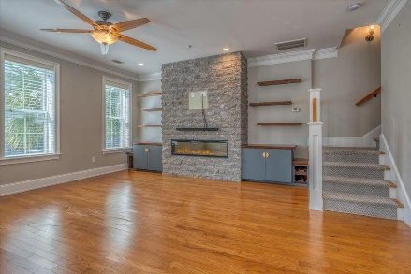
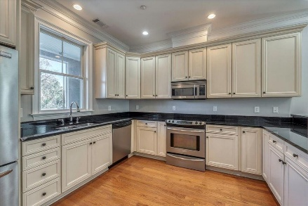
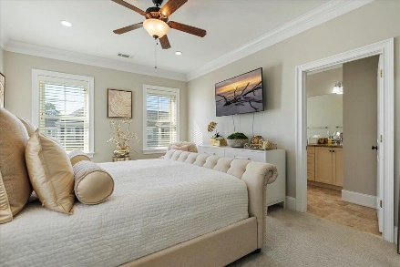
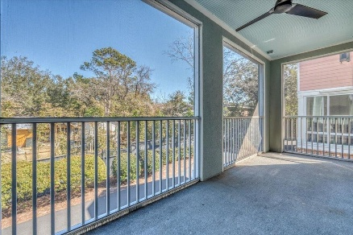
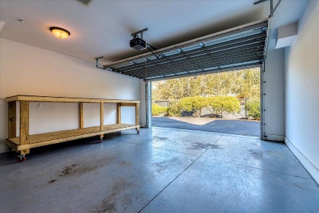

656 Coleman Boulevard 405 Six Fifty Six Coleman · Mount Pleasant, SC 29464 · MLS# 24030773 · $990,000
Seller Now Offering $7,500 Towards Buyers' Concessions
Seller now offering $7,500 towards buyers concessions. Use it to buy down a lower interest rate, for your closing costs, flooring, painting or other upgrades. Exceptional Opportunity at The Residences of Six Fifty Six Coleman Boulevard! Priced at $160,000 less than the best available comparable property in the neighborhood, this home offers incredible potential for the buyer who wants to create their dream space. Located in the sought-after Coleman Boulevard District, this property presents a rare chance to personalize and renovate to your heart's desire. Whether you're looking to update the kitchen, modernize the bathrooms, or transform the screened porch to a sunroom, this home provides the perfect canvas.
With 4 bedrooms and 3.5 bathrooms this corner unit is filled with natural light, thanks to an abundance of windows that create a bright and airy atmosphere throughout. The home features two separate entrances-one leading to the foyer and garage and the other to the fourth bedroom, which includes an en-suite bath, making it ideal as an office or private guest suite. With an elevator that services all three floors, this condo ensures easy accessibility and comfort.
Inside, you'll find an open floor plan that includes crown molding throughout. The custom stone wall with an electric fireplace serves as a stunning focal point, complemented by built-in cabinets, reclaimed wood counter tops, and custom shelves from Encore Reclaimed Lumber and Millwork.
The generous sized primary bedroom suite has a walk in closet, separate shower and jacuzzi tub. There are 2 additional bedrooms on the 3rd floor with a full bath and laundry room.
As one of only two units with dual entrances and the only 1 with a locked outdoor owner's closet for additional storage, this condo also includes a 2-car garage, offering both privacy and convenience. The competitive price means you'll have the flexibility to add your own updates and upgrades, all while enjoying the benefits of a prime location! Don't miss an opportunity to invest in your future with a property that can be tailored to your taste and needs. Schedule your showing today and envision the home of your dreams!
Michelle Wood
843-410-3691
michelle.wood@agentownedrealty.com
AgentOwned Realty Preferred Group
824 Johnnie Dodds Blvd
Mt Pleasant, SC 29464
michellewood.agentowned.com

