Slide 1

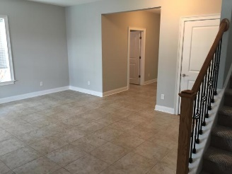
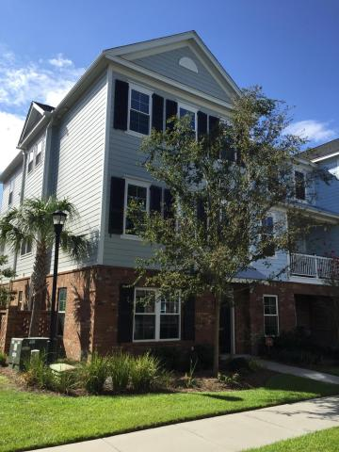
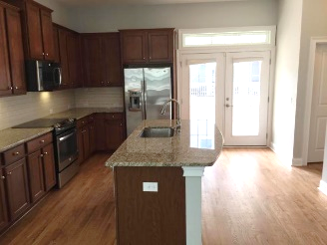
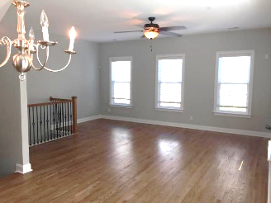
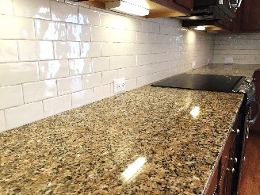
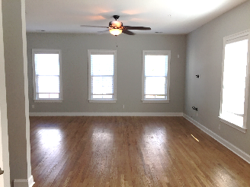
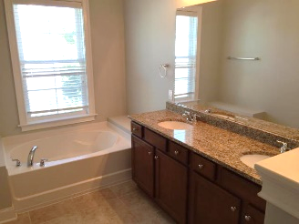
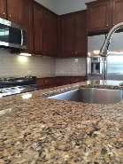
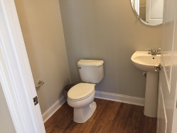
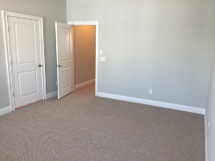
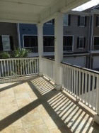
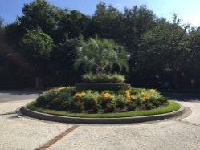
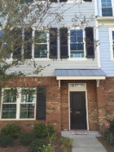
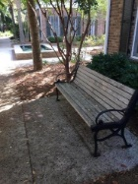


Immaculate Newer Townhouse with All of the Upgrades! For Rent - $3,000/mo Walk to shopping, dining, and Shem Creek
656 Coleman Boulevard #901
Six Fifty Six Coleman :: Mount Pleasant, SC 29464 :: MLS# 16022749 :: $3,000/mo
2,414sf :: 3 Bedrooms :: 3½ Baths
This property is move-in-ready! IT'S LIKE NEW - townhouse style condominium with all the upgrades in the Six Fifty Six Coleman Plaza. Granite in Kitchen and Baths, Hardwood floors, 10 foot ceilings, beautiful crown molding are just several features of this Mount Pleasant Beauty. There is ample closet space in the bedrooms and hallways that will allow for storage. Equipped with a 2 car garage with built-in cabinetry and a utility sink. This home boasts Stainless Steel appliances & a Washer and Dryer - all less than 3 years old. You can not beat the location either... it's close To Sullivan's Island, Isle of Palms, Old Village and Downtown Charleston. Also just a short walk to shopping, groceries & Shem Creek's amenities. Easy access to I-526.
Jon Moore
Mobile - (843) 732-3365
Jon@CharlestonRealEstateGroup.com
Charleston Real Estate Group. LLC
792 Folly Rd. C1
Charleston, SC 29412
www.charlestonrealestategroup.com

