Slide 1

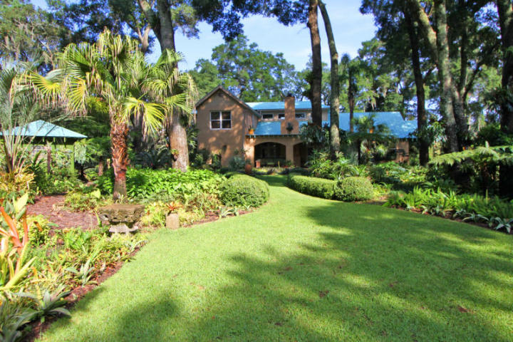
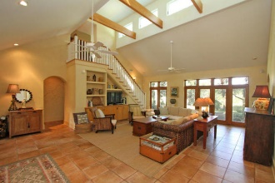
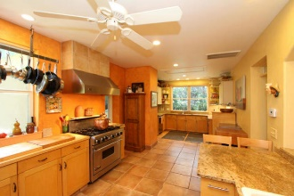
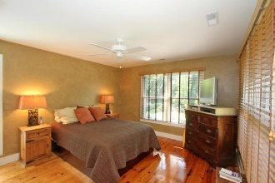
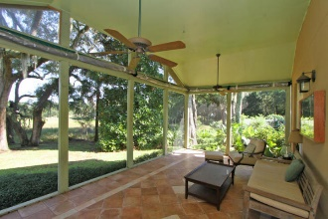
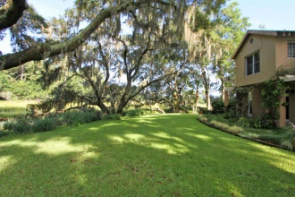
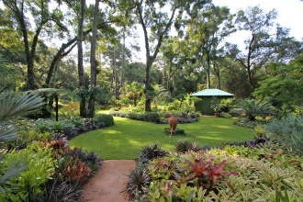
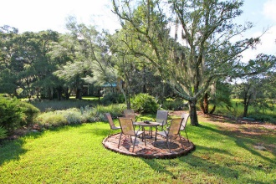
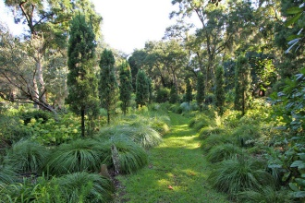
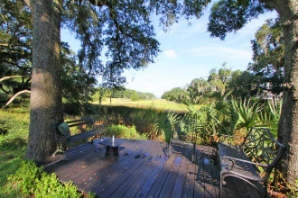


657 North Sterling Drive Charleston, SC 29412 MLS# 15022205 $1,695,000
Join us for lunch and bring your clients!
Thursday October 22nd 11a-1p
Never before offered for sale!
Nestled in what is truly one of the most astounding private gardens in Charleston and featured in national publications, this waterfront estate is the dream of any tropical garden enthusiast! This magnificent home rebuilt in 2001 features a full front porch opening onto the gardens, central living area with two story vaulted ceiling and clerestory windows for natural lighting. Huge true chef's kitchen with walk-in refrigeration. High ground is about 1.65 acres and marshland is about 1.65 acres in addition.
Charlie Smith
(843) 813-0352
csmith@csarealestate.com
www.csarealestate.com
CSA Real Estate Services 339 Cabell Street
Charleston, SC 29407-6928

