Slide 1

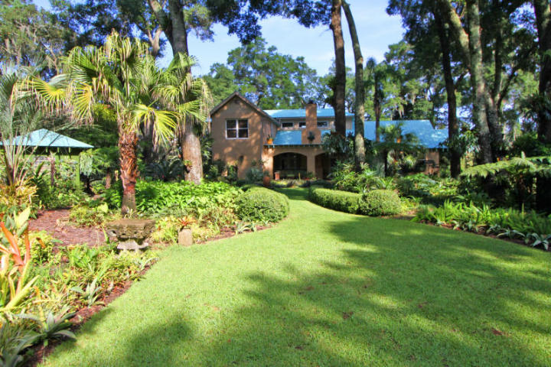
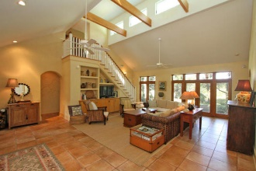
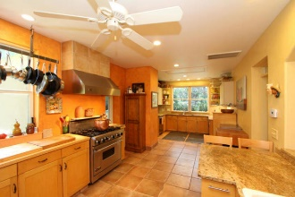
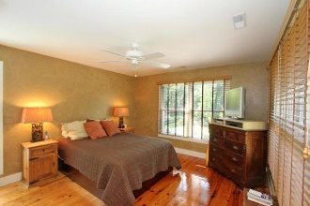
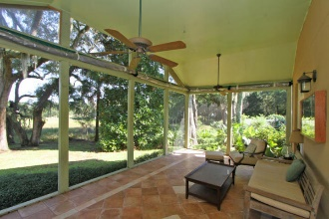
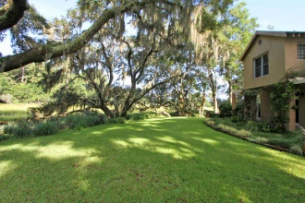
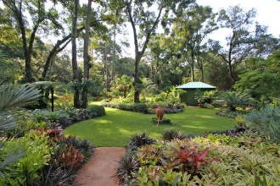
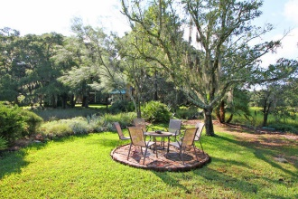
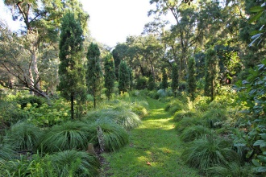
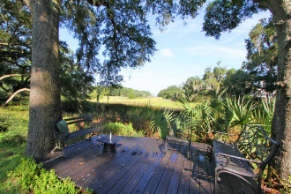


657 N Sterling Drive
Charleston, SC 29412
MLS# 15022205
$1,695,000
Never before offered for sale!
Nestled in what is truly one of the most astounding private gardens in Charleston and featured in national publications, this creek front estate is the dream of any tropical garden enthusiast! This magnificent home rebuilt in 2001 features a full front porch opening onto the gardens, central living area with two story vaulted ceiling and clerestory windows for natural lighting; huge true chef's kitchen with walk-in refrigeration. Kitchen opens to a large screened porch which opens onto the creek and doubles as a greenhouse in the winter. The property includes the marshlands adjoining it as well as those wrapping around the adjacent property and leading to Wampler Drive. High ground is about 1.65 acres and marshland is about 1.65 acres in addition.
Charlie Smith
(843) 813-0352
csmith@csarealestate.com
www.csarealestate.com
CSA Real Estate Services
339 Cabell Street
Charleston, SC 29407-6928

