Slide 1
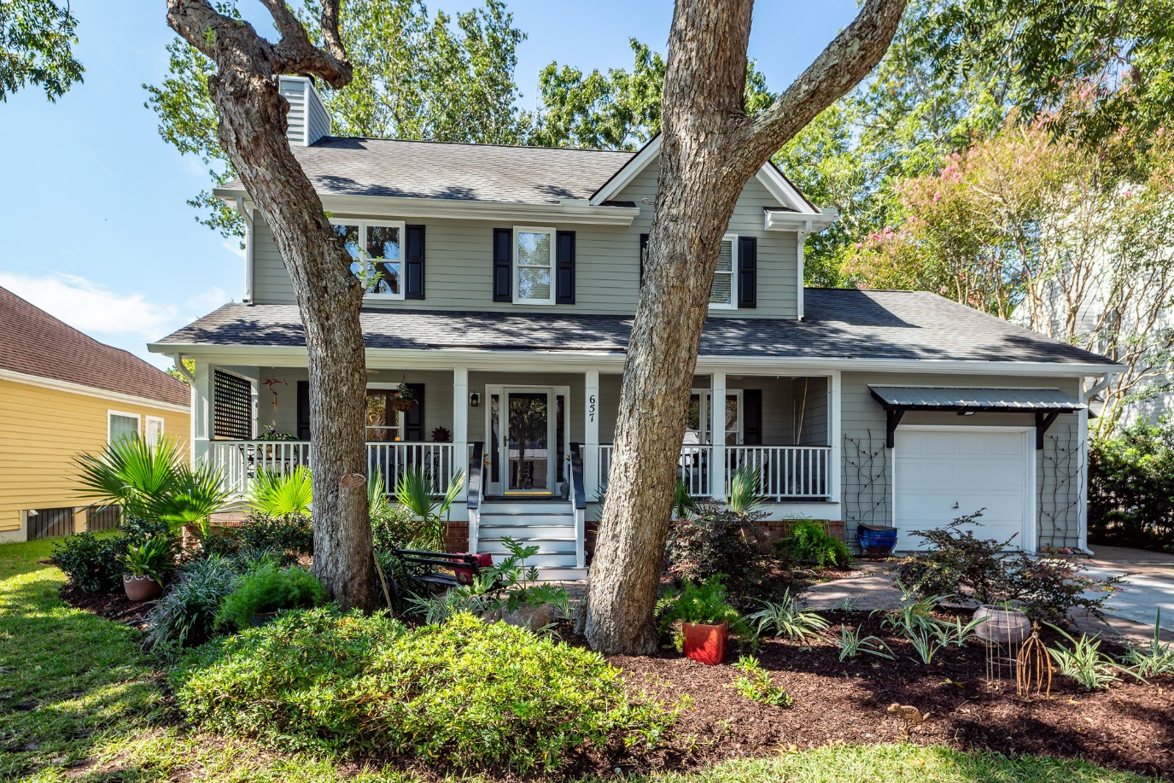
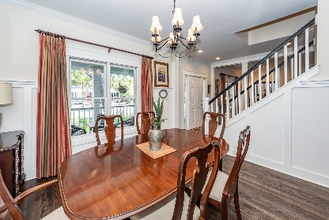
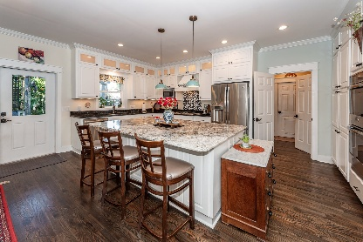
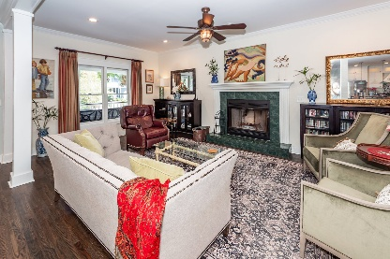
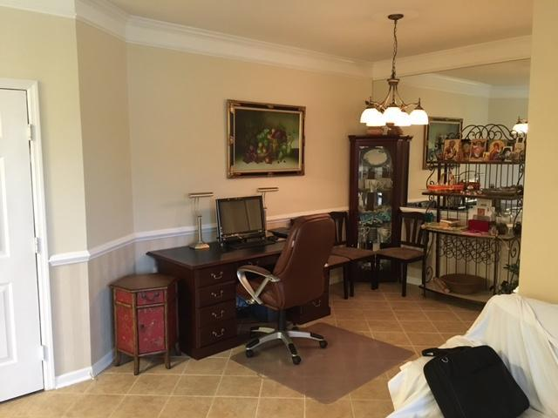
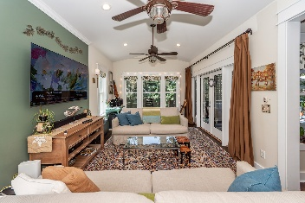
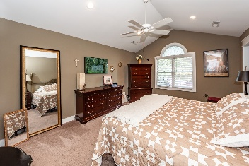
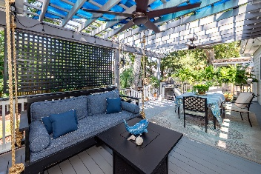
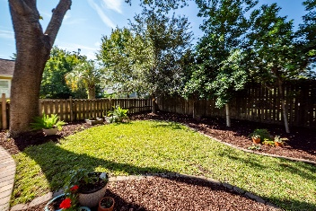
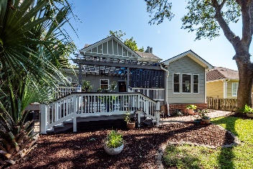



Price Drop, Pre-Listing Inspection, Encapsulated Crawl Space, Walk to Mt Pleasant Academy and only $300 HOA Fee!
OPEN HOUSE ON SUNDAY, 11/30 FROM 1-3PM
657 Gate Post Drive
Old Village Landing | Mount Pleasant | MLS# 25025435 | $1,665,000
Just off of Center Street, nestled in the picturesque Old Village Landing subdivision of Mount Pleasant, this 4-bedroom, 3-bath home captures the charm of Lowcountry living while offering all the comforts of modern updates. With 2,622 square feet of inviting living space, this home is more than a place to live—it's a place to create memories. Imagine walking to the Pitt Street Bridge at sunset, grabbing fresh produce at the local Farmers Market, or meeting friends for coffee just steps from your front door. Families will love being within walking distance to Mount Pleasant Academy and Moultrie Middle School, while everyone will appreciate the quick access to Charleston's Peninsula and the beaches just minutes away. Click on More for additional information!
Inside, timeless touches like gleaming hardwood floors, crown moulding, and smooth 9' ceilings create warmth and elegance. A cozy fireplace anchors the living room, while the heart of the home - a spacious kitchen with double ovens, a 36" gas stove, and a large island - invites cooking, gathering, and entertaining. The separate dining room is ready for holidays, celebrations, and everyday family dinners. The primary suite is a true retreat, featuring a vaulted ceiling, abundant natural light, and two walk-in closets. Outdoors, a full front porch welcomes neighbors with Southern charm, while the rear deck with grill hookup is perfect for summer barbecues and evenings under the stars. An outdoor storage building keeps everything neatly tucked away.
This home has been lovingly cared for with thoughtful updates: electrical wiring upgrade (2015), UV filter installed in the air handler, ductwork cleaned in 2024, Crawl Space Encapsulation including Dehumidifier was done in 2024, and a tankless hot water heater. Every detail has been designed to ensure both comfort and peace of mind. Whether it's morning walks to the water, afternoons on the porch, or evenings gathered around the fire, this home offers a lifestyle that is hard to match. Welcome to Old Village Landing - where community, convenience, and charm come together.
TAKE A VIRTUAL TOUR
Cheryll Woods-Flowers
843-442-2219
cflowers@woodsflowers.com
www.woodsflowers.com
Coldwell Banker Residential Brokerage | 1127 Queensborough Blvd | Suite 103 | Mt Pleasant, SC 29464

