Slide 1
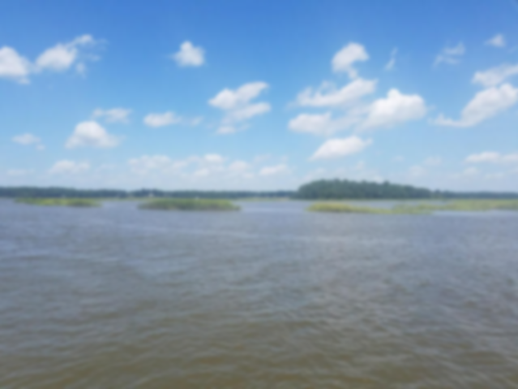

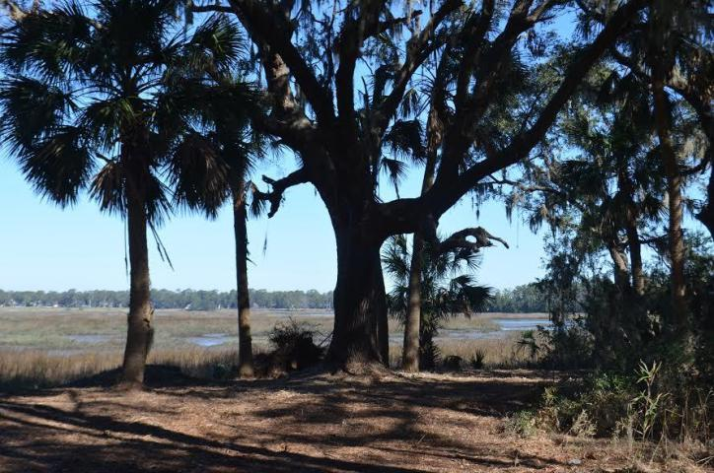
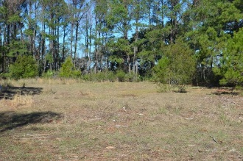
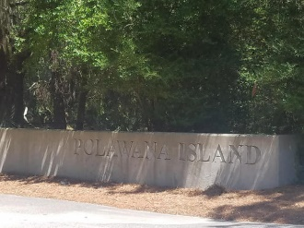
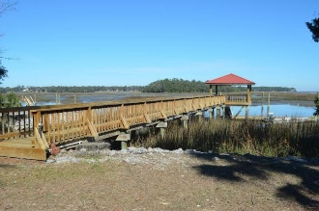
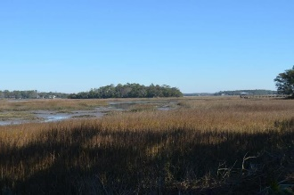
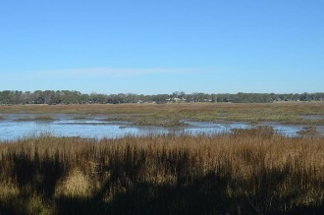
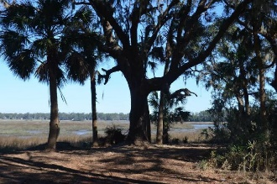
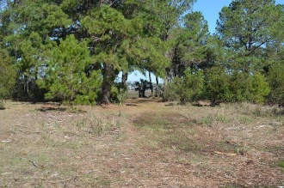
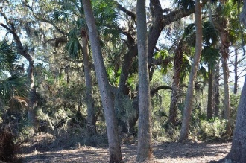
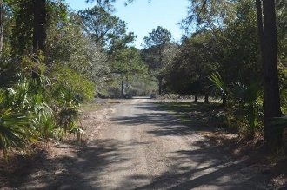
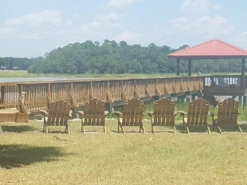
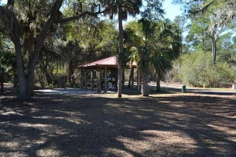
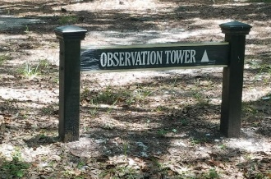
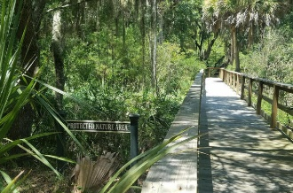
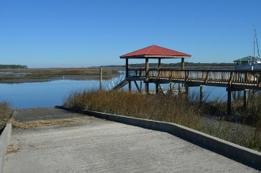
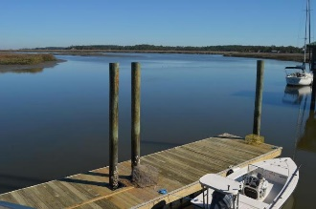




5+ Waterfront Acres for your dream home
65 Net Menders Loop
Polawana Island - St Helena Island, SC 29920
CHS MLS# 17011963 | BFT MLS# 364754 | $325,000
Beautiful sunsets and nature a plenty, this gorgeous 5.81 acre waterfront lot on Polawana Island is the perfect site to build your dream home. Polawana Island is located adjacent to Dataw Island just minutes from Historic Downtown Beaufort SC. This gated community offers owners privacy in a beautiful natural setting. Amenities include a community dock, boat ramp and pavilion, walking trails and 2 nature observation areas. Dock permit in hand! Motivated sellers! Bring all offers!
Lizzie Ray
(843) 452-9298
lizzieray1122@gmail.com
www.charlestonrealestategroup.com
Bryan Hughes
843.298.4313
BHughes@FoundationRealtyTeam.com
www.hiltonheadrealestates.com
Charleston Real Estate Group | 792 Folly Rd. C1 | Charleston, SC 29412
Foundation Realty | 22 Folly Field Road | Hilton Head Island, SC 29928

