Slide 1

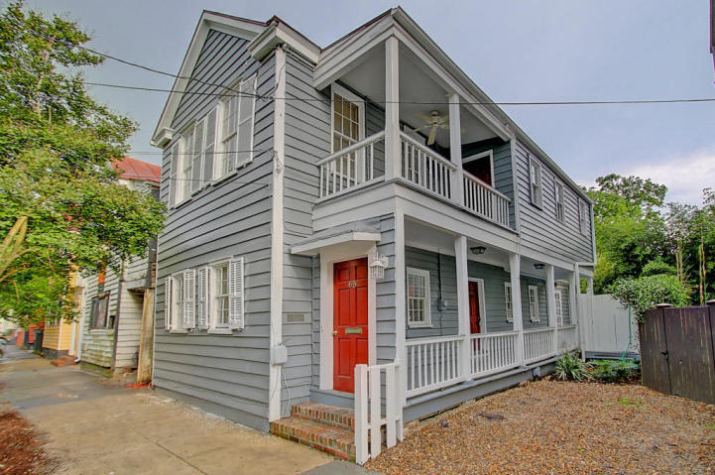
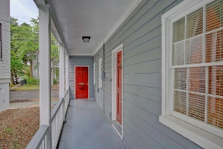
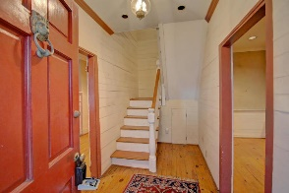
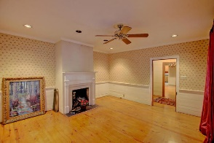
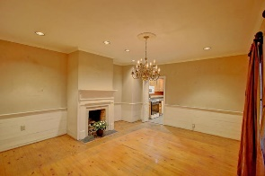
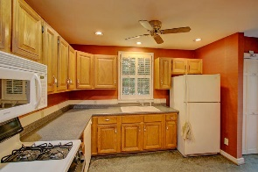
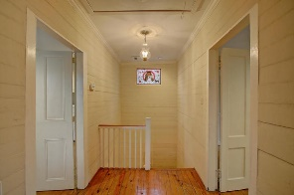
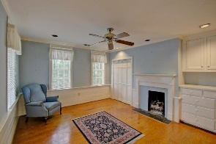
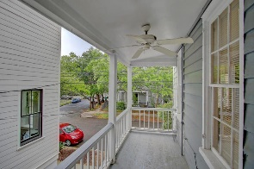
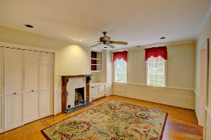

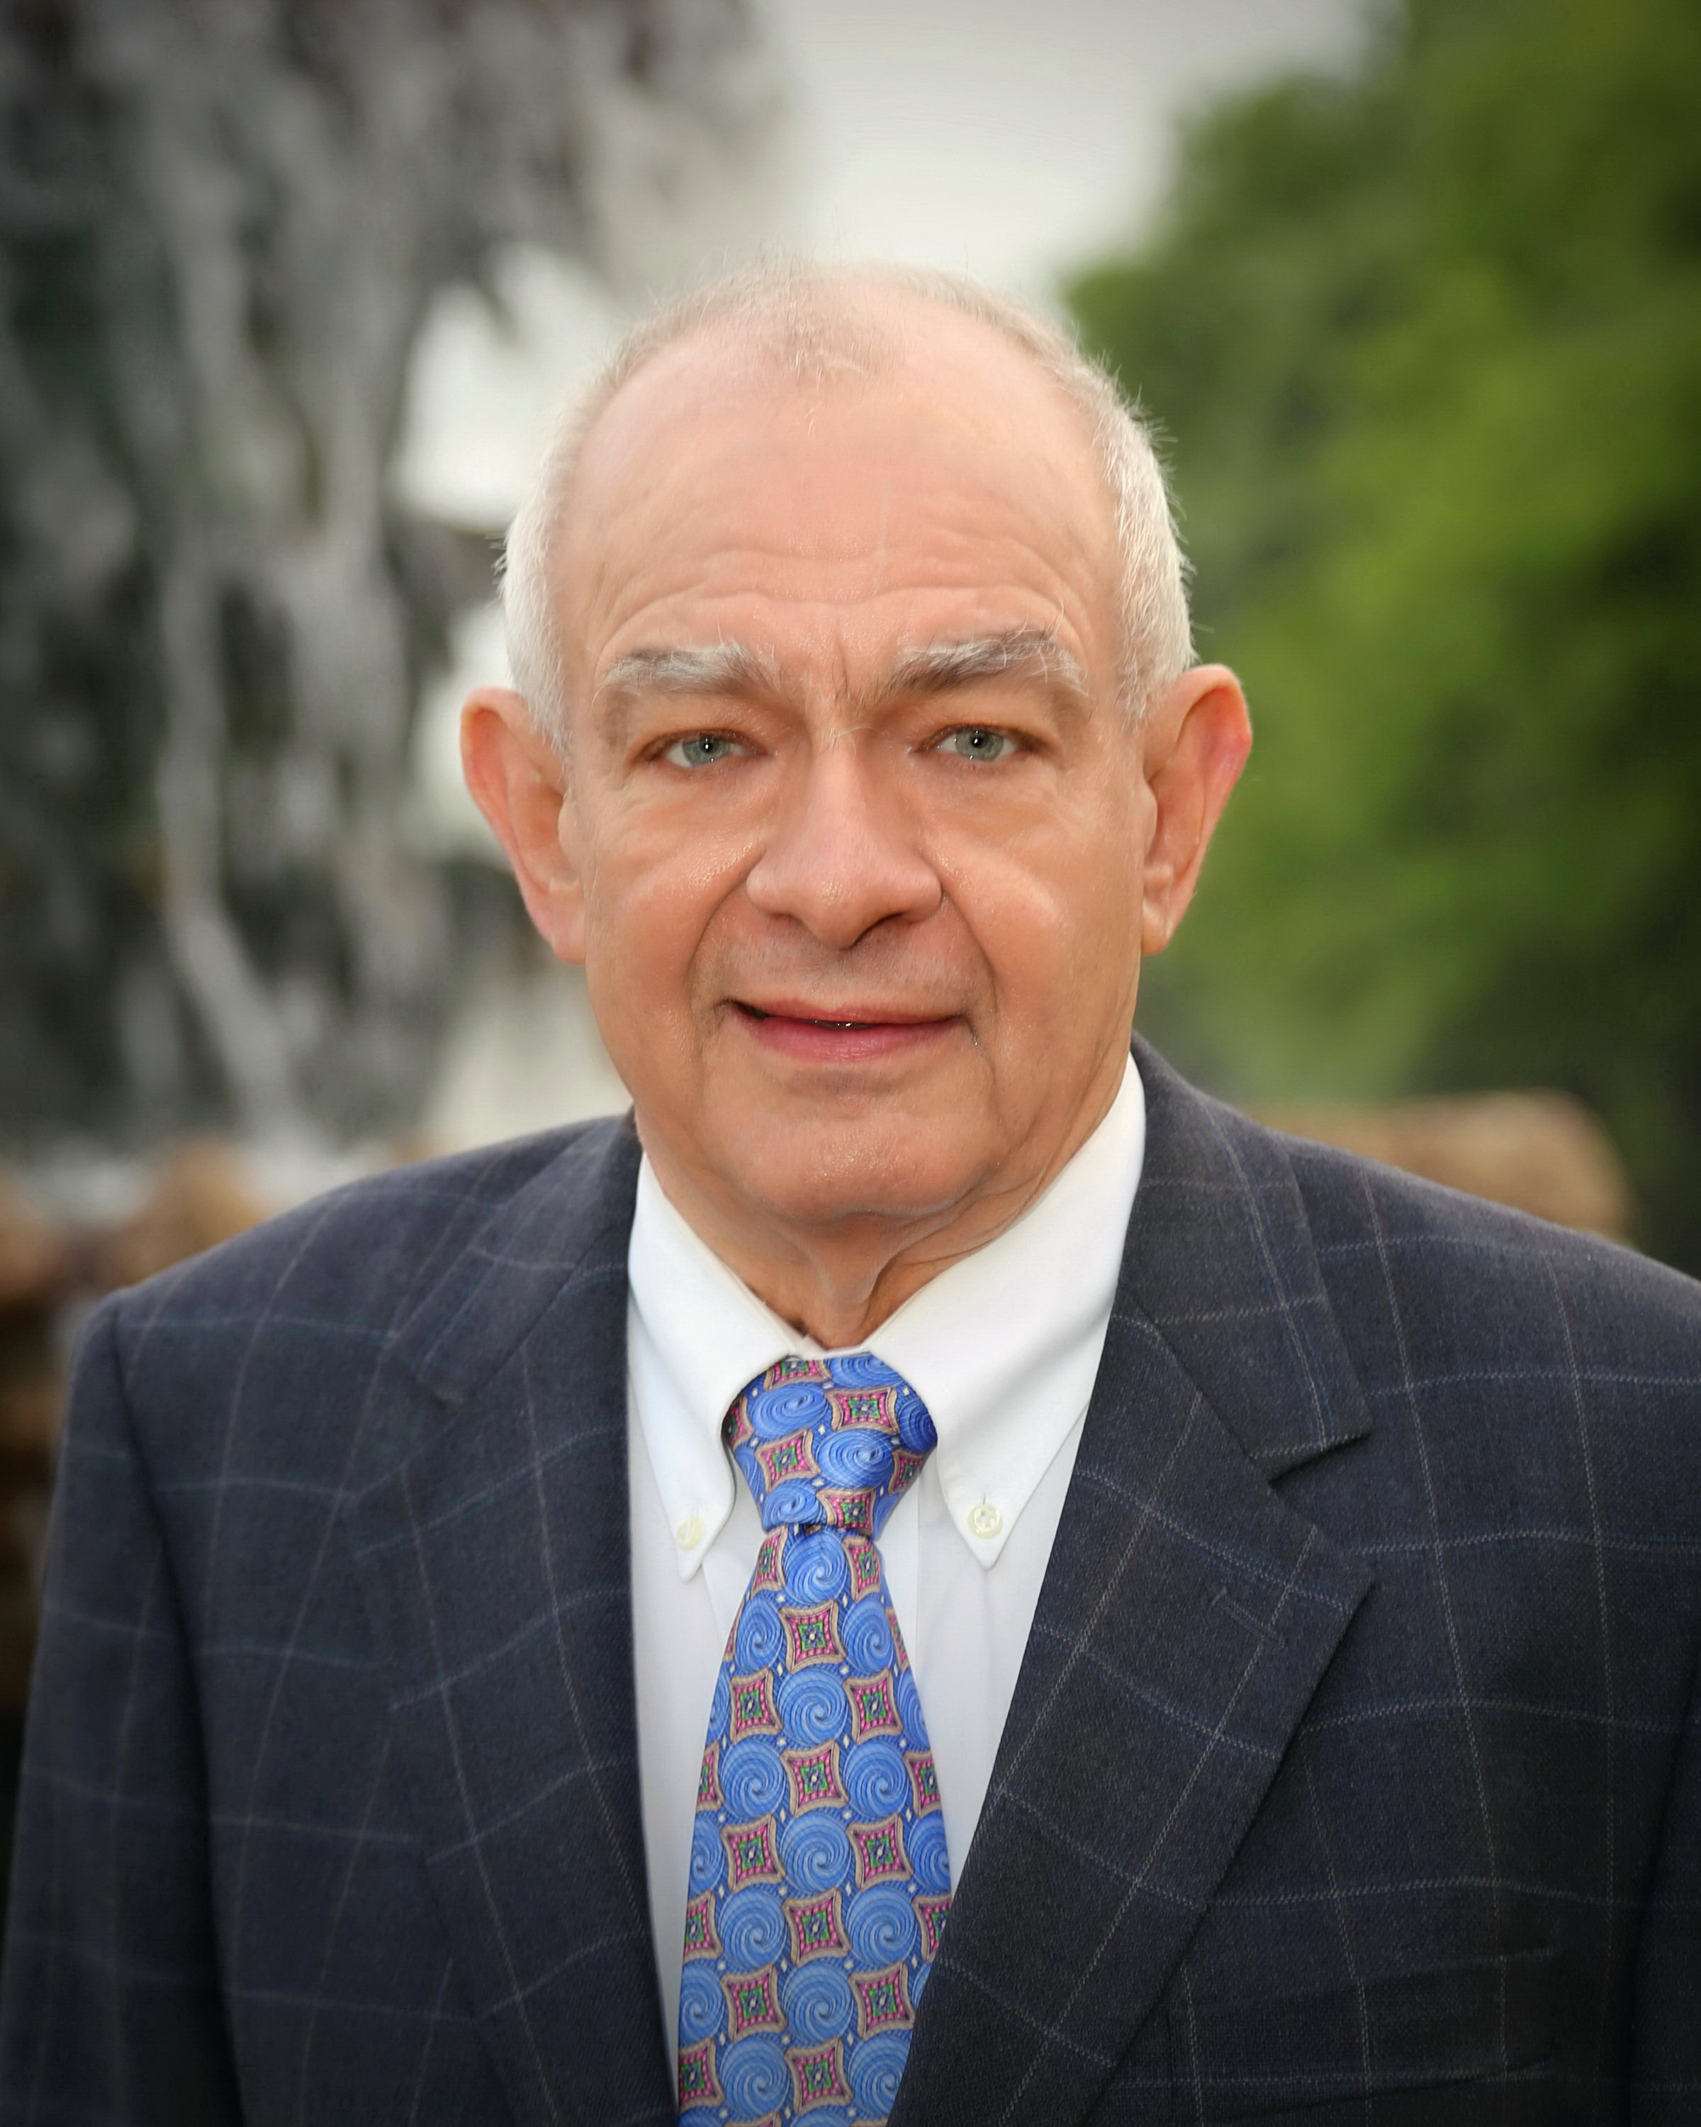
65 Radcliffe Street Radcliffeborough Charleston, SC 29403 MLS# 16011028 | $495,000
Great Neighborhood Great Bones!
Just Reduced!
Historic 1872 Charleston single house in central downtown location near upper King Street shops and restaurants. Easy walk to MUSC, Charleston School of Law. Four working fireplaces (three gas, one wood) and one off street parking place. Standing seam metal roof. Porches on both levels provide great circulation for entertaining. New custom home to the right and historic Charleston Single House under restoration to the left.
CSA Real Estate Services 339 Cabell Street
Charleston, SC 29407-6928
Doug Ludlum
(843) 452-8504
ludlum9834@aol.com
www.csarealestate.com

