Slide 1
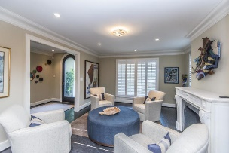
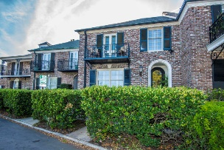
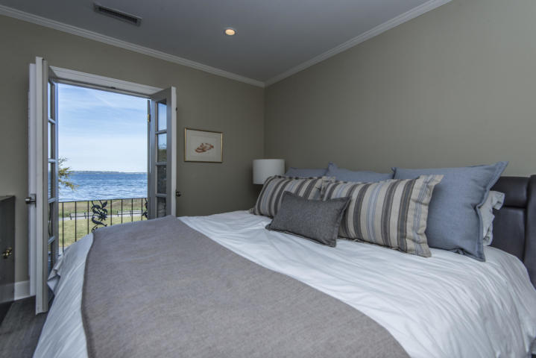
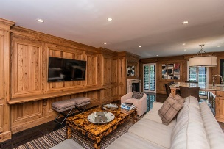
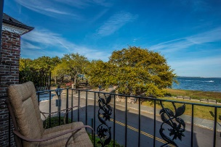
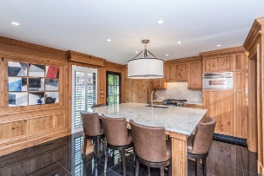
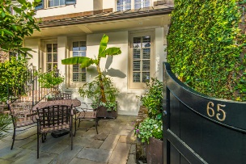
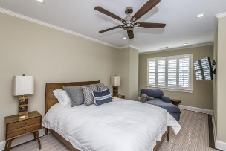
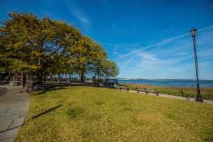


65 Concord Street #6 South of Broad ~ Charleston, SC 29401 MLS# 19009829 ~ $1,599,000
$150,000 PRICE REDUCTION
3.5% Buyer's Agent
Commission
MOTIVATED SELLER!!
This property offers breathtaking views of Charleston Harbor and Waterfront Park. This fully renovated home features an open floor plan, gorgeous kitchen with large granite island, high end appliances, pecky cypress paneling and a fireplace in the den/kitchen areas and fireplace in LR. Second floor offers 3 BR (dual master) w/ en-suite baths plus a third bedroom and conveniently stacked full-sized washer/dryer. The MBR has French doors opening onto a wrought iron balcony overlooking the harbor. In the rear is a lovely, private, landscaped walled-in garden patio with a water fountain, perfect for entertaining or relaxing and opens to one deeded parking spot off Exchange St. The crawl space is encapsulated and has a dehumidifier. This helps to reduce moisture; reduce the risk of mildew; keeps pipes safe from freezing; improves the quality of the air quality in the house and it helps with the heating/cooling of the house.
Sunday Lempesis
843-371-1076
sunday@carolinaone.com
Daniel Carabus
843-793-9265
dcarabus@carolinaone.com
Carolina One Real Estate
195 W Coleman Blvd
Mt Pleasant, SC 29464

