Slide 1
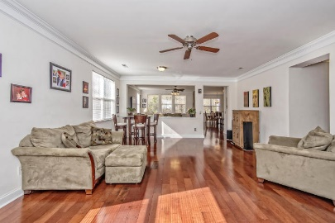
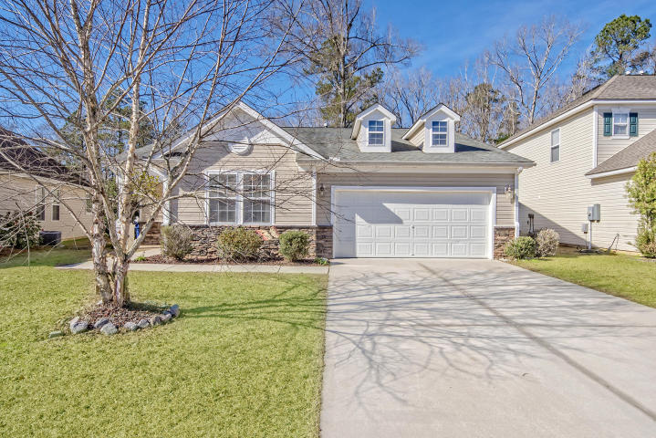
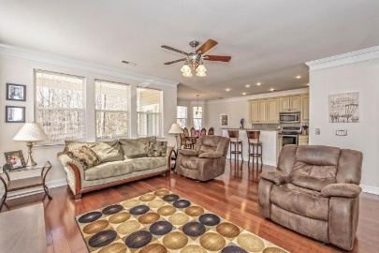
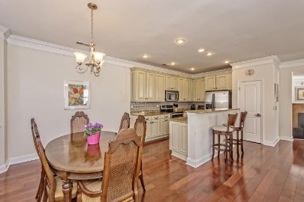
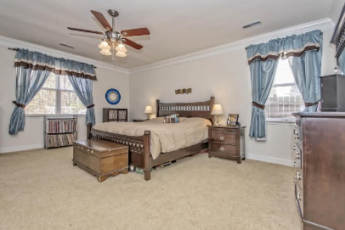
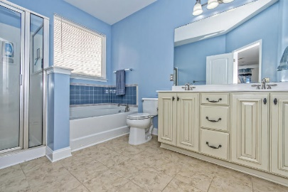
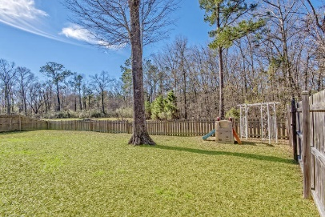
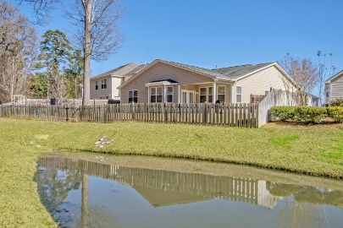


660 Grassy Hill Road
Blackberry Creek | Summerville | MLS# 17002281 | $224,900
$1,000 Agent Bonus
Just Listed!
There is so much to love about this upgraded one-story 3BR/2BA home.
Step inside to an open concept floor plan with hardwoods throughout except for carpet in bedrooms and tile in bathrooms and laundry room. The kitchen has raised-panel cabinet-doors, granite, tile back-splash, recessed lighting, island w/room for bar stools, SS appliances including fridge, bottom-mounted sink plus a pantry. The eat-in area can accommodate a large dining set. Relax in the great room off of the kitchen as well as celebrate family dinners in a separate formal dining area. The bonus room, currently being used as a playroom can be an office/den/guest room. The Master Suite is huge offering more than enough space for a king-size bedroom suite. Enjoy your backyard w/access to pond and no neighbors behind you. The fully fenced yard has 3 entry gates, French drains, a covered patio with plenty of room to play, garden or just relax. There is also a new gas fireplace stand-alone unit that has never been used. One of the huge benefits of this home is the Energy Efficiency. There is a radiant barrier in the attic that helps to lower the utility bills. Other important features include gutters, storm door, 9' ceilings, heavy crown moulding, double-tab roof shingles, upgraded light fixtures, added back splash in Master bathroom by garden tub. Extended warranty on AC unit exp. 1/2018, transferable termite bond w/Clarks. This one-story floor plan built by KB Homes is the largest one offered at the time neighborhood was being built. There are also walking trails w/bridges and ponds plus a large picnic pavilion. Desirable DD2 schools less than 1.5 miles away, Close proximity to I-26, shopping, restaurants, downtown Charleston and area beaches.
See more of this home at: http://zyndicate.co/660Grassy-branded.html
Beth Mandell
M 843-900-1296 | O 843-871-2121
bmandell@century21properties.com
www.bestcarolinahomedeals.com
Century 21 Properties Plus of Summerville | 118 W Richardson Ave | Summerville, SC 29483

