Slide 1
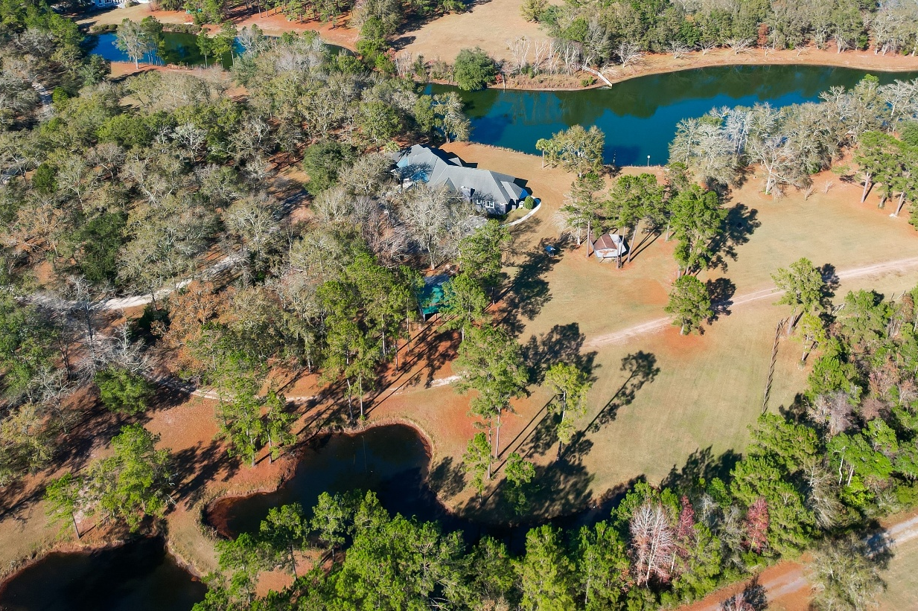
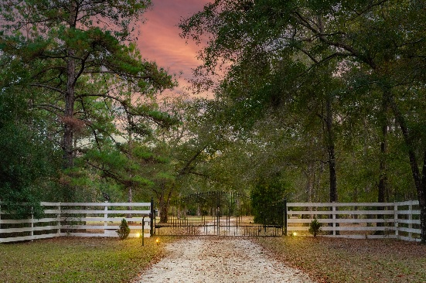
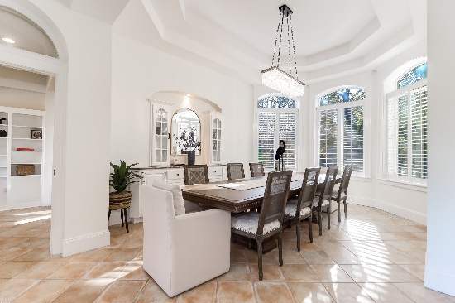
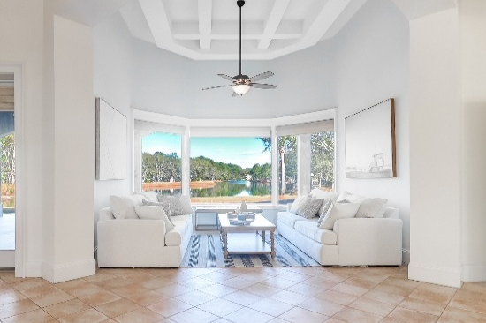
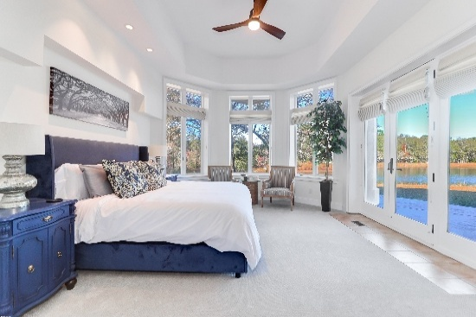
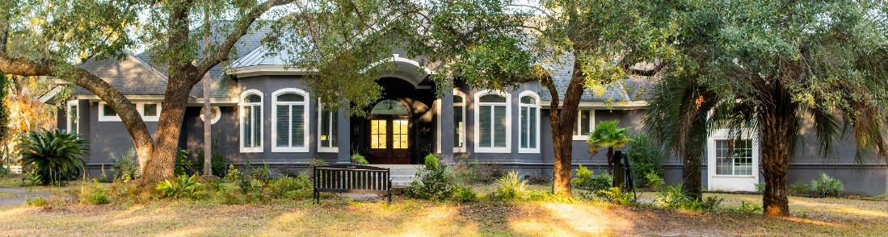
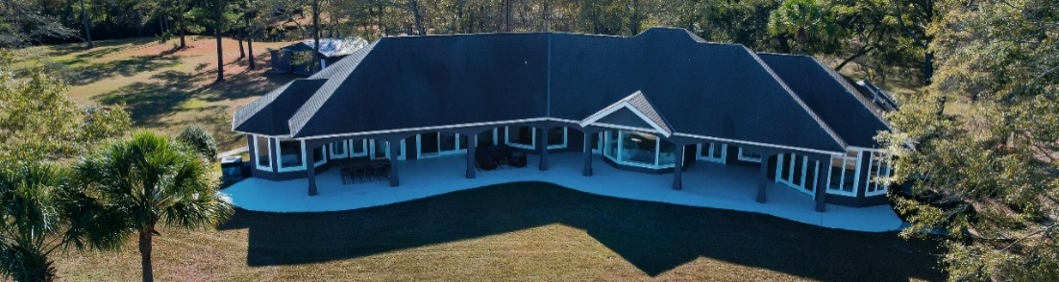


Private 26 Acre Gated Luxury Lakefront Home
4.2 Acres
6615 Old Jacksonboro Rd
Ravenel, SC 29470
MLS# 25033073 | $2,499,000
3 Bedrooms | 3½ Bathrooms | 3885 SF
The perfect place for a private sanctuary, multigeneration retreat, family community or
income generating investment.
For more information or a tour of the most serene breathtaking property around give me a call.
Christina Garvin
843-270-7667
cgarvin63@gmail.com
kayreg.com
Kay Real Estate Group, LLC
1 Carriage Ln BLDG D
Charleston, SC 29407

