Slide 1
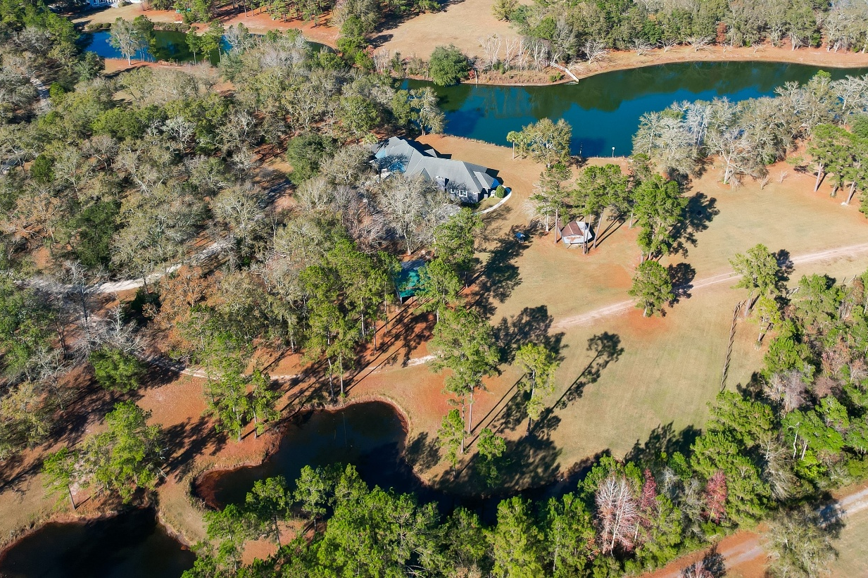
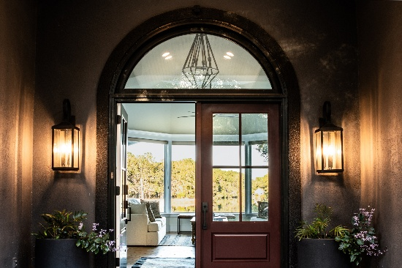
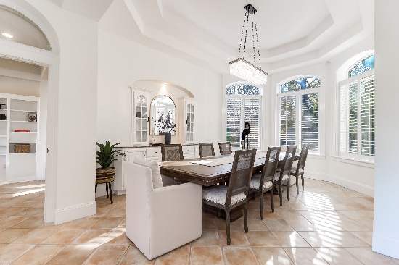
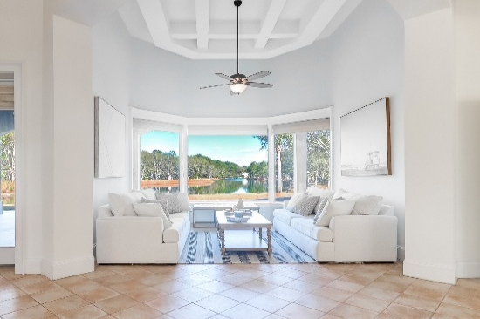
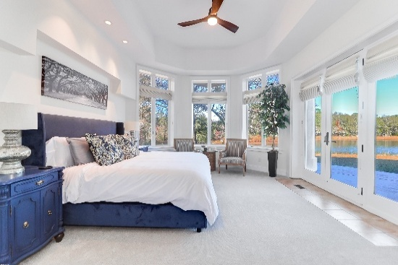
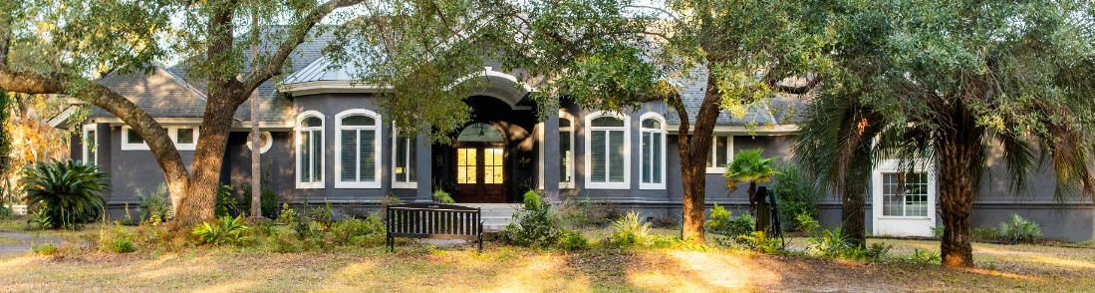
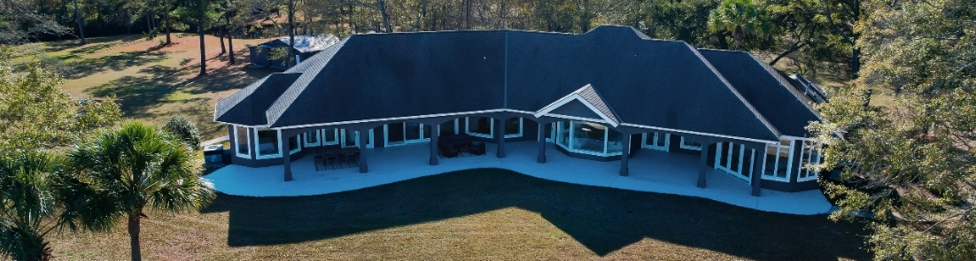


Sneak Preview
Coming end of December
26-acre Gated Lakefront Estate
4.2 Acres
6615 Old Jacksonboro Rd
Ravenel, SC 29470
3 Bedrooms | 3½ Bathrooms | 3885 SF
Christina Garvin
843-270-7667
cgarvin63@gmail.com
kayreg.com
Kay Real Estate Group, LLC
1 Carriage Ln BLDG D
Charleston, SC 29407

