Slide 1
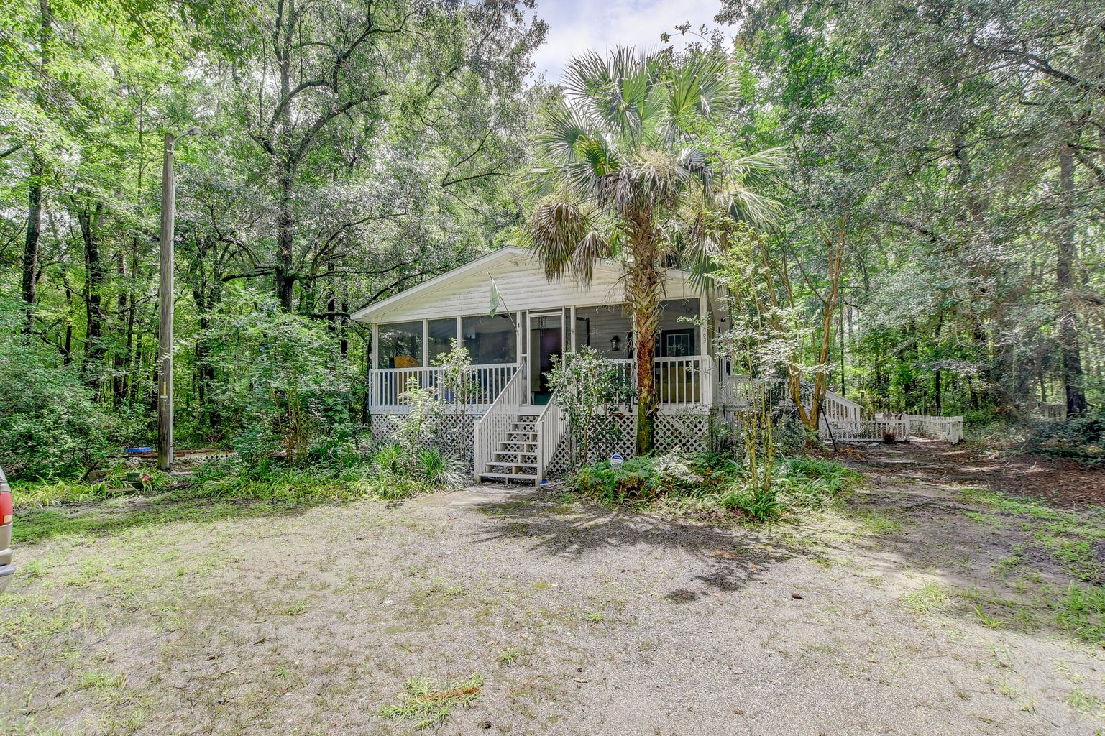

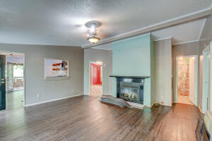
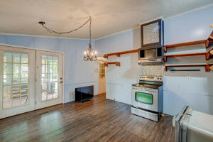
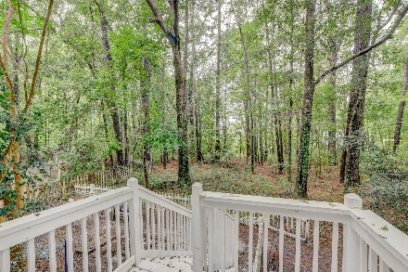
Price Improvement!
OPEN HOUSE
SATURDAY 12-3
Open House Saturday 12-3
663 Main Road
Johns Island, SC 29455 ~ MLS# 22023206
$299,900
Tucked away off Main Road on Johns Island, you'll find a home and a detached structure nestled on 2 serene wooded acres with mature trees, flowers, and bushes. Enter this home to find the family room with a fireplace. Pass through to find the eat-in kitchen. The large primary bedroom has an en-suite bath. Two additional bedrooms, a full bathroom, and a laundry room complete the interior of the home. A screened porch and a new deck are great spots to enjoy the views. Outside, a detached building and a storage building can also be found on the property. This property is location 1.1 miles from the Limehouse Boat Landing, 2.6 miles from Publix, 4.8 miles from shopping and dining at the West Ashley Circle, and 11.9 miles from downtown Charleston.
*Seller to make no repairs.
Book your showing today!
Stacy Danosky sdanosky@mattoneillteam.com 843-860-8048

