Slide 1
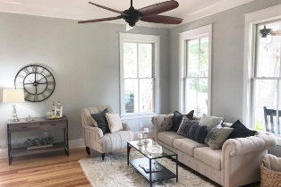
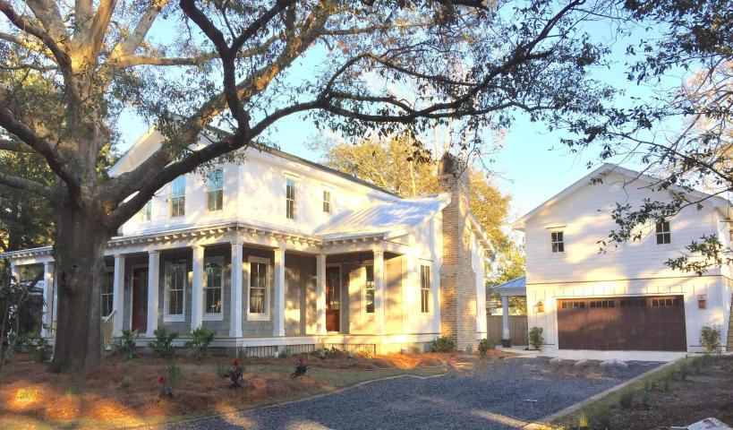
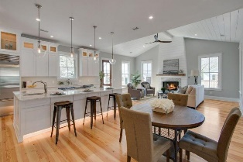
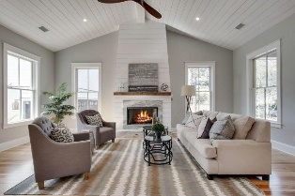
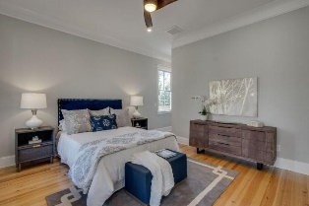
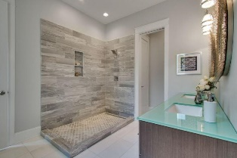
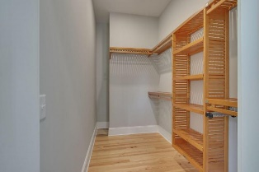
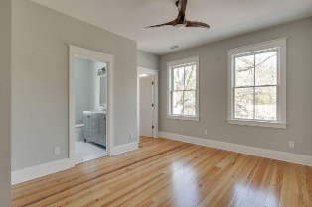
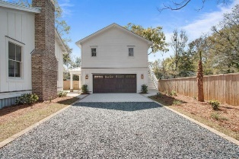
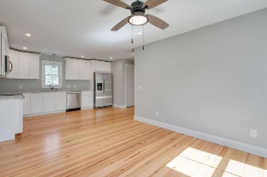

667 Adluh Street
Mount Pleasant, SC 29464
MLS# 18008738 ~ $1,485,000
Old Village Charm
Open House Saturday 11-2
Nestled in the heart of Old Mt Pleasant this beautiful newly built home offers a total of 5 Bedrooms, 5 1/2 Baths, shiplap cathedral ceiling and a very open first floor living area. Every detail has been attended to from the custom design to the superb finishes throughout. The "chef" in your family will marvel at the gourmet Kitchen which includes a 48" Wolf Gas range incorporated in the 10' x 5.5' island featuring a translucent under-lit Quartzite counter, down draft ventilation system & prep sink. The Kitchen includes a Sub-Zero Refrigerator, 156 bottle Wine/Beverage cooler, and Microwave Drawer. The Kitchen opens into a spacious area that includes Living, Dining, and Family Rooms. Enjoy the look and feel of southern charm with the gorgeous new heart pine floors which are throughout the home. Relax in front of the custom shiplap faced gas fire place with a repurposed heart pine mantle from the original home at this location.
Check out the listing to see more details!
Lloyd Realty
838 McCants Dr.
Mt. Pleasant, SC 29464
John Lloyd
(843) 732-1607
john_lloyd@hotmail.com

