Slide 1
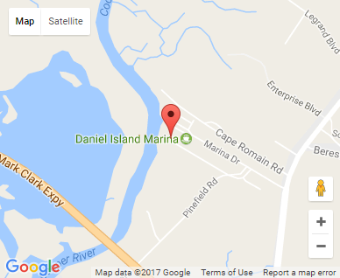
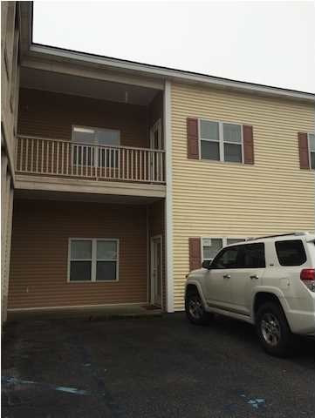


Small Office Investment
668 Marina Dr #D100
Charleston, SC 29492
OFFICE FOR SALE
959 Square feet office suite leased to one tenant.
The entire portfolio is for sale at $135 per square foot and is listed in the MLS.
Catylist ID: | #29893111
Building Size (RSF): | 959 SF
Sale Price: | $136,178
Unit Price: | $142 PSF
Zoning: | GC - General Commercial District
Class of Space: | Class B
Cap Rate: | 7.2%
County: | Berkeley
Tax ID/APN: | 271-10-01-019
David H Seay
CCIM, BIC, CCIM, REALTOR
(843) 364-6720
david@seaydevelopment.com
Seay Development, LLC
3404-202A Salterbeck Street
Mt. Pleasant, SC 29466 www.seaydevelopment.com

