Slide 1
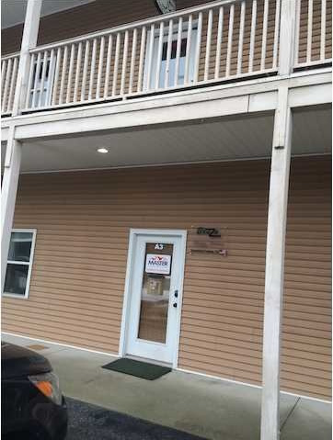
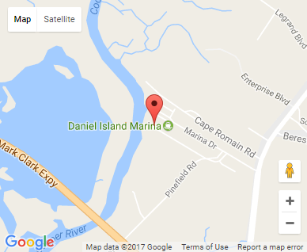


Small Office Investment
668 Marina Dr #D101
Charleston, SC 29492
OFFICE FOR SALE
958 SQUARE FEET OF CLASS B OFFICE SPACE FOR SALE IN THE DANIEL ISLAND MARINA OFFICE CONDO DEVELOPMENT CONSISTING OF ONE TENANT.
Catylist ID: | #29893112
Building Size (RSF): | 958 SF
Sale Price: | $136,036
Unit Price: | $142 PSF
Zoning: | GC - General Commercial District
Class of Space: | Class B
Cap Rate: | 7.21%
County: | Berkeley
Tax ID/APN: | 271-10-01-020
David H Seay
CCIM, BIC, CCIM, REALTOR
(843) 364-6720
david@seaydevelopment.com
Seay Development, LLC
3404-202A Salterbeck Street
Mt. Pleasant, SC 29466 www.seaydevelopment.com

