Slide 1
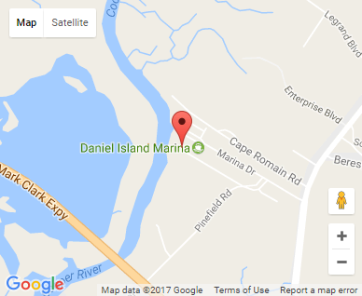
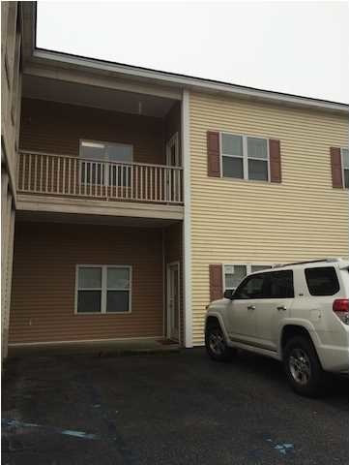


VACANT
668 Marina Dr #D203
Charleston, SC 29492
OFFICE FOR SALE
Get to work fast and get anywhere even faster with close proximity to Clement's Ferry Road, I-526, the CHS Airport and Highway 17 or Long Point Road in minutes. Demographics are strong here for "High Society" and Urban Tapestry". Easy access to I-526 via Clement's Ferry Road. TMS: 27110010030 and 031. DEED SQFT: 2,004 . This entire portfolio is for sale and listing in the MLS at $135 per square feet.
Catylist ID: | #29893118
Building Size (RSF): | 2,004 SF
Sale Price: | $284,568
Unit Price: | $142 PSF
Zoning: | GC - General Commercial District
Class of Space: | Class B
Cap Rate: | Undisclosed
County: | Berkeley
Tax ID/APN: | 271-10-01-030
David H Seay
CCIM, BIC, CCIM, REALTOR
(843) 364-6720
david@seaydevelopment.com
Seay Development, LLC
3404-202A Salterbeck Street
Mt. Pleasant, SC 29466 www.seaydevelopment.com

