Slide 1
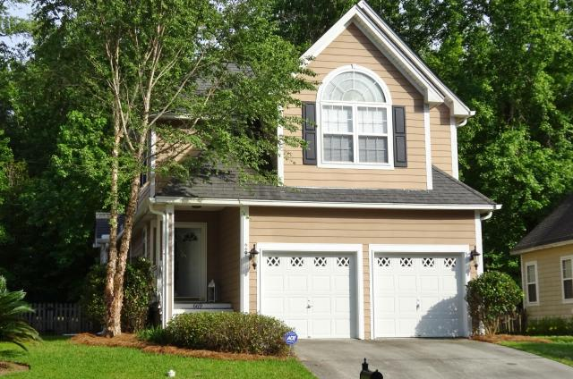
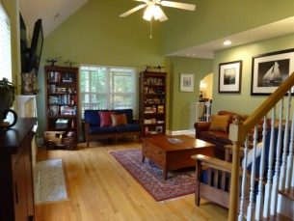
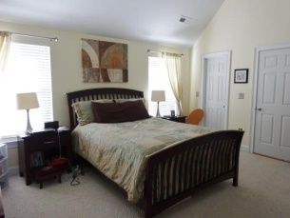
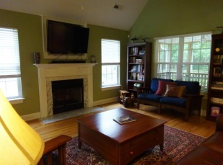
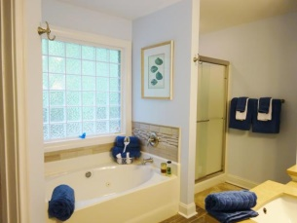
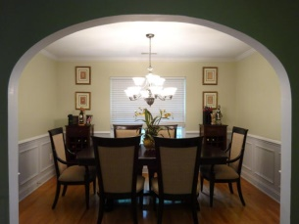
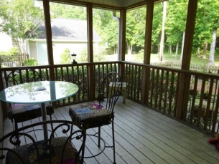
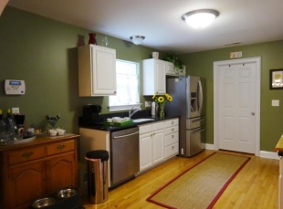
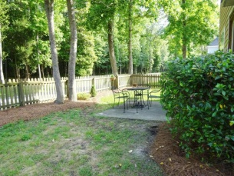


This Home Is A Must See!
669 Fair Spring Dr
Schieveling Plantation
Charleston
MLS# 15012973
$269,900
Beautiful Well Maintained Home in the highly desired Schieveling Plantation! This home has all of the upgrades you could want! Downstairs features hardwood floors throughout with a large 2 story family room with a gas burning fireplace. Beyond the family room is the bright open kitchen with granite countertops and smooth top stove. The Kitchen opens up to the formal Dining room featuring wainscoting and crown molding. Upstairs features 2 very large guest bedrooms, and a very large master suite fully equipped with his and hers walk in closets! The master and guest bathrooms have been completely renovated featuring furniture quality vanities, framed mirrors, and custom tile work! The master bath will be your spa escape with a large garden tub and walk in shower!
Karrie Britton
M - (843) 478-9638
design_elements@msn.com

