Slide 1

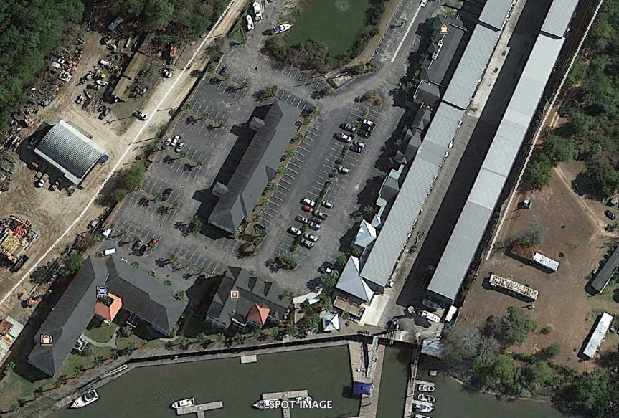
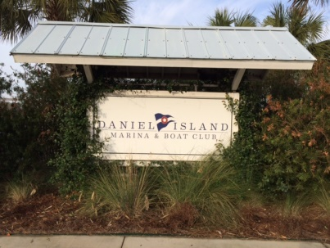
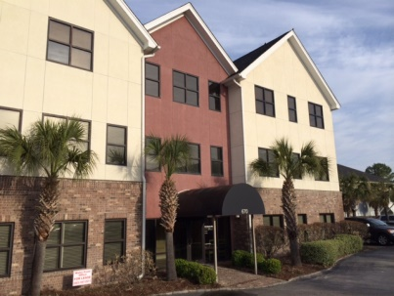


Turnkey Investment Property 100% Occupied
Charleston Investment Property for Sale – Daniel Island Marina Investment Portfolio for Sale
6.5% CAP ($155 PSF or $3,546,090)
This is an investment portfolio, fully leased, currently managed and ready to sell. Call now for tours and further information. A detailed rent roll (12 Tenants), pro forma and floor plans are available upon request. A phenomenal location in close proximity to 526 Clements Ferry and Highway 41, makes this a portfolio that leases well and is well run by local management. The tenants are seasoned and many have multiple options to renew. ERSI area demographics segment "High Society" and "Upscale Avenues" as abundant in this area. Call for more information and see attachments and pictures. The Marina allows pedestrian use of the boardwalks, seating areas and cafe for lunch or breaks away from the office. Please do not approach Tenants or property without an appointment.
Address: 669 MARINA DR
Area: BER-Wando/Cainhoy Area
Building Square Feet: 22878
Category: details
City: CHARLESTON
County: Berkeley
Listing ID: 1407740
Listing Price: $3,546,090
Net Operating Income: 230526
Property Name: DANIEL ISLAND MARINA

