Slide 1
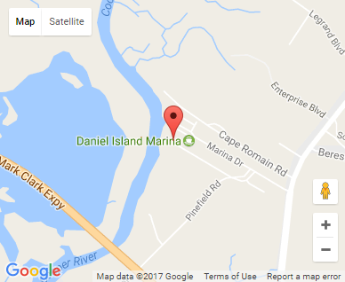
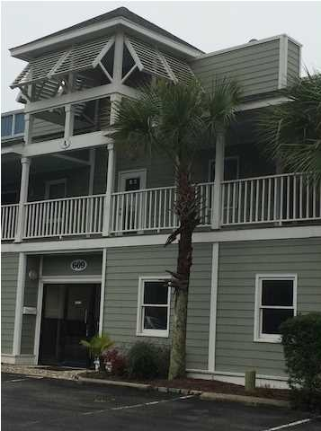


Small Office Investment
669 Marina Dr #A201
Charleston, SC 29492
OFFICE FOR SALE
867 Square Feet of Class B Office Space for Sale in the Daniel Island Marina Office Condo Development. Get to work fast and get anywhere even faster with close proximity to Clement's Ferry Road, I-526, the CHS Airport and Highway 17 or Long Point Road in minutes. This space is currently occupied so call for terms of the lease.
Catylist ID: | #29893104
Building Size (RSF): | 867 SF
Sale Price: | $123,114
Unit Price: | $142 PSF
Property Use Type: | Net Leased Investment (NNN), Investment, Business
Class of Space: | Class B
Cap Rate: | 7.49%
County: | Berkeley
Tax ID/APN: | 271-10-01-004
David H Seay
CCIM, BIC, CCIM, REALTOR
(843) 364-6720
david@seaydevelopment.com
Seay Development, LLC
3404-202A Salterbeck Street
Mt. Pleasant, SC 29466
www.seaydevelopment.com

