Slide 1
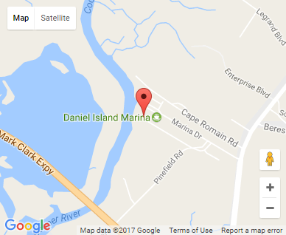
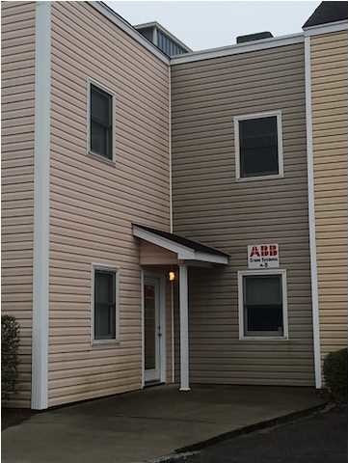


Small Office Investment
669 Marina Dr #B100
Charleston, SC 29492
OFFICE FOR SALE
2,020 Square Feet of Class B Office Space for Sale in the Daniel Island Marina Office Condo Development consisting of one tenant. Office consists of two tax map numbers (006 and 007). Get to work fast and get anywhere even faster with close proximity to Clement's Ferry Road, i-526, the CHS Airport and Highway 17 or Long Point Road in minutes. This space is currently occupied so call for terms of the lease. Demographics are strong here for "High Society" and Urban Tapestry". Easy access to I-526 via Clement's Ferry Road.
Catylist ID: | #29893106
Building Size (RSF): | 2,020 SF
Sale Price: | $286,840
Unit Price: | $142 PSF
Property Use Type: | Net Leased Investment (NNN), Investment, Business
Class of Space: | Class B
Cap Rate: | 6.12%
County: | Berkeley
Tax ID/APN: | 271-10-01-006
David H Seay
CCIM, BIC, CCIM, REALTOR
(843) 364-6720
david@seaydevelopment.com
Seay Development, LLC
3404-202A Salterbeck Street
Mt. Pleasant, SC 29466 www.seaydevelopment.com

