Slide 1
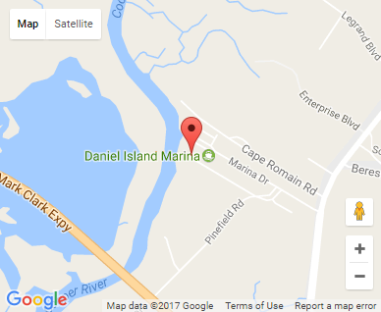
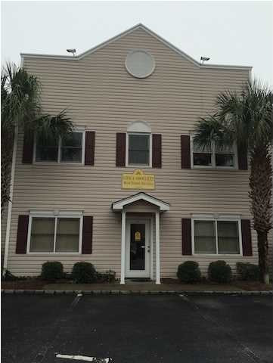


Small Office Investment
669 Marina Dr #B200
Charleston, SC 29492
OFFICE FOR SALE
1,050 Square Feet of Class B Office Space for Sale in the Daniel Island Marina Office Condo Development consisting of one tenant. TMS: 2711001010. The entire portfolio is for sale as well in the MLS.
Catylist ID: | #29893107
Building Size (RSF): | 1,050 SF
Sale Price: | $149,100
Unit Price: | $142 PSF
Property Use Type: | Net Leased Investment (NNN), Investment, Business
Class of Space: | Class B
Cap Rate: | 6.5%
County: | Berkeley
Tax ID/APN: | 271-10-01-010
David H Seay
CCIM, BIC, CCIM, REALTOR
(843) 364-6720
david@seaydevelopment.com
Seay Development, LLC
3404-202A Salterbeck Street
Mt. Pleasant, SC 29466 www.seaydevelopment.com

