Slide 1
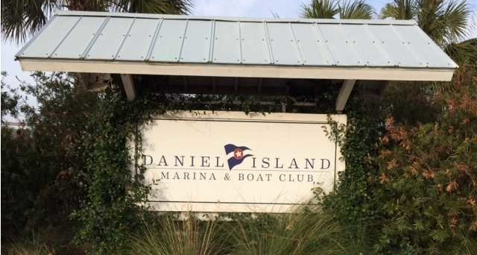
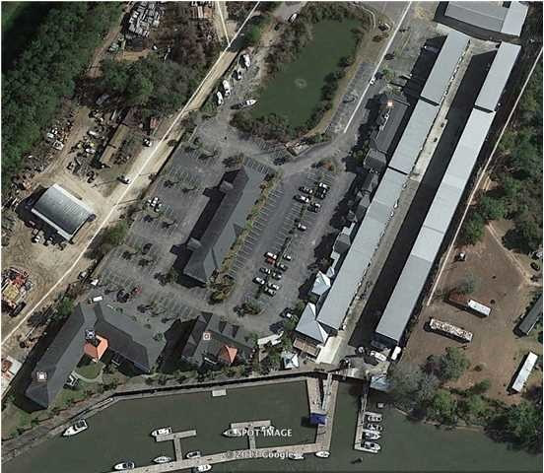
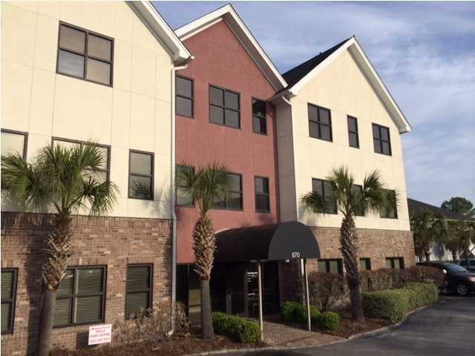
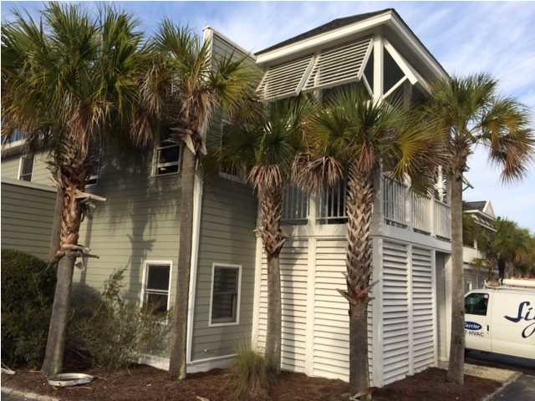
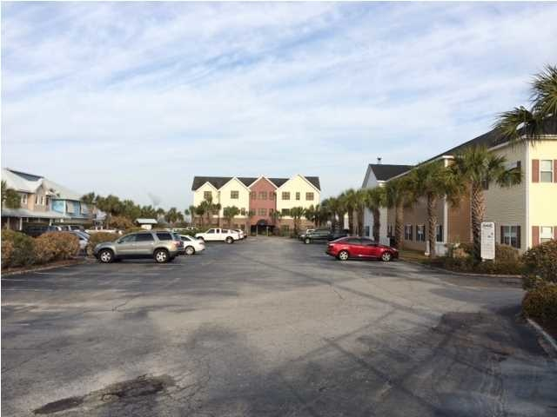
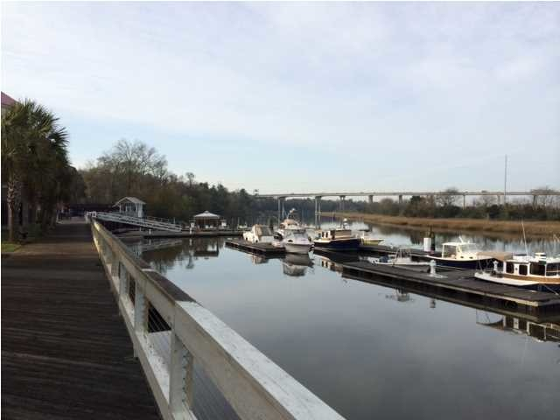


DANIEL ISLAND MARINA
669 Marina Drive
Charleston, SC 29492
OFFICE FOR SALE
This is an investment portfolio, fully leased, currently managed and ready to sell. Call now for tours and further information. A detailed rent roll (12 Tenants), pro forma and floor plans are available upon request. A phenomenal location in close proximity to 526 Clements Ferry and Highway 41, makes this a portfolio that leases well and is well run by local management. The tenants are seasoned and many have multiple options to renew. ERSI area demographics segment "High Society" and "Upscale Avenues" as abundant in this area. The Marina allows pedestrian use of the boardwalks, seating areas and cafe for lunch or breaks away from the office. Please do not approach Tenants or property without an appointment.
Catylist ID: | #29893105
Building Size (RSF): | 20,344 SF
Sale Price: | $2,746,440
Unit Price: | $135 PSF
Property Use Type: | Net Leased Investment (NNN), Investment, Business
Class of Space: | Class B
Cap Rate: | 8.05%
County: | Berkeley
Tax ID/APN: | 271-10-01-004
David H Seay
CCIM, BIC, CCIM, REALTOR
(843) 364-6720
david@seaydevelopment.com
Seay Development, LLC
3404-202A Salterbeck Street
Mt. Pleasant, SC 29466
www.seaydevelopment.com

