Slide 1
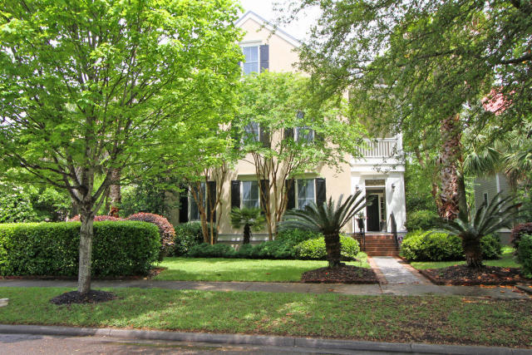
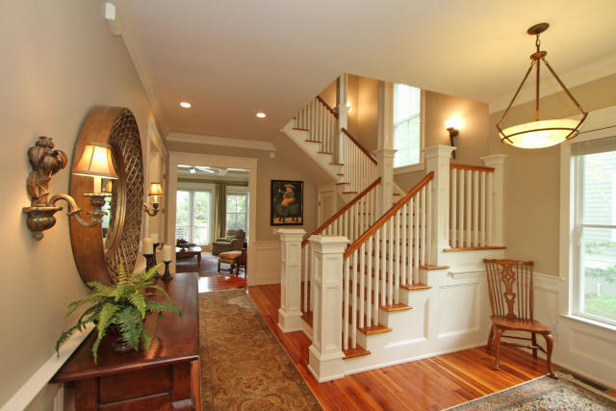
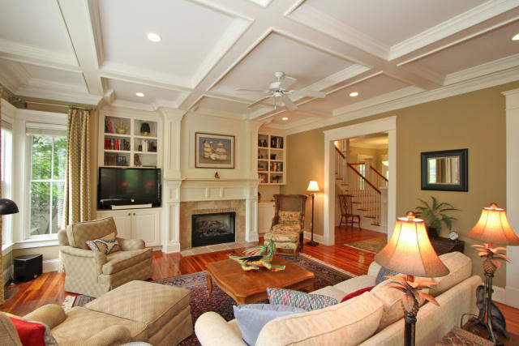

66 Dalton Street Daniel Island
Price Reduction on this Beautiful Daniel Island Park Home
MLS: 15011493 LP:$1,000,000
Larry Mead 843.754.5040 larry.mead@carolinaone.com

