Slide 1
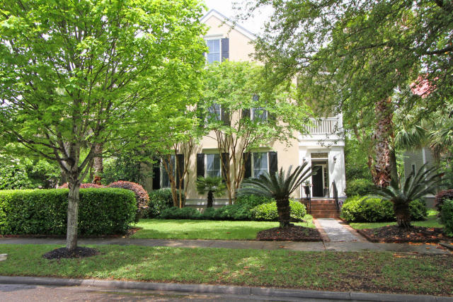
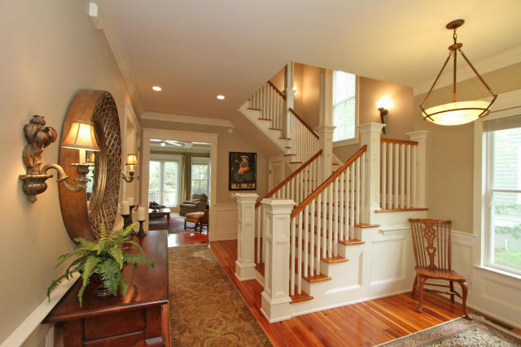
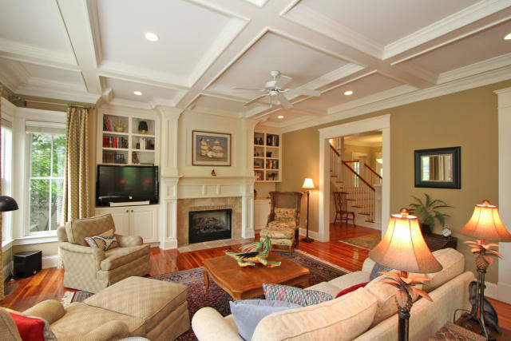

66 Dalton Street Daniel Island
$5,000 Selling Agent BONUS with Ratified Contract by 9/15/15
MLS: 15011493 LP:$1,150,000
Larry Mead 843.754.5040 larry.mead@carolinaone.com

