Slide 1
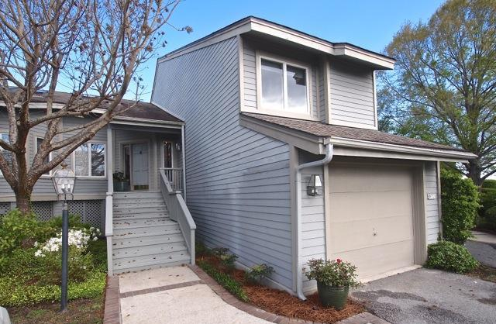
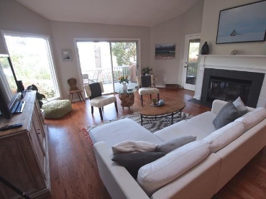
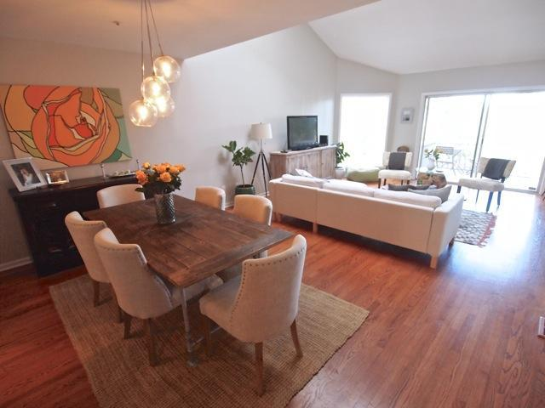
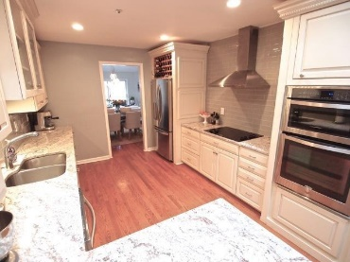
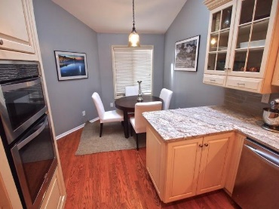
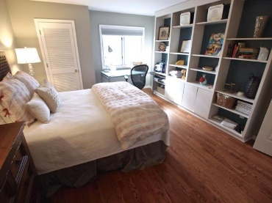
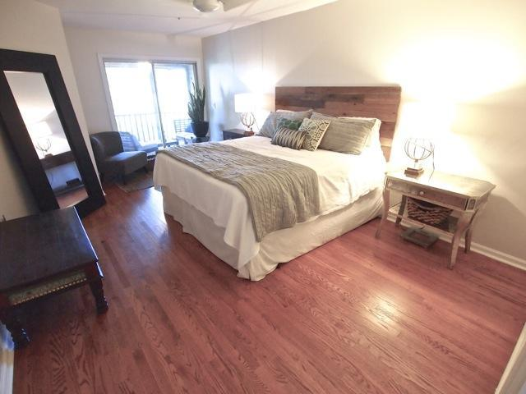
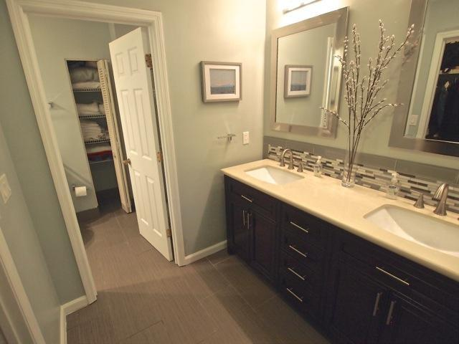
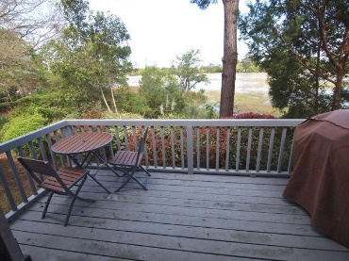
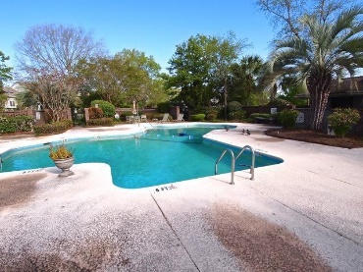


670 Harbor Creek Place Harbor Creek Charleston, SC 29412 MLS# 16009643 $399,000
Location! Location! Location! Minutes to Downtown Charleston and close to Folly Beach.
This beautiful marsh & water front townhouse/condo community is Island Living at its finest. The total renovation($70k)condo has new kitchen cabinets, new granite counter tops, new floor, new backsplash and new upgraded appliances. Popcorn ceiling removed in entire home. All new paint, all refinished wood floors, complete renovations on both bathrooms.
Lovely marsh view, screened porch to enjoy lovely Charleston outdoor living. Fire place in family room. One car garage and storage space. There is an extra space in the attic which you can access from on of the master bedroom closets. This bright open floor plan home will welcome you.
Cathy Rosenblum
843-817-7869
crosenblum@comcast.net

