Slide 1
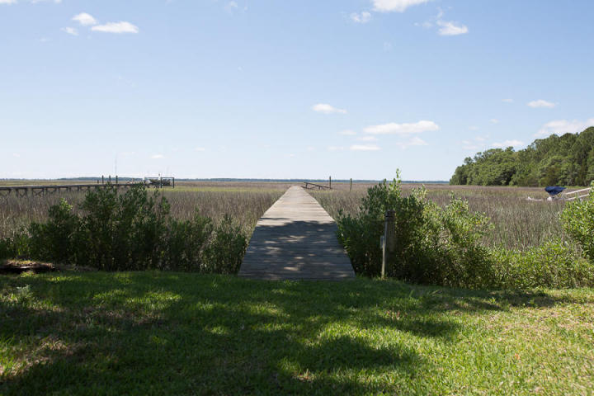
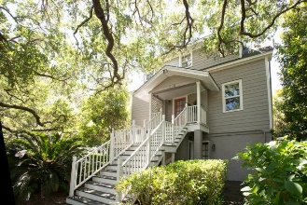
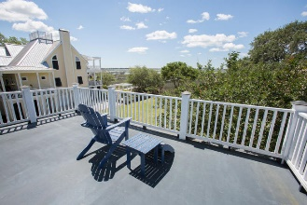
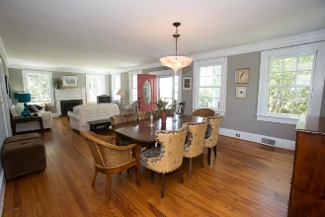
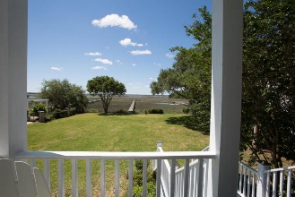
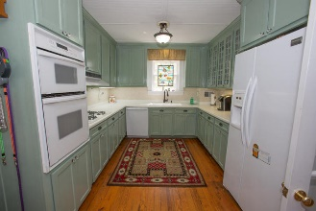
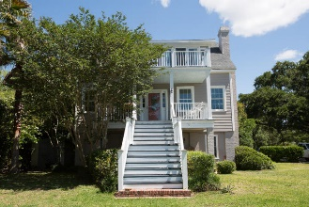
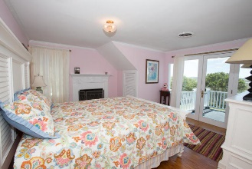
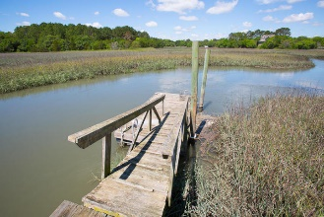
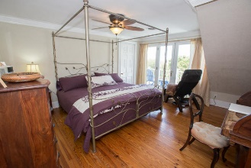



Must See!
Waterfront Historic Home with dock!
671 Cedar Point Drive
Cedar Point · Charleston · MLS# 16012381 · $799,000
Majestic setting on a quiet cul de sac. Enjoy the breathtaking views of Clark Sound from the upper and lower decks of this absolutely beautiful, completely renovated 1890's old plantation home. 5 bedroom 3 bath with original hardwoods through out. Wide base boards, dental molding, and large window moldings are just some of the old charm details this house boasts. Bright and airy living room with gas fireplace and french doors leading to the deck. Perfect for entertaining. 3 bedrooms on the 3rd floor with crown molding. 2 of the bedrooms have french doors leading to the upper deck. Upstairs bathroom with basket weave tile. 1st floor is currently tenant occupied on month to month basis. Has been residing there for many years. Rent $1200 a month. 1st floor is a mother in law suite/apartment with 2 bedrooms, 1 full bath and kitchen.
Michael Dew
O (843) 870-7000
M (843) 870-7000
michaeledew@gmail.com
www.michaeldewrealestate.com
AgentOwned Charleston Group
902 Savannah Hwy
Charleston, SC 29407
Real Estate ● Mortgage Insurance ● Business Brokerage

