Slide 1
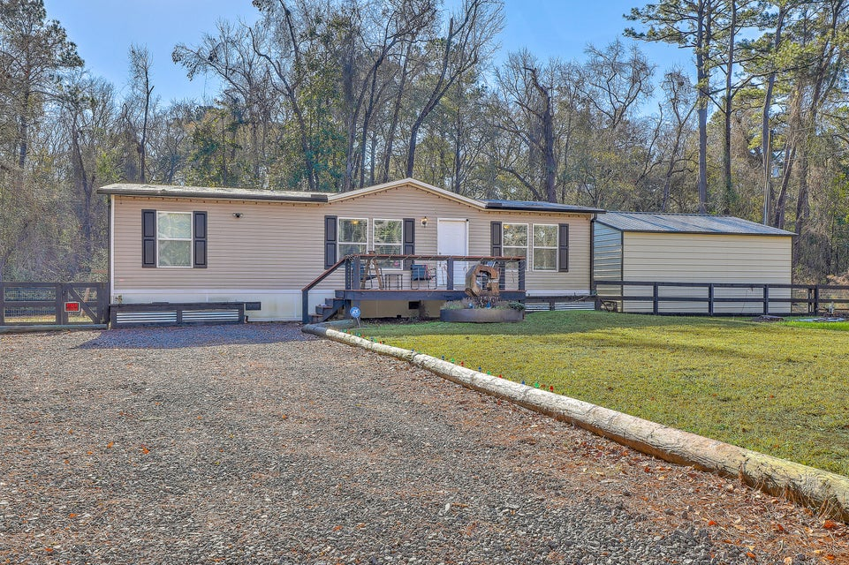
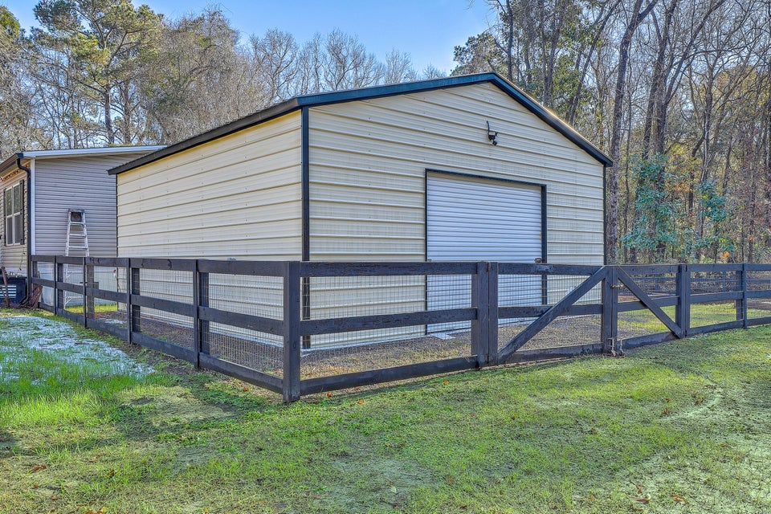
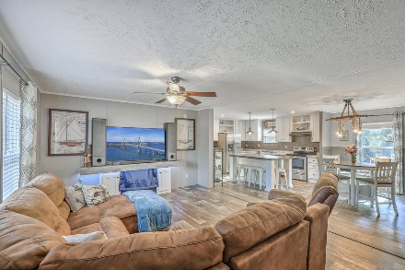
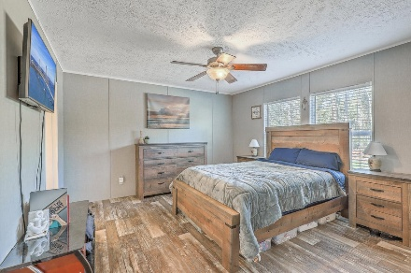
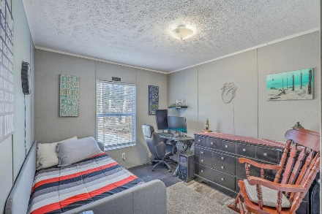
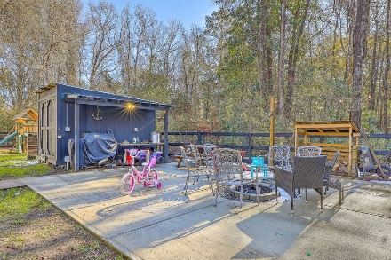


6739 Maybank Highway
Welcome to Wadmalaw!
Wadmalaw Island, SC 29487
MLS# 25002060 | $370,000
Welcome to your forever home on Wadmalaw Island, showcasing an open floor plan perfect for entertaining. The kitchen is the heart of the home with its beautiful island large enough for seating. There is plenty of cabinets and counter space for the cook in the kitchen. Beautiful vinyl flooring throughout. Separate laundry area. The spacious master bedroom and luxurious master bath, is complete with an oversized shower, dual sink vanity, and garden tub, which offers a serene sanctuary. The master is located separately from the other two bedrooms which provides additional seclusion. The half-acre property features a fenced back yard, storage shed, and concrete patio area. This backyard is so welcoming for those nightly fires and grilling!
There is an amazing 600sqft metal building workshop/garage equipped with power, insulation, and a mini-split. Perfect for your hobbies! Everything here is just 3 years old which makes this property truly a move-in ready dream come true! Wadmalaw Island is a desired area in the Lowcountry for the history, farming, fishing, shrimping and boating! This home is less than a mile to the Charleston Tea Plantation and Rockville. It's less than 2 miles to the Cherry Point Boat Landing. Schedule a showing to appreciate this gem in person.
VIDEO TOUR
Kelly Rozier
(843) 209-3129
kellywrozier@gmail.com
Brand Name Real Estate
4 Carriage Lane Suite 106
Charleston, SC 29407

