Slide 1
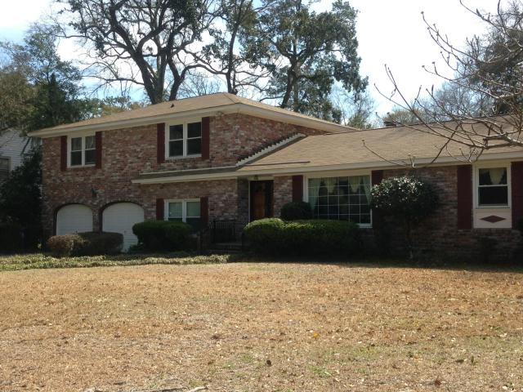
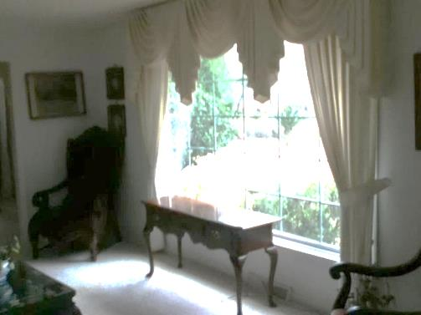
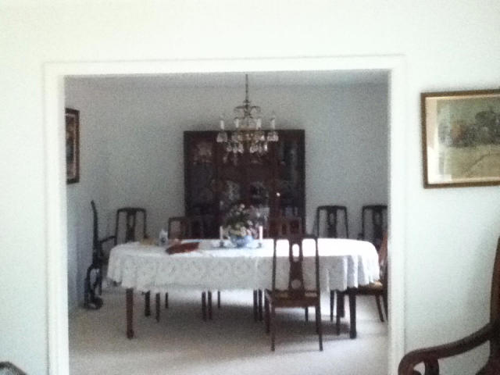
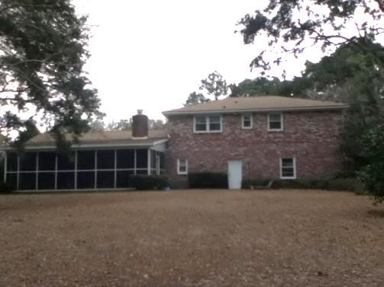


67 Fort Royal Avenue
Wespanee Plantation – Charleston
MLS# 15002207 - $395,000
Price Reduced $55k ~ Motivated Sellers!
Beautiful large brick home on a specious lot. Located just 5 minutes from downtown in the popular Wespanee Plantation. This home includes a Formal Living, Formal Dining, Family room with wood burning fireplace, 4 or 5 bedrooms, study, and hardwoods throughout. Outside boasts a large private fenced yard and a screened porch ( 30 x15) with built in brick grill. Transferable termite bond, Security System with ADT, and Celling fans in all bedrooms. This is a must see home that offers everything.
Lane Boris
Office - (843) 864-9150
Cell - (843) 864-9150
lboris@carolinaone.com
www.LaneBoris.com
Carolina One Real Estate
873 Orleans Road, Ste 102
Charleston, SC 29407

